Slide 1
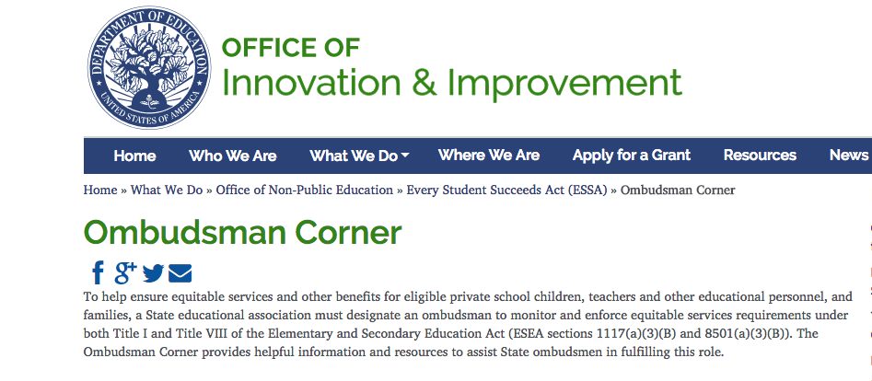
Wisconsin Private School Ombudsman
Notes:
An example of this open collaboration with the DPI is WCRIS securing the contract to be Wisconsin’s Private School Ombudsman. The Ombudsman is an employee of WCRIS and is accountable to their governing Board of Directors and the Executive Director (Sharon) but is paid for by the DPI.

Slide 2
Meet Wisconsin’s Private School Ombudsman
Notes:
My name is Abbie Pavela and I am Wisconsin’s Private School Ombudsman and also WCRIS’ Project Manager for Title Programs.

Slide 3
What Is An Ombudsman?
[om-buh dz-muh n, -man, -boo dz-, awm-, om-boodz-muh n, -man, awm-]
According to merriam-webster:
a government official (as in Sweden or New Zealand) appointed to receive and investigate complaints made by individuals against abuses or capricious acts of public officials Ex: The town's ombudsman said he would look into charges of corruption.
one that investigates, reports on, and helps settle complaints Ex: An ombudsman will deal with complaints from the hospital's patients and staff.
Notes:
The meaning of the word “ombudsman” to you is the person who monitors and enforces equitable service requirements under the reauthorization of the Elementary and Secondary Education Act, called The Every Student Succeeds Act or ESSA.

Slide 4
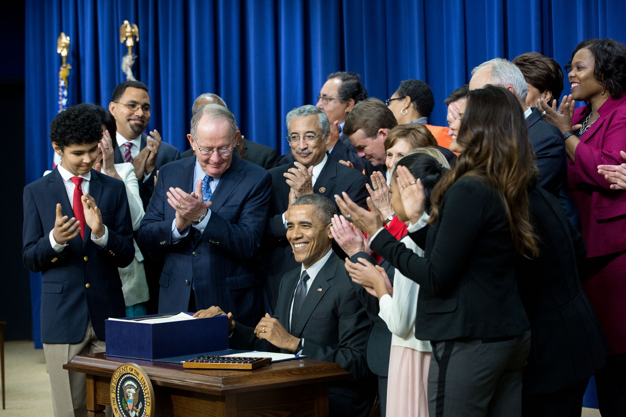
Why An Ombudsman?
+
Official White House Photo by Amanda Lucidon.
Notes:
The Council for American Private Education (CAPE), of which WCRIS is the state chapter, lobbied for 40 years to have the ombudsman included in the reauthorizations of the Elementary and Secondary Education Act (ESEA).
Finally, the ombudsman position was included as a requirement for every state in the ESSA.

Slide 5
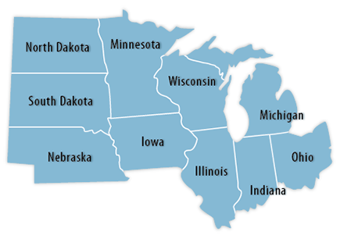
So Every State Has One? Is Wisconsin’s Different?
Wisconsin is the first state to house the ombudsman position at a private, non-profit (WCRIS).
Notes:
States are just starting to onboard the ombudsman position. Most have included theirs within their state education agency (here it’s the DPI)
I am part of a monthly teleconference group for the Midwest’s ombudsmen.
Our counterparts in these other states are reporting a slow start to getting this position in place.
Many are struggling to balance their public school experience with understanding private schools and their needs.
Wisconsin is the first state to house the ombudsman position at a private, non-profit (WCRIS).
This unique situation allows for a private/public partnership between WCRIS and Wisconsin’s Department of Public Instruction (DPI).

Slide 6
What Does the Ombudsman Do?
Advocate for private school students by working with local districts and the DPI to make sure the provisions for equitable services for private school students are being met.
Provide accurate information about what your students are entitled to and how to access these services.
Make sure you are aware of the best ways to utilize the services and funding available.
Resolve any problems that may arise between your school and your local district.

Slide 7
What Does This Difference Mean For You?
As an employee of WCRIS, a private school graduate and a former private school employee, I understand the importance of your school’s unique mission, vision and values and will use this understanding when helping you prepare for consultations with your public school districts, and when communicating your student’s needs to DPI, should conflicts arise, to make sure your students receive their equitable share of Title funding based on the provisions in the ESSA.
Notes:
I am Wisconsin’s Private School Ombudsman and WCRIS’ Project Manager

Slide 8
Speaking of Consultation…
Be prepared. Use the WCRIS resources available. As the ombudsman, I will provide continual communication and updates on how best to prepare for consultations with your local district.
Review WCRIS “7 Things” Document
Notes:
Lets start with #4:
The law requires “timely and meaningful consultation” which means this is a collaboration between your school and the public district – not the district telling you what they will offer with no input from you and your stakeholders.
“Timely consultation” means that your LEA gave you advance notice of planned consultation meetings for private school stakeholders.
“Meaningful consultation” means that all required consultation topics were covered and you were given an opportunity for input.
The goal of the equitable provisions in the ESSA is to reach an agreement between the LEA and the private school(s).
Consultations should not be “one and done” but a continued communication process between your school and your LEA.
#1, #2 & #5 --
To prepare for consultations start reviewing your Title I program/services and evaluating students NOW if you haven’t already been doing this. A good rule of thumb is to continually access the programs throughout the year – check on your eligible students progress with their teachers and parents. Note any hiccups – what’s working and what’s not. It is difficult, if not impossible for districts to “add” students to services once the funds have been dispersed (in a perfect world early September) – this is guidance that is given to LEA’s from the DPI.
Review what services are are eligible under Title I. The DPI is currently working on a webinar for Allowable Expenditures for Title I Funds.
Consider the poverty data you are using – is there a method that would yield more accurate results? Be prepared in consultations to discuss how you determined the poverty data on your students and ask your LEA how they would prefer you collect this – this must be a method you both agree on. Acceptable methods are listed on the WCRIS website.
Title I eligibility is based on low income count (180% of poverty) and is generated by where the student resides but serves “educationally needy students.”
If you have eligible students who reside in different districts, you should have consultations scheduled with each district and an Affirmation Form completed and signed with each. It is the LEAs responsibility to determine eligible private school students and to reach out to you BUT don’t expect this. Guidance from the DPI includes “private school responsibilities” which includes providing your district(s) with grade and address and socio-economic status for each student so the LEA can determine eligibility. Be proactive and reach out to your district if you think you have an eligible student(s).
Review your district’s grant application – are your eligible students receiving comparable services to similar eligible public school students?
A note on using vendors: districts must go through a procurement process with the state for accepting contracts with third party vendors. In some cases this can take up to 6 months. If you want to ask for a vendor for services and have this ready to go by the Fall you must start this process sooner versus later. Districts have been given guidance on creating policies for third party vendor procurement and setting standards for which vendors are “Accepted”. If they deny your request to use a vendor/your specific vendor, they must provide a reason based on FACTS, not opinions, in writing.
It is best practice to conduct a needs assessment for your eligible students to use in planning your title services. You can create your own or ask the district if you can use the one they use. If the district asks to see your assessment, you should consider sharing it with them, but you are not required to by law. It is up to the private school to determine “educational need” and what services you feel are appropriate for these students. (Ex: student in gifted & talented at the public school but “educationally needy” at the private school.)
#3 –
Under NCLB districts could appropriate funds for their needs first and then offer whatever was left to private schools. Under the ESSA, consultations and agreed upon services/funding with private schools must take place before the district apportions funds. This means private schools receive a proportionate share of funding with equitable services.
Make sure you are aware of your allocation and how much each service being offered ”costs”. Ask for a break down of costs if necessary. (Ex. A reading interventionist’s time includes prep and drive time to the school)
You are not required to pool your title funds with the other private schools in your district. Sometimes this may be beneficial, say if your allocations are small and you’d get more services for more students if you joined your money. But consider first – you must rank order your eligible students – once the funds for services run out down the list, the students near the bottom may not receive services. Before agreeing to pool – where do your neediest students fall in the rank order and will funds reach them? If not, your school is not actually receiving the services generated by your title funding.
#6 –
There is a carry over amount based on the LEA’s allocation --
LEAs with Allocations* Less than $50,000 - may carryover unobligated funds without limitation.
LEAs with Allocations* Greater than $50,000 LEAs May carryover 15 percent of the unobligated funds into the succeeding fiscal year. LEAs must apply for a waiver to carryover more than 15 percent of the total allocation. This is only allowed once every three years.
*It is important to note that the carryover limit is based off the LEA’s Title I-A allocation amount plus funds transferred from Title II-A.
That 15% carry over includes unused private school funds which go back into a private school pot to be dispersed in the next school year. So if you don’t use your title funds in the year allocated you may get a portion of carry over funds the next year but it might not be the same amount your school had carried over the previous year.
#7 –
Do not rely on “word of mouth” or “gentleman’s agreements”. You must have any agreements on funding/services in writing. The ESSA requires appropriate documentation for all aspects of consultation/agreement of funding and services between LEAs and private schools. You will have the opportunity to include WHY you feel you have not received timely and meaningful consultation if you check “no” on the private school affirmation form. It would be wise to keep detailed notes and records of consultation meetings and provide specific examples of concerns.
In order to take full advantage of consultations with your LEA, WCRIS recommends contacting them in advance of your scheduled meetings to ask for information on the amount of funds that will be available for Title services -- THIS was not possible for the 2017-18 school year as districts were not aware of their allocations because the DPI was not told how much the state allocation would be per the US DOE. (This could be an ongoing problem so unreliable advise at this time. Doesn’t hurt to ask the district anyway but know it is not their fault if they don’t have an answer right away)

Slide 9
Things to Keep in Mind for Consultations
Title funding for private schools is based on a “targeted assistance model” – meaning the federal government can’t give money to private schools directly – so these Title programs are funding for eligible students, teachers and staff and NOT funding for the school.
Consultations should not be “one and done” but a continued communication process between your school and your LEA.
An LEA can not mandate to you how to spend your funds (example: pooling funds between schools) but they can make suggestions on how to maximize your funding to receive the best services for your kids.
LEAs are responsible for sending you the Private School Affirmation Form before scheduled consultations take place.
The private school must sign the Affirmation Form and check “Yes” that they have received timely and meaningful consultation.
Ask for a copy of your LEAs grant application. This is a public record and can help you plan your services by comparing what similar eligible public school students are receiving.
Title I is full of nuances in federal law for what is/is not allowed – if you have specific questions please reach out to the ombudsman and/or WCRIS for help.

Slide 10
Things to Consider Before Checking “No”
No funds can be dispersed to the LEA or private school until an agreement is reached and an Affirmation Form has been signed with the “Yes” box checked
Without funds, no Title services can move forward for either party
Consider what is within the confines of the law – is what you are asking for reasonable? Is it more or less than what the public school district is offering their students?
Is there a better way you can utilize available funds for your students? This is a chance to get creative if your allocation is small or inadequate to service all of your needy students. Reach out to WCRIS if you need guidance on ideas for using your funds.
Are you receiving your proportional share of funding? Was it determined appropriately and fairly by you and the public school district?
Did you reach agreement for services or did you feel like the district told you what to do/what they are doing with little to no input from you and other private school stakeholders?

Slide 11
Resources: Preparing for Consultations
Completion of the affirmation form, in consultation with your local district, is the first step towards getting the services your students are entitled to receive.
Visit the WCRIS website at https://www.wcris.org/school-resources/wisconsin-private-school-ombudsman/ for resources to use while preparing for consultations.
Visit the DPI’s website here for…
Title I: https://dpi.wi.gov/title-i
Title II: https://dpi.wi.gov/title-ii
Title III: https://dpi.wi.gov/english-learners/title-iii
Title IV: https://dpi.wi.gov/titleiva
Notes:
In the coming weeks the Ombudsman will begin sending weekly/every two weeks (?) eLetters with crucial information you will need for meetings this Spring. At this time we are working with the DPI on how to best achieve this goal. eLetters may come from WCRIS or the DPI or a combination of the two. We will send sign up information to your superintendent when the process has been finalized.
The DPI also has a tool on their website for calculating allocations, short films to help explain the more complicated aspects of Title I fundign, and PowerPoints discussing their guidance to LEAs on equitable participation.

Slide 12
Understanding Federal Programs
The ESSA, IDEA (Individuals with Disabilities Act) and the WI SNSP (Special Needs Scholarship Program i.e. voucher) are all different programs.
The ESSA and IDEA are federally funded programs, the SNSP is a state funded program
You can have students receiving funding from these programs concurrently. I.e. a student could receive funding from the ESSA’s Title I program and the IDEA. Or the IDEA and have an SNSP voucher, or any combination of the three programs.
ESSA and IDEA funds supplement NOT supplant what private schools are already doing for their students.
The Ombudsman function only monitors and enforces equitable participation of private school students in the ESSA, not IDEA or SNSP or other WI Choice programs.
WCRIS and myself, in the role of WCRIS Project Manager, can help with questions on the IDEA, SNSP and other WI Choice Programs.
Notes:
Example of “supplement, not supplant” is the school who took one of their private school teacher’s contracts, who was authorized by the public school district to provide Title I services NOT during regularly scheduled school/contract hours (no double dipping) and subtracted the exact dollar amount of the Title funding they were receiving for services. This is not allowed.

Slide 13
A Disclaimer.
The WCRIS ombudsman is an impartial arbiter.
Notes:
You may at some point come to me with an issue and may not like the guidance you receive but the same goes for public school districts.
But, rest assured that I understand and support your school’s unique mission and the importance any extra funding - whether that is $1 per student or $1 million dollars - can make for your students.

Slide 14
How Can You Help?
Be Patient
&
Involved
Notes:
I will be available 5 days a week starting April 2
This is all new so there will be some growing pains
If I send surveys please respond. If I host trainings (either virtually or in person) please try and attend or send someone to represent your school. When we have the eLetter up and running make sure you follow up if there is a sign up period involved and then read the eLetter ☺
We have a unique position here in Wisconsin with the model we are using for the positon of the ombudsman – you, private schools, have the opportunity to be in the driver’s seat for it’s success by participating in these opportunities specifically designed for you!

Slide 15
Questions?

