Slide 1
ESSA Requirements for Equitable Participation of Private Schools
Abigail Pavela, WCRIS
Sharon Suchla, Ed.S., DPI
February 26, 2018

Slide 2
Today’s Topics
Consultation process for Title I, II, III and IV services to private schools
Private school responsibilities
Role of the ombudsman
Complaint process

Slide 3
LEA and Private Schools’ Consultation
Must occur during the design & development of programming
The LEA and private school officials shall both have the goal of reaching agreement on how to provide equitable and effective programs for eligible private school children
Section 1117(D)(5)(b)(1)

Slide 4
Consultation
Private School Affirmation form certifies that the consultation was:
timely,
meaningful, and
the program design is equitable with respect to private school students.
Districts are advised to review the form before it is uploaded to WISEgrants.

Slide 5
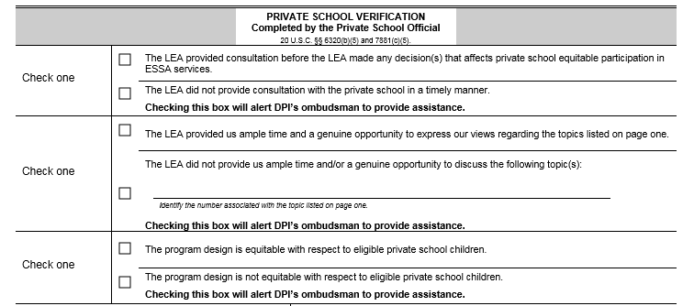
PI-9580-AC

Slide 6
ESEA Consultation
How children’s needs will be identified
What services will be offered
How, where and by whom
How the services will be academically assessed and how the results will be used to improve those services
The size and scope of the equitable services, the proportion of funds that is allocated for such services, and how that proportion is determined
Section 1117(b)(1)(A-E)

Slide 7
ESEA Consultation
The method or sources of data that are used to determine the number of children from low-income families in participating school attendance areas who attend private schools
How and when the LEA will make decisions about the delivery of services to such children, including consideration and analysis of the views of the private school officials on potential third-party providers
Section 1117(b)(1)(F-G)

Slide 8
ESEA Consultation
If the LEA disagrees with contracting with a third-party provider, the LEA will provide an analysis of the reasons in writing
Whether the LEA will provide services directly or through another party
Whether to provide equitable services by the funds allocated to each private school or to pool funds
Section 1117(b)(1)(H-J)

Slide 9
ESEA Consultation
When, including approximate time of day, services will be provided
Whether to consolidate and use funds provided under Title I-C, II-A, III-A and IV-A and IV-B to provide services to eligible private school students participating in programs
Section 1117(b)(1)(K-L)

Slide 10
Checkpoint
Any questions?

Slide 11
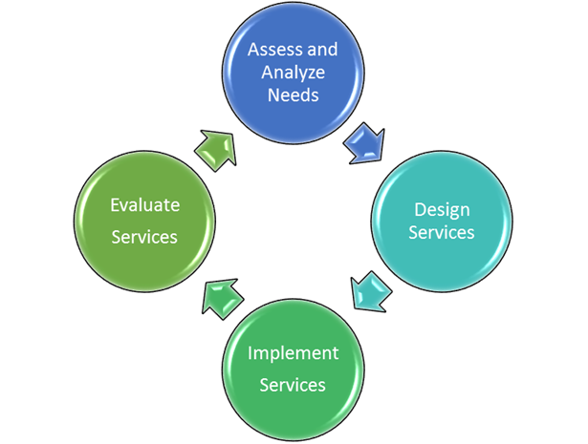
Continuous Process

Slide 12
Private School Low Income Calculation
LEA shall have the final authority to calculate the number of children, ages 5-17, who are from low-income families and attend private schools by—
Using same measure of low-income as public schools
Using the results of a survey
Applying the low-income percentage of each participating public school attendance area
Using an equated measure of low-income correlated with the measure of low income used to count public school children
8
Section 1117(c)(1)(A-D)

Slide 13
Equitable Share
The proportional share is calculated by determining the number of eligible Title I students in the private schools as compared to the number of eligible income public school students and then applying that proportion to the total LEA allocation.
The proportional share must be calculated before any allowable expenditures and reservations by the LEA.
May occur each year or every 2 years.

Slide 14
Title I-A
Allocation is generated by low-income students who by age and address would have attended a public Title I school.
All students who would have attended a Title I school in the district are eligible for Title I services in the private school regardless of socio-economic status.
Services are provided to eligible students identified as having the greatest need.
Title I provides supplemental instruction by appropriately licensed teachers.
LEA maintains responsibility for Title I services and resources.
Services are secular, neutral, and non-ideological and address the needs of the eligible private school students.
Notes:
JZ note: link to calculator here

Slide 15
Title I-A
Allocation is generated by low-income students, who by age and address would have attended a public Title I school.
All students who would have attended a Title I school in the district are eligible for Title I services in the private school regardless of socio-economic status.
Services are provided to eligible students identified as having the greatest need.
Title I provides supplemental instruction by appropriately licensed teachers.
LEA maintains responsibility for Title I services and resources.
Services are secular, neutral, and non-ideological and address the needs of the eligible private school students.

Slide 16
Title I-A
Under Title I, Part A local education agencies (LEAs) are required to provide services for eligible private school students, their families and teachers, or other educational staff.
Services are always targeted assistance.
Services should begin when public school services begin.

Slide 17
Checkpoint
Any questions?

Slide 18
Private School Responsibilities
Provide LEA with grade and address for each private school student so that LEA can determine if student is eligible for Title I services.
Provide LEA with student’s socio-economic status so that LEA can determine if the student generates Title I funds.
Conduct a needs assessment to determine Title I services to request.
Using multiple assessments, determine students in greatest need of Title I services.
Rank order students by greatest need for Title I services.

Slide 19
Title II-A
Purpose:
Provide all Wisconsin students equitable access to expertise and resources by supporting educator and principal preparation and professional growth.
Private School:
Provide total number of K-12 students attending the private school regardless of socio-economic status or residency.

Slide 20
Title I-A & II-A
Title I-A can provide professional development for teachers working directly with Title I students.
Title II-A can provide professional development to all teachers for the purpose of increasing student academic achievement.
Professional development must be secular. The LEA is responsible for reviewing and approving requests prior to event.
Allowable professional development includes training provided by the LEA, conferences, and book studies.

Slide 21
Title III-A
Purpose:
To help ensure that English Learners, including immigrant children and youth, attain English language proficiency and meet the same standards that all children are expected to meet.
Private School:
Provide grade and native language for English Learners (EL)

Slide 22
Title III-A
Providing professional development
Providing a Language Instruction Educational Program (LIEP)
Providing and implementing other activities and strategies for Language Instruction Educational Program for English Learners (EL)
Examples: parent, family, and community engagement activities; coordinating services; offering early college, high school, or dual or concurrent enrollment programs for ELs.

Slide 23
Title IV-A
Purpose:
Title IV, Part A is a newly enacted grant for 2017-2018, known as the Student Support and Academic Enrichment (SSAE) Grant. Title IV-A authorizes activities in three broad areas: access to a well-rounded education, improving school conditions for learning to ensure safe and healthy students, and improving the use of technology to improve academic achievement and digital literacy.
Private School:
Propose activity within one or more of the three areas.

Slide 24
Title IV-A Possibilities
Well-Rounded Education: Providing access to fine arts, improving STEM programs, strengthening instruction in American history, civics, geography, etc.
Safe and Healthy Students: Tobacco, alcohol and drug abuse prevention, anti-bullying programming, drop-out prevention, etc.
Effective Use of Technology: Providing high quality professional development, developing courses using technology, etc.

Slide 25
Checkpoint
Any questions?

Slide 26
Ombudsman
To help ensure such equity for such private school children, teachers, and other educational personnel, the State agency involved shall designate an ombudsman to monitor and enforce the requirements of this part.
Section 1117(a)(3)(B)

Slide 27
Ombudsman
The results of the agreements between public and private school officials made during consultation shall be transmitted to the ombudsman.
Section 1117(b)(1)

Slide 28
Checkpoint
Any questions?

Slide 29
Resources
ESSA TI-A Private School Equitable Share Calculator
ESSA Title II-A Equitable Share Calculator

Slide 30
ESEA Consultants
Title I Directory: https://dpi.wi.gov/title-i/consultant-directory
Title II: Jacqueline Abel, jacqueline.abel@dpi.wi.gov
Title III: Audrey Lesondak, audrey.lesondak@dpi.wi.gov
Title IV: Emily Holder, emily.holder@dpi.wi.gov

Slide 31
Thank you for attending!
Title I
Sharon Suchla
sharon.suchla@dpi.wi.gov
(608) 266-3983
ESSA Ombudsman
Abigail Pavela
essaombudsman@dpi.wi.gov
(608) 287-1224

