Slide 1
Strategies and Interventions for Responsive Classrooms
cc: Keoni Cabral - https://www.flickr.com/photos/52193570@N04

Slide 2
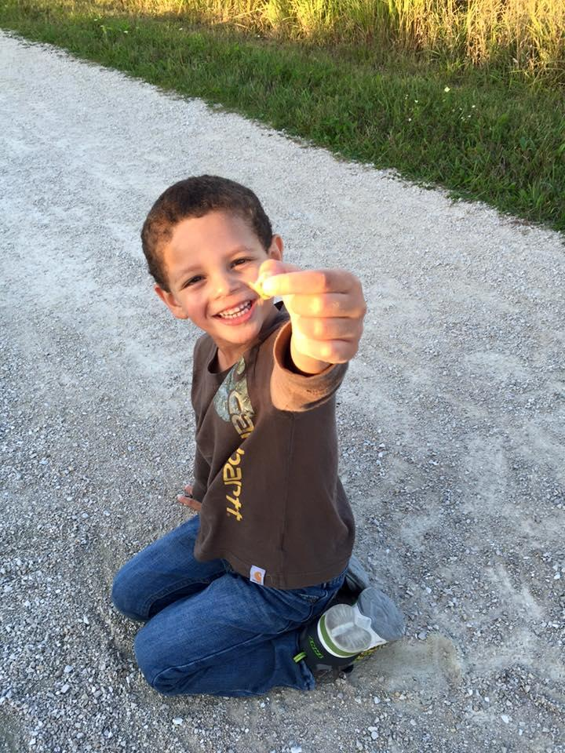
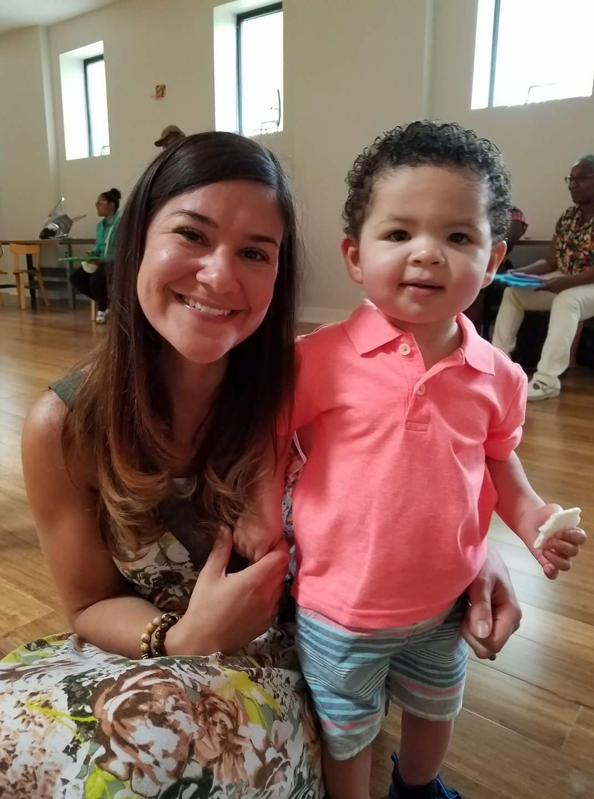
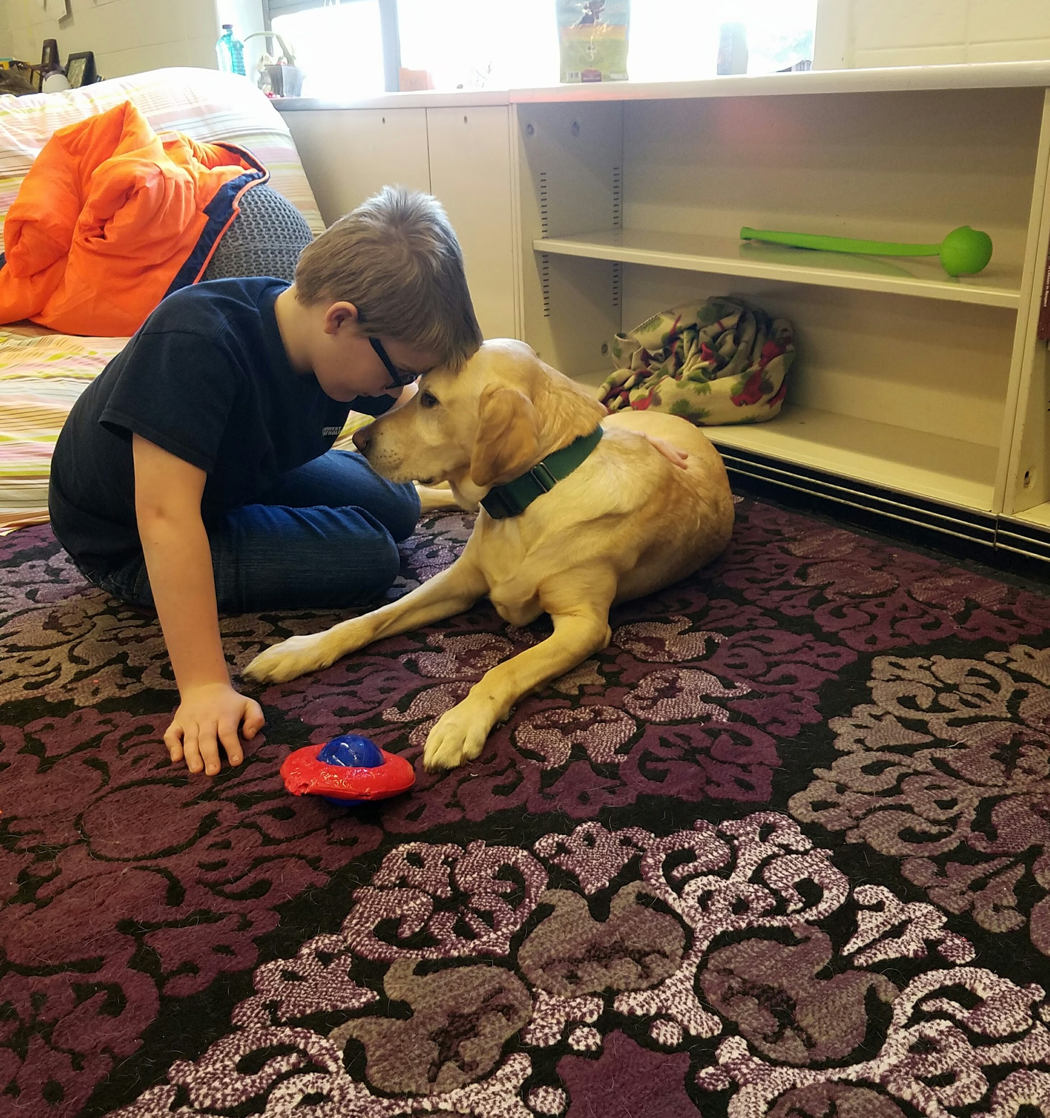
Tarah Randazzo
Notes:
I am an Aunt to my two nephews Vincenzo and Giovanni. I have a Therapy Dog who I not only incorporate into the school setting but we also volunteer together at Ronald McDonald House. Here is a picture of my entire family..I am very close with my family and we loved to do stuff together. Lastly this is me and my now Fiance, Craig. We literally just got engaged on Saturday so please excuse me if I have to refer to my notes a little more than usual. My head is still in the clouds.
I am a school counselor and a licensed professional counselor. I work full time in the school setting and part time in the clinical setting as a child and adolescent therapist. For the past 4 years I have been a school counselor at Northwest Catholic School in Milwaukee. We are a choice school, with 98% of our population being choice. About 3 years ago we decided to take the steps to become a trauma sensitive now what we call a responsive school. Much of what I will share today will be based on the experience I had being part of the implementation of becoming a responsive school.
2

Slide 3
Objectives
Discuss components of a Responsive Classroom/School
Learn about responsive teacher behaviors.
Learn about specific classroom and school-wide practices designed to meet the social emotional needs of students.
Share data from Northwest Catholic School’s initiative
Notes:
3

Slide 4
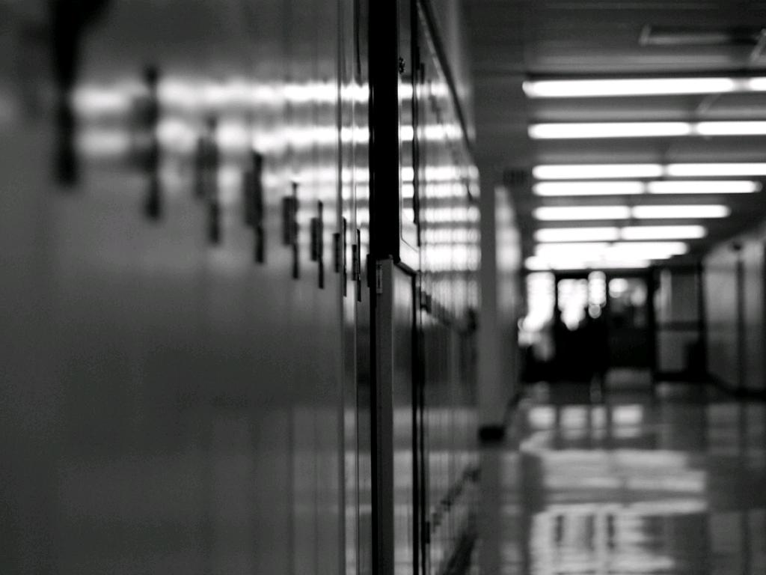
The most recognizable impacts of trauma on education fit into two intertwining categories:
Impacts on academic performance:
Reduced cognitive capacity
Sleep disturbance
Difficulties with memory
Language delays
Impacts on social relationships:
Need for control
Attachment difficulties
Poor peer relationships
Unstable living situation
Child Safety Commissioner (2007)
cc: shinealight - https://www.flickr.com/photos/19720483@N04
Notes:
Impacts on academic performance
Sleep disturbances can cause poor concentration.
Problems with memory make learning harder.
Traumatized children will have difficulty organizing and processing the content of academic lessons for later retrieval and application.
Language delays may reduce a students capacity for listening, understanding and verbal expression. Furthermore, traumatic experiences can disrupt the ability of children to learn and process verbal information and use language as a vehicle for communication. These language problems can undermine literacy skills, social-emotional development, and behavioral self-regulation.
Impacts on social relationships
The need for control can contribute to conflict with teacher and other students.
The school setting can be a battleground in which traumatized children’s assumptions of the world as a dangerous place sabotage their ability to develop constructive relationships with nurturing adults.
Unfortunately, many traumatized children adopt behavioral coping mechanisms that can frustrate educators and evoke reactions that both strengthen expectations of confrontation and danger and reinforce a negative self-image.
Attachment difficulties and poor peer relationships can significantly impair students relationships with teachers and students, making school an unpleasant and unsafe place. Traumatized children may suffer delays in the development of age appropriate social skills. They may not know how to initiate and cultivate healthy interpersonal relationships.
Children who are reactive, impulsive, or aggressive may mask their feelings of vulnerability with a “strike-first” posture in response to threat. Seeing through the lens of their negative worldview, they often misinterpret classroom encounters and then overreact with confrontation and aggression that frightens their peers.
Children who live in unstable living situations show a reduced capacity to learn and to engage with a new school. Many children enduring traumatic stress are deprived of such a stable environment. Instead, they may be “raised in households in which rules and routines are subject to the whim of the parent”; for them, the move into a more sequential ordering of the world may be considerably more difficult than it is for other children.

Slide 5
Trauma & School Performance
Students who have experienced trauma:
Are two-and-one-half times more likely to fail a grade
Score lower on standardized achievement test scores
Have more receptive or expressive language difficulties
Are suspended or expelled more often
Are designated to special education more frequently.
Center for Disease Control and Prevention, 2009
Notes:
5

Slide 6
Shift from "What's wrong with you" TO "What happened to you"
Notes:
So often we hear the question or experience internal dialogue of what’s wrong with you? Why are you acting like that? Why won’t you/Why can’t you just?
A Responsive School or Responsive teacher who is trauma informed changes their perspective and understanding from “what’s wrong with you to what happened to you?
We may not always know what has happened to our students but the idea is we realize “children do well if they can” ..so we equip ourselves with a compassionate approach and utilize an approach to support all students in our classrooms.

Slide 7
Helping Traumatized Children Learn
Notes:
Creating and running a trauma-sensitive school or classroom is not about educators doing therapy. Rather, it is about creating and supporting a culture that prioritizes safety, empowerment, trust, choice, and collaboration. It this environment, everyone (school counselors, psychologists, and social workers, teachers, administrators, bus drivers, play ground supervisors, janitors, etc) learns about the prevalence and impact of trauma in the lives of children and families. This awareness drives the transformation of the school environment, policy/practice, educational strategies, staff training, involvement of families, etc. to ensure that children impacted by trauma can learn and be successful.
7
2/23/2012

Slide 8
What is a Responsive School?
Notes:
Being a responsive school means we recognize the strong link between academic success and social-emotional skills. Therefore, as a responsive school we teach social and emotional skills along with their academic lessons. We also teach and provide our students the opportunity to practice self regulation skills. The goal is to maximize student learning. Northwest Catholic is using specific classroom and school-wide practices, that have been shown to increase academic achievement, decrease problem behaviors, improve social and self regulation skills, and raise the quality of instruction.
If you were in part 1 of this workshop you had the opportunity to learn a ton about the Brain from Lea and she talked about how Trauma can impact the brain and learning.
Our responsive school practices also help us support and teach children who have experienced trauma. We don’t always know exactly what has happened to our students, but we do know that approximately 1 out of 4 children are exposed to a traumatic event by the age of four. Trauma means something different to different people, but may include:
Abuse Domestic Violence
Natural disasters Car accidents
Painful procedures Life-threatening medical conditions
Homelessness Adoption
Incarcerated parents Mentally ill parents or caregivers
Deportation Exposure to community violence

Slide 9
Responsive Schools benefit all children....
Whose history is unknown
Whose trauma may never be identified
Who are impacted by their traumatized classmates
Notes:
It is not about assessing for trauma. We don’t assess for Trauma in a school setting We don’t need to know whether or not they have experienced Trauma because these strategies and approaches benefit all children. We will spend our time today focusing on universal strategies that can be implemented school-wide, we will even practice a few together and I will also touch on a few Tier 2 and 3 strategies.

Slide 10
STEPS TO CREATE A TRAUMA SENSITIVE/RESPONSIVE SCHOOL
Engage leadership
Perform needs assessment
Review literature (see sources)
Provide training so ALL staff are aware of the impact of trauma on behavior and learning and can help to develop strategies to support these children
Implement classroom strategies to establish SAFETY, EMPOWERMENT, COLLABORATION, CHOICE, and TRUST.
Notes:
1)Engaging the leadership is a critical first step in the success of any school priority. This step can be initiated by exposing leaders in a school to information on the impact of trauma on learning and behavior. A team should be formed that includes school administration and members from multiple disciplines from all areas of the school. Before going forward with any training and planning, this teams has to make sure there is strong buy-in.
2)A team should be created to answer these questions:
How will our school be conscious of signs of trauma?
What will we do when we suspect trauma? What is our procedure for making referrals? How do we handle abuse and neglect referrals?
How do we reach out to families that need help? How do we maintain the dignity and confidentiality of a child’s family?
How do we interface with the community in a way that communicates that we are a safe and respectful place?
How will we be conscious of this in the academic, disciplinary and social arenas of our school culture?
What is our shared vision for creating a trauma-sensitive school?
How will we evaluate our effectiveness?
School Culture – The beliefs and attitudes that are rooted in the history of the school. This determines the rituals and traditions of a school. Current school rules and policies reflect the school culture. A trauma-sensitive school has policies and procedures that are consistent with maintaining a safe environment for all students. A committee is often needed to review policy and procedures through a trauma-sensitive lens.
School Climate is related to school culture. However, school climate refers to the feel, atmosphere, tone, and personality of a school. This is characterized by how people treat and feel about each other, and the extent to which people feel included and appreciated.
Here are some questions to ask ourselves when assessing school culture and climate:
Is our school environment welcoming to students and families?
What is the stigma around needing help?
Do we focus on student strengths?
Are we able to access needed resources, so that our students arrive at school ready to learn?
Are staff able to recognize signs of trauma?
Do staff know what to do when they suspect abuse/neglect?
Do we have a shared vision for creating a trauma-sensitive school?
4)Training needs to take place school-wide so that all staff are aware of the impact of trauma on behavior and learning and can help to develop strategies to support these children. Staff is trained develop relationships thoughtful and intentional kindness, unconditional respect, empathy towards students and attunement. We must be able to attune to a child to accurately read the cues of his emotional state and his readiness to learn. It is through relationship that we teach self regulatory skills and emotional control. This is the foundation; without it other strategies will not be effective.
10

Slide 11
Key Components of Responsive Schools Training for School Personnel
Foundational knowledge about brain & neuroscience, trauma’s impact on the brain, attachment & learning
Trauma-sensitive school framework
Compassionate discipline
Teacher support (e.g., coaching), self-care, professional development
Parent & Student education
Trauma-responsive whole-school (universal strategies); strategies in class delivered by teachers; interventions delivered by counselors
DATA, DATA, DATA & ongoing evaluation
11
Notes:
If a school decides to create a trauma sensitive or responsive school environment, these are some of the components that go into training all school personell.

Slide 12
Components of a Trauma Sensitive/Responsive School
Support and teach children who have experienced trauma
Teach social and emotional skills
MindUP Curriculum
Teach and practice self regulation skills
Focus on the strong link between academic success and social-emotional skills
Practice self regulation skills daily, such as mindful breathing or movement.
Approach is "What happened to you" not "What's wrong with you"

Slide 13
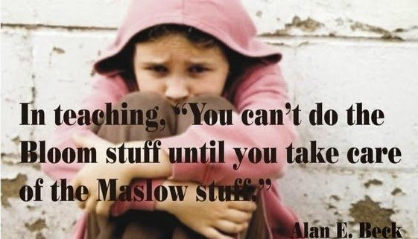
The Essentials
Compassionate communication
Empower students
Choice
Control
Autonomy
Understand Trauma
Promote Safety
Focus on strengths
Build relationships
Cultural sensitivity

Slide 14
Describe A Safe Place for You
Imagine a time when you received help or support that made you feel safe:
What did it feel like?
Who helped?
What helped?
What part did trust play in your sense of safety?
Notes:
We are going to begin by talking about safety.

Slide 15
Strategies to Establish Safety
Clear /consistent rules for managing behavior/setting limits
Least Invasive Strategies
Accommodations to meet individual strengths and needs:
Transition and Safety Plans
Calm Zones
Predictable structure, relationships, and environment to promote safe surroundings and interpersonal relationships
Monday Morning class meetings
Daily Schedule
Environment Check
Reduce bullying and harassment
Notes:
Establishing safety is a key component of a responsive classroom.
This first point ties into both establishing safety and building trust. The student does not want to feel as though they are on a stage when their behavior is not ideal and we don’t want to give them that stage, so utilizing least invasive strategies is an example of a clear consistent approach to managing your classroom.
We are thinking ahead of what could possibly be triggers for students and setting them up for success by helping them feel as though they are in a secure and safe environment.
Students may be lacking this structure at home so providing them with the opportunity to build meaningful relationships and connect with others allows them to send signals to their brain that this is safe environment which then encourages an environment to learn

Slide 16
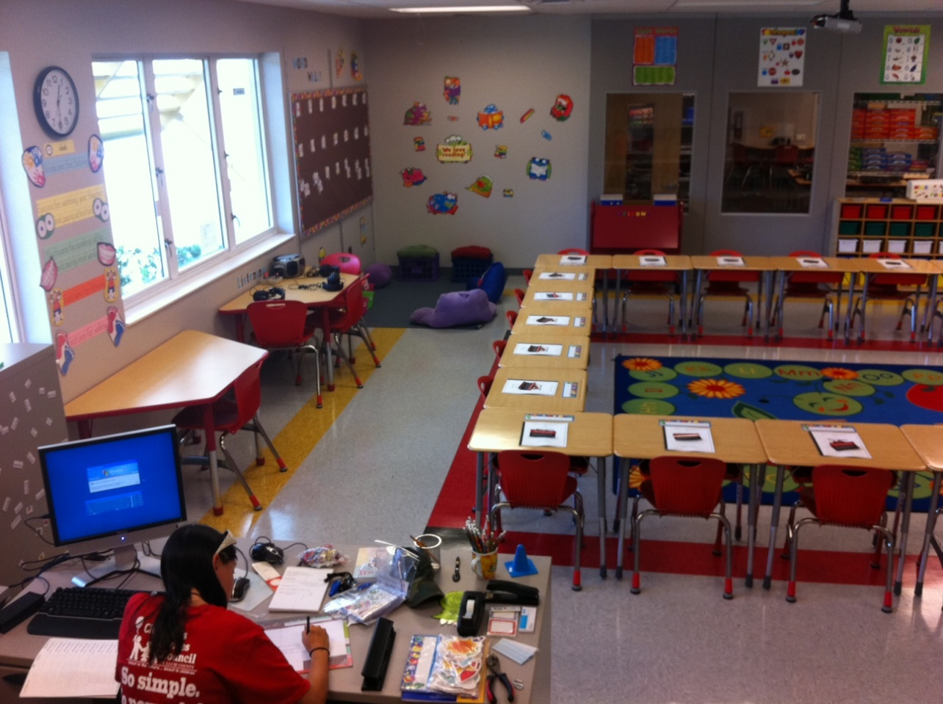
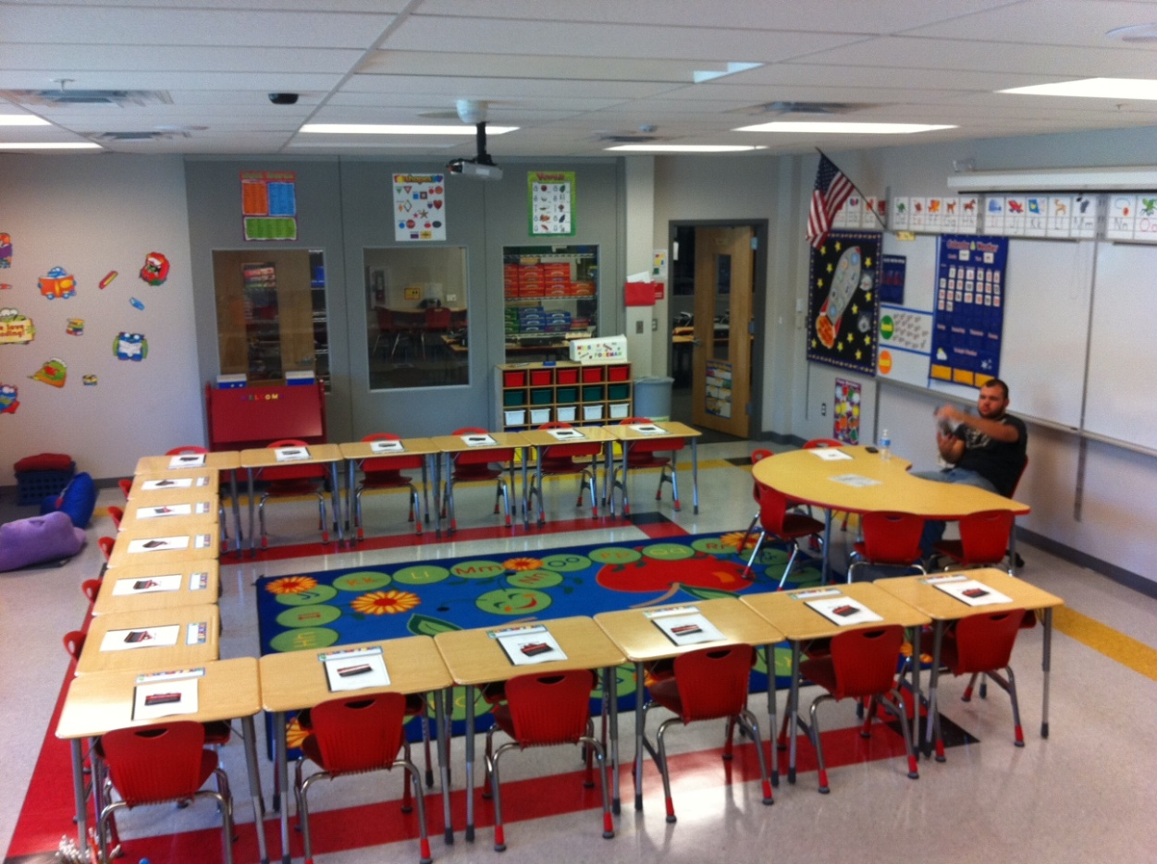
Notes:
We are going to compare two classrooms. Take a moment to observe and notice this classroom. How would you feel in this classroom as a student? As a teacher?

Slide 17
Notes:
Now take a look at this classroom. What do you notice that is different? How would you feel in this classroom as a student? As a teacher?
Which room would you feel more safe in? Can you share why?

Slide 18
Environment Check Exercise
Access, doorways, how many exits?
Lighting?
Smells?
Personal space?
Seating arrangement – crowded? Too close?
Power differential, are your needs met?
Is this a calming environment, if not, what would
help?
Notes:
As you are setting up your classrooms for this school year. Here are some things that can consider.

Slide 19
Strategies to Establish Trust
Build relationship based on trust by...
Maintaining unconditional positive regard for all students
Check assumptions, observe and question
Being a relationship coach
It’s ALL about Relationships… https://www.ted.com/talks/rita_pierson_every_kid_needs_a_champion
Notes:
Relationship with the educator based on:
Maintaining unconditional positive regard for all students – Students who experience trauma are often in competition with their teacher for power and attempt to control the environment to achieve safety. This can be frustrating, because the student seems to be in control of her behavior and simply want “her own way.” However, the more helpless a child feels the worse the behavior will become. A teacher must exercise control and hold students accountable, but never in a way that resembles or reminds them of abuse (e.g., yelling, threats, coercion, sarcasm). Teachers need to be respectful, consistent, non-violent and offer to share control, whenever appropriate, and at developmentally appropriate levels.
Check assumptions, observe and question – Effective teachers monitor their assumptions and reactions to a student and stop, observe and question. “I notice that when I call out to the class you throw your book. Tell me what that is about? Are you worried something bad will happen?” Take time to stop and listen.
Be a relationship coach – Effective teachers teach students how to get along with others and support positive relationships between students in school as well as between children and parents. Teaching and modeling social skills helps children develop and improve these skills. Students learn behavior that is modeled for them.
Ask audience to get into small groups and make a list of strengths for the school in creating trauma-sensitive environments and then a list of unmet needs in this area. Have groups report out and look for themes. Celebrate the strengths and use the needs to help guide the later discussion of “Next Steps.”
19

Slide 20
Ideas for Building Relationships
Meet and greet at the door/Shake their hands
Student survey of interests
Anagram nametags
Acknowledge students by name
Personal notes on assignments
Student of the week
Classroom morning meetings
Weekly questions about you
Weekly ice breakers

Slide 21
Classroom Management in a Responsive School/Classroom- Use the Least Invasive Form of Intervention
IDEAL: to solve a case of disruption quickly, successfully, and with the least possible disruption to the whole class and without escalating the student further.
Notes:
How you manage your classroom and behaviors relates directly the relationship you will have with your students. Using least invasive strategies is a way to manage behavior in a non confrontational way and a way that feels safe for students who have been impacted by trauma

Slide 22
Use the Least Invasive Form of Intervention
1. Give a non-verbal correction
Tap on desk, eye contact, proximity
2. Positive Group Correction
Check yourself- we should be tracking!
3. Anonymous Individual Correction
“We are still missing two of our friends!”
4. Private Individual Correction
Walk over to the student's desk, lean down, and QUIETLY give the redirection. “I asked for everyone’s eyes, I need yours too!”
Notes:
22

Slide 23
Use the Least Invasive Form of Intervention
5. Lightening Quick Correction
“Ewell, I need your eyes! Breonna, I love your tracking!”
Take attention off of students
Goal: when making an individual verbal correction limit the amount of time a student is “onstage” for something negative
6. Consequence
Consequence should be fitting to the behavior as much as possible.

Slide 24
Strategies to Establish Collaboration
School Staff – Consult in other classrooms and invite staff to consult in your classroom.
Students – Collaborate with students. They often know what would help them, but no one thinks to ask them.
Family – Provide education, training and support to families in need in a positive, respectful and supportive way.
Community – Partner with mental health providers and others who support children in the community.
Notes:
School Staff – Utilize Building Consultation Teams to strategize for students. Fellow staff can serve as a resource for potential solutions. Consult in other classrooms and invite staff to consult in your classroom.
Students – Collaborate with students. They often know what would help them, but no one thinks to ask them. Build a relationship that establishes you on the same team as the student.
Family – Use families as resources to support a child. Provide education, training and support to families in need in a positive, respectful and supportive way.
Community – Learn about community resources and make referrals when needed. Partner with mental health providers and others who support children in the community. Invite them to be part of the team in supporting students.
24

Slide 25
Responsive Teacher Behaviors
Creates and/or maintains consistent daily routines for the classroom.
Tells children when something out of the ordinary is going to occur.
Offers children developmentally appropriate choices.
Anticipates difficult periods and transitions and offers extra support during these times.
Uses techniques to support children’s self-regulation.
Helps students manage their feelings during intense emotional moments by remaining composed and offering empathy and support.
Is appropriately nurturing and affectionate.
Uses positive guidance and supportive interventions to help all children
Goals for achievement of students affected by traumatic experiences are consistent with the rest of the class.
Notes:
1. Creates and/or maintains consistent daily routines for the classroom. (Students know the order of the day or events and how they will be carried out. There is a schedule for the day or calendar of events visible to the students. Expectations are communicated in clear, concise, and positive ways.)
2. Tells children when something out of the ordinary is going to occur. (Activities are structured in predictable and emotionally safe ways. Teacher warns children about bell, fire drill, special assembly, visit from an outsider, etc.)
3. Offers children developmentally appropriate choices. (Students’ strengths and interests are encouraged and incorporated. Students have ownership of their behaviors and interests. Students are allowed to choose options or activities, such as where they want to sit or do for certain activities.)
4. Anticipates difficult periods and transitions and offers extra support during these times. (Teacher sits by student, walks with student, etc.)
5. Uses techniques to support children’s self-regulation. (Teacher introduces breathing and other centering activities, such as mindfulness, during and outside of school-wide mindfulness activities to help children self-regulate. Opportunities exist for students to learn and practice regulation of emotions and modulation of behaviors.)
6. Helps students manage their feelings during intense emotional moments by remaining composed and offering empathy and support. (Opportunities exist for learning how to interact effectively with others. Teacher calmly initiates healthy and reparative interactions, validates student’s feelings and communicates that s/he understands that the student is upset, explains to the student that s/he needs to keep his body safe, and slowly moves between student and what or who s/he is acting out toward. (This shows that the teacher understands that children make sense of their experiences (negative and positive) by reenacting them in play or through interactions with peers or adults).)
7. Is appropriately nurturing and affectionate. (Teacher is sensitive to children’s individual triggers, physically affectionate only when student seeks it.
8. Uses positive guidance and supportive interventions to help all children. (Teacher guides children to appropriate activities, helps children understand their action and how it impacts others.)
9. Goals for achievement of students affected by traumatic experiences are consistent with the rest of the class. (Information is presented and learning is assessed using multiple modes. Opportunities for all students exist for learning how to plan and follow through on assignments.)
25

Slide 26
School-Based Strategies & Interventions
Tier 1 –
Universal Strategies
Tier 2 & Tier 3 Targeted Counseling Strategies
Morning meetings
Mindfulness Moment – same time every day
Yoga, meditation, 3-6 breathing, imagery
Heart breathing
Mindfulness Bottles
Community drumming
Reduced Stimuli
Music
Rhythmic activities
Parent Ed.
Growth Mindsets, Positive Discipline, Sensory experiences, Mindfulness
Classroom Guidance using Mind Up or other social-emotional curriculum
Tier 2 – Selective
Classroom Strategies
Individual counseling
Narrative approaches
Play, art, music-based
Drumming/Rhythmic activities
Sensory Interventions
Heart Breathing
Support groups (art-based)
Animal Assisted Intervention
Co-facilitate Multimodality Trauma Treatment (MMTT) with trained Licensed Counselor
Community Referrals
Collaborative Problem-
Solving
3-6 breathing
Calming Zone
Sensory interventions
visual, auditory, touch, movement, taste, and smell
Time Out bottles
Drawing
Further reduce stimuli
26
Notes:
26

Slide 27
Tools and Strategies
Calming bottles
Drumming
Breathing ball
Stability balls
Sensory tools
Meditation/Guided Imagery
Yoga
Animal Assisted Therapy
cc: Nick Kenrick. - https://www.flickr.com/photos/33363480@N05

Slide 28
cc: ForbesOste - https://www.flickr.com/photos/71035640@N08

Slide 29
“Mindfulness means paying attention in a particular way; On purpose, in the present moment, and non-judgmentally.” - Jon Kabat-Zinn
cc: lewishamdreamer - https://www.flickr.com/photos/26503210@N00
Notes:
Mindful eating exercise

Slide 30
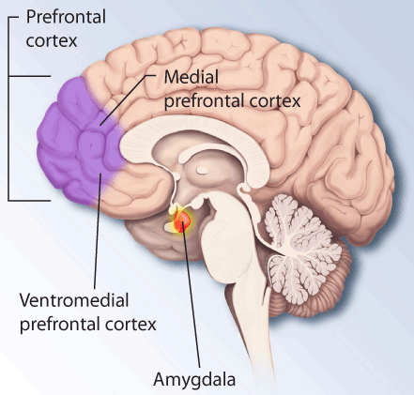
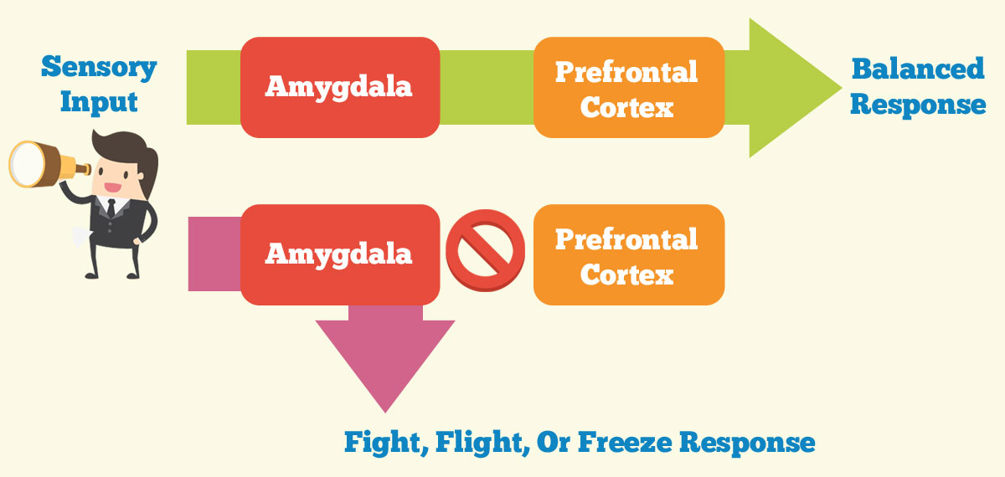
MindUP Curriculum
Notes:
Show MindUP Posters
Talk about upstairs brain and downstairs brain poster

Slide 31
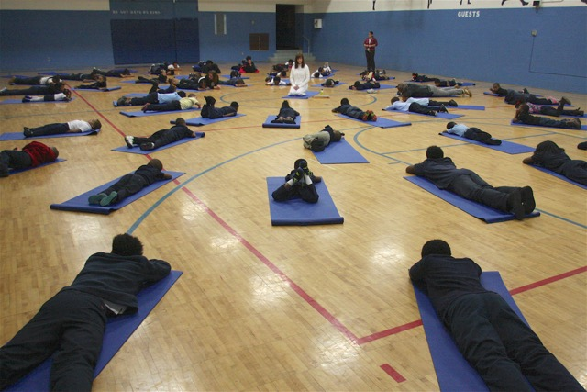
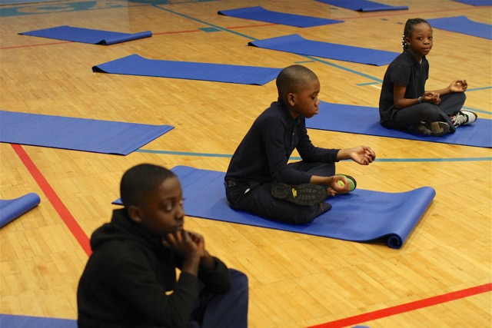
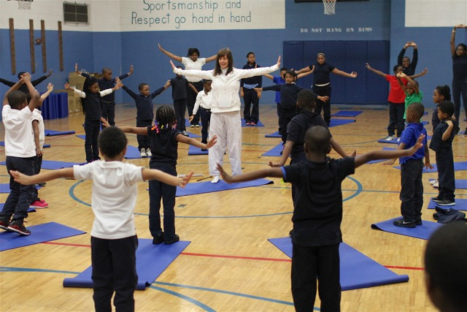
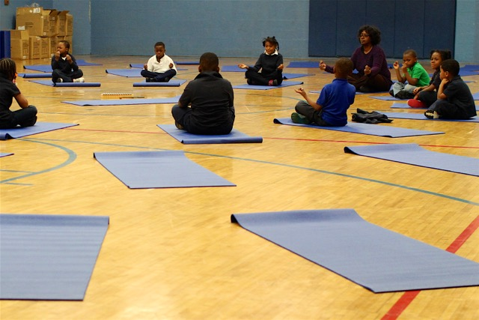
Yoga & Mindful Movement
Notes:
Do mindful movement as a group

Slide 32
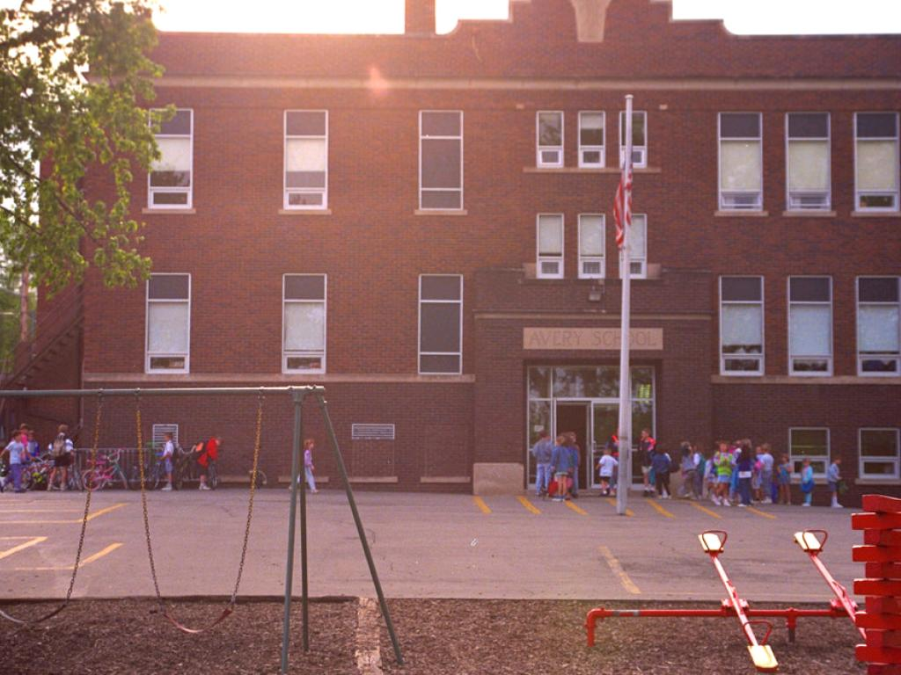
Morning Meeting
Gather students
Greeting
The Daily Four or ice breaker of choice
Celebration/Shoutouts
Concerns
Review schedule for the day
Mindfulness activity
Look to someone around you and wish them a good day
cc: Ed Yourdon - https://www.flickr.com/photos/72098626@N00
Notes:
If time implement a mock morning meeting

Slide 33
10 Things Every Teacher Should Know about Childhood Trauma
Kids who have experienced trauma aren’t trying to push your buttons
Kids who have been through trauma worry about what’s going to happen next
Even if the situation doesn’t seem that bad to you, it’s how the child feels that matters
Trauma isn’t always associated with violence
You don’t need to know exactly what’s cause the trauma to be able to help
Kids who experience trauma need to feel they’re good at something and can influence the world
There’s a direct connection between stress and learning
Self-regulation can be a major challenge for students suffering from trauma
It’s okay to ask kids point-blank what you can do to help them make it through the day
You can support kids with trauma even when they’re outside your classroom
cc: T.Kiya - https://www.flickr.com/photos/38217580@N05
Notes:
10 Things Every Teacher Should Know about Childhood Trauma

Slide 34
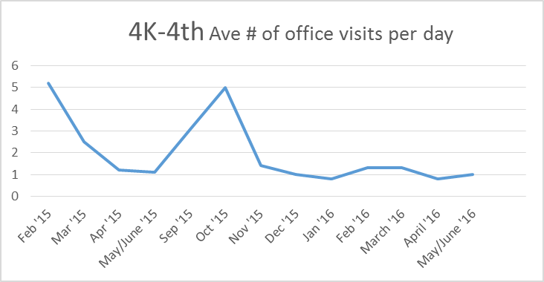
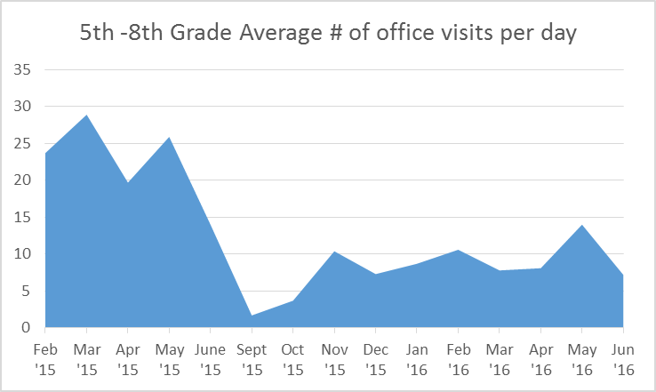
Telling an adult when they start to feel overwhelmed with emotion (safety and self-regulation) encourages children to trust teachers & staff to deal with issues as they arise rather than acting out in the classroom.
Notes:
• In the first year of programming, we saw office visits for behavioral incidents reduced by 79% and incidences of classroom disruption and defiance reduced by 80% for 4K-3rd grades. This year the fourth graders moved to the elementary level, and in spite of having more students in the school, compared to the same months of that previous year, office visits for behavioral incidents was reduced by 35% and incidences of defiance in the classroom was reduced by 64%. For 4K-4rd grade classrooms, student behavior that elicited parent contact remained consistent; however the percentage of students who were engaged in learning in the classroom increased compared to last year when trauma sensitive school programming was being implemented.
• For the 5th-8th graders, compared to the months the trauma sensitive school program was being implemented the year prior, student office visits for disruptive and defiant behavior, or physical altercations was reduced by 65%, dropping from an average of 22.4 to eight office visits per day. (The impact of not having fourth graders at the upper campus may inflate these results, however, the fourth graders accounted for the fewest office visits the year prior).
• It was predicted that as students learned to recognize when negative emotions were being triggered, student requests to go to the office for a ‘self-time out’. After a huge surge in self-time outs the year prior when students initially learned how to recognize their feelings, student initiated self-time decreased as students learned to regulate or control their emotions on their own.
In the 4K-4th grade classrooms, the number of incidences of classroom disruption and defiance was reduced by 64%;
•In 5th-8th grade classrooms, the number of students involved in physical altercations was reduced by 60% compared to the year prior for the same months trauma sensitive programming was being implemented. The more than 50% percent reduction in defiance toward teachers shown the year prior was maintained as further reductions were shown. The highest measured number of acts of defiance the year before during program implementation was 106 in a single month; this year the highest measured number of acts of defiance was 57 in a single month.
While the number of minutes of classroom instruction that were reclaimed is difficult to determine, the percentage of office visits that resulted in loss of instruction was reduced by 66% in the middle school grades and 80% in the elementary grades.

Slide 35
Northwest Catholic School
Responsive School
https://www.youtube.com/watch?v=zLlMOV62LHg
Notes:
7/25/16
https://www.youtube.com/watch?v=zLlMOV62LHg
35

Slide 36
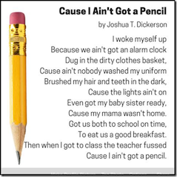

Slide 37
Questions?
Calming Bottle Raffle

Slide 38
Thank You!!!
Tarah Randazzo LPCIT, DPI Licensed School Counselor
tarahrandazzo@gmail.com

