Slide 1
The Engineering Design Process and BSV (Biodegradable Sustainable Vehicle)
A presentation by Anneleisa Gruber

Slide 2
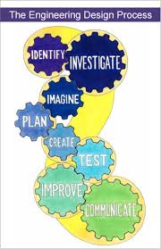
What is the Engineering Design Process?
Simply put, this is the process all Engineers go through to solve a problem.
What are the “steps”?
Identify
Investigate
Imagine
Plan
Create
Test
Improve
Commnicate
Notes:
What are the importance of each.

Slide 3
How does it look with a lesson?
The BSV is a cumulative project that ends a unit on Force and Motion.
Quick History
Identify a problem.
This can be one that you made up or one that you have the students come up with
Needs to be meaningful
Greenies Environment Corp is a new green company that specializes in making sustainable products that are made from 100% biodegradable materials. They have recently had interest in constructing vehicles out of biodegradable materials to cut down on the amount of exhaust given off by traditional gas powered motors. They have already developed the biofuel engine for the vehicle. They have recruited you and other engineer firms to develop a proof of concept prototype for the body of the vehicle. You will need to develop a model that is lightweight, durable, and stable: can travel for long without falling apart. It must be able to hold and carry a load of 160kg.
Investigate (what do you need?)
Let your students research the problem
Can provide info, or let them loose
Pull in from other fields
Notes:
I’ll be going through each step with a lesson I have done in the classroom. Explaining how each step can be customized.
Quick History; This was a project that was set up before I started and I received no help or infomation on. It started out w/food and I knew that was going to be expensive and a waste of time. The students looked at it as a fun goof off time and didn’t see the real world implications of the project. I swtiched it to found materials about three yearss ago and incorporated the EDP to give a rich context and a deeper meaniing. My students became global citizens.
Identify; BSV Greenies Environment Corp is a new green company that specializes in making sustainable products that are made from 100% biodegradable materials. They have recently had interest in constructing vehicles out of biodegradable materials to cut down on the amount of exhaust given off by traditional gas powered motors. They have already developed the biofuel engine for the vehicle. They have recruited you and other engineer firms to develop a proof of concept prototype for the body of the vehicle. You will need to develop a model that is lightweight, durable, and stable: can travel for long without falling apart. It must be able to hold and carry a load of 160kg.
Investigate: BSV: this is where the specifics come out. The modeling information, Design and testing information. And so forth. Be specific but include wiggle room. Let them come up with ideas of what may be needed and then tell them the specifics

Slide 4
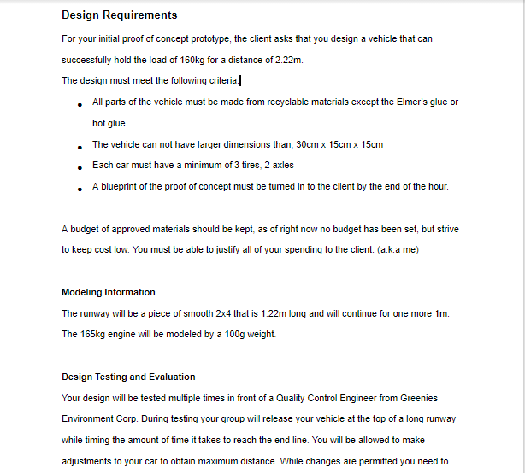
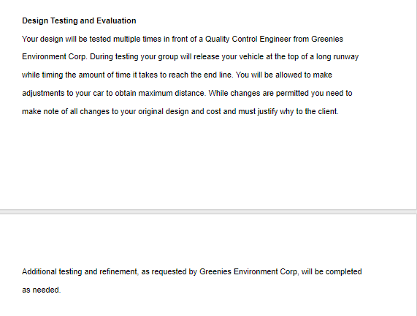
How does this look with a lesson?

Slide 5
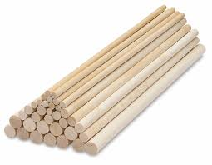
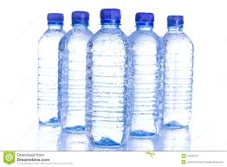
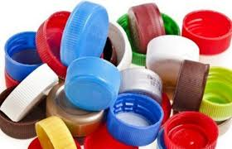
How does this look with a lesson?
Imagine
Aka: brainstorming.
I do not give specifics about materials just yet
More research if need be
Play with materials
I give most time in the first day for this
Plan
Homework
Group or individual
Three ideas
Cost analysis comes in (age dependent)
Notes:
Imagine
because I want them to create as many ideas as possible without material restrictions Let the students manipulate the materials,
This is important, let them play, this is how they find out how the materials will work together,
Example: how to best put on a wheel and where the axle should go
thI will have the materials avalible at this time
The biggest challenge is what to use as wheels and how to make them trun. I put this problem back on the student and let them figure it out.
Plan
Specifc costs, and available materials
Drawn out
Rationale for the cost (age appropriate)

Slide 6
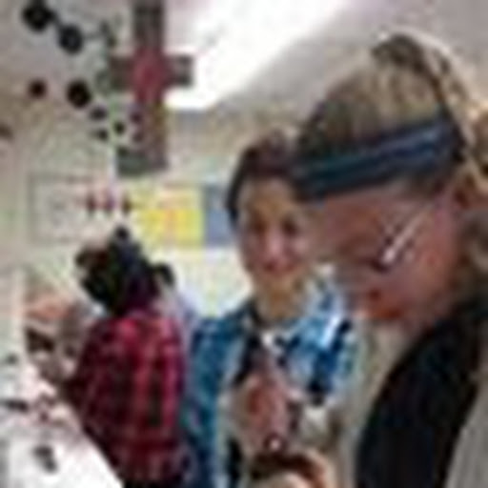
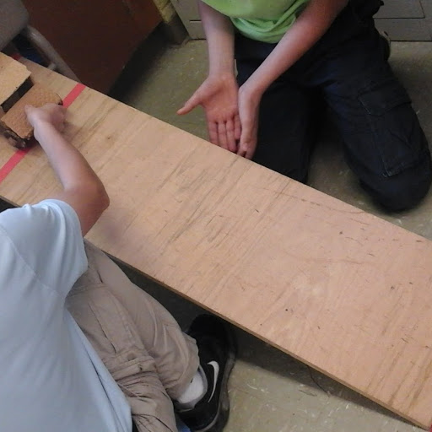
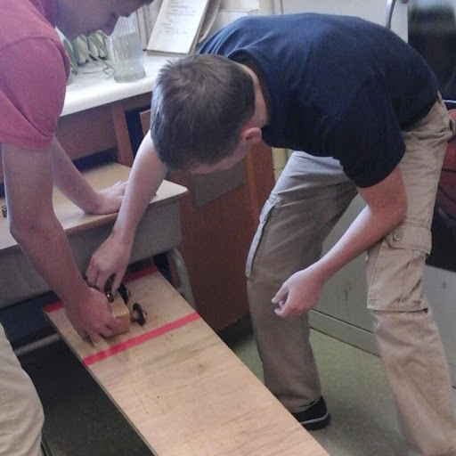
How does this look with a lesson?
Create
Once the plans have been approved they can begin to build
Test
2 types of tests
Allow to test on their own
Official test infront of quality control (for the “grade”),
I set a certain number of times that they have to do the quality test
Improve
After each test is an improvement
Document, document, document
After each change they have to justify why.

Slide 7
How does this look with a lesson?
Communicate
One of the key steps in the EDP is communicating what you learned
Two way
Throughout they keep an Engineering Journal
They keep notes, thoughts, drafts in the journal
Reflect at the end of the class (or as homework)
Justify why they made the changes that they made
Final Report
Answer a series of questions
Justify their frame
Place to tell me honestly if I should choose their design and whw

Slide 8
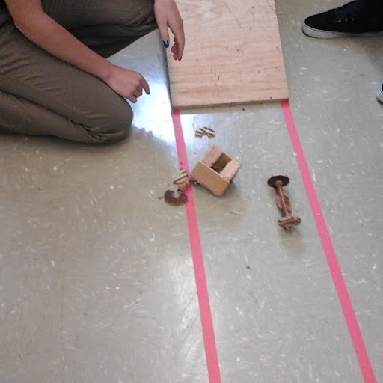
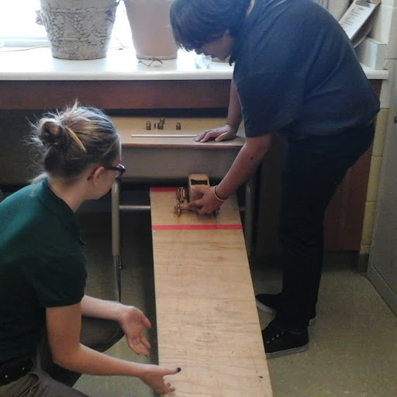
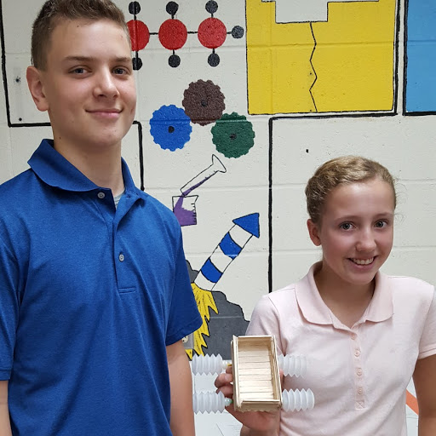
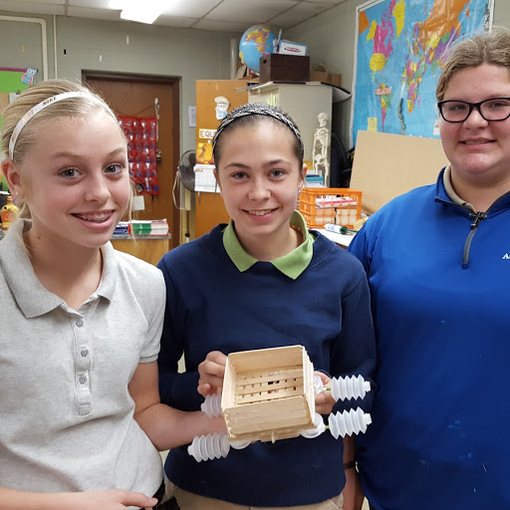
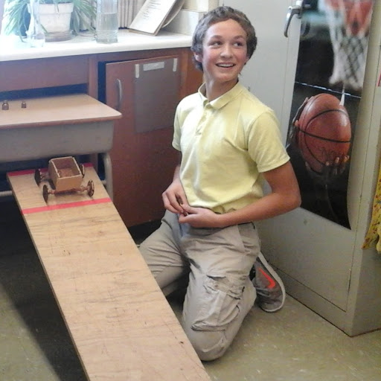
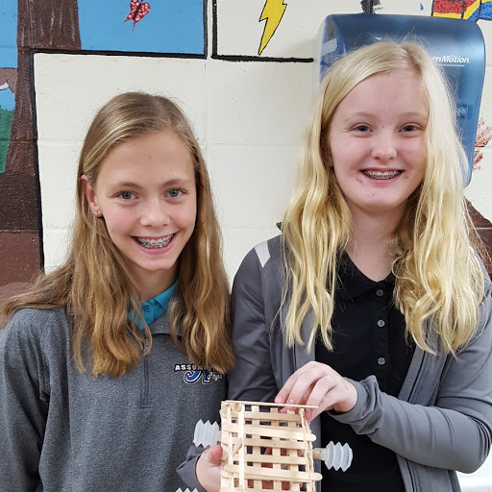
Past cars

