Slide 1
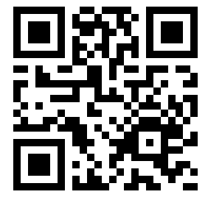
Plickers
Assessment Done Quicker!
http://bit.ly/WCRIS-Plickers
Presentation folder
Notes:
Create QR code for this presentation.

Slide 2
Jim Kroll - contact information
Currently serving: St. Paul’s Lutheran School
Janesville, Wisconsin
School: (608) 754 - 4471, ext 207
Cell: (608) 295 - 7007
jkroll@stpaulsjanesville.com
@jim_kroll

Slide 3
Some of the people / organizations I follow...
@alicekeeler
@Shake Up Learning”
@DitchThatTxtbk
@jmattmiller
@K9ComfortDogs

Slide 4
Assessment
“A formative assessment or assignment is a tool teachers use to give feedback to students and/or guide their instruction. It is not included in a student grade, nor should it be used to judge a teacher's performance. Both of these would be considered summative assessments.”
David Wees , Formative Assessment Specialist for New Visions for Public Schools, Posted 12/10/2012 12:18PM

Slide 6
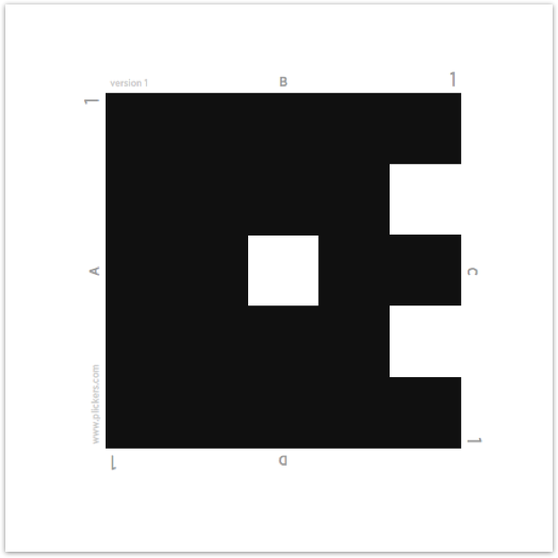
Plicker card
Numbered
Assign a card to each student
Students hold the card up to answer questions
Notes:
Available FREE from Plickers website. You can also order them Amazon - 40 laminated cards for about $20.

Slide 7
Plicker Cards
Available FREE from Plickers website.
Amazon - 40 laminated cards for about $20.

Slide 8
Consider this...
Card stock
Trim / Crop Cards
Multiple sets
Management
Notes:
Have some untrimmed cards so they see the need / reasoning.

Slide 9
Before class . .
www.plickers.com
Create classes
Download cards
Write questions
Download app to device

Slide 10
Teacher’s view
Scan the class
Watch information change as you scan
Green = Correct
Red = Incorrect

Slide 11
Wisconsin History Review
“We will begin our class today using Plickers.”
Distribute cards
www.plickers.com
Use Plickers app on your cell phone, iPad, tablet

Slide 12
Resources
Plickers
56 Examples of Formative Assessment
Plickers on the App Store
Plickers on Google Play
Simple Formative Assessment with Plickers
Twitter

