Slide 1
“Love & Logic” 9 Essential Skills for Love & Logic Classrooms Low Stress Strategies for Highly Successful Educators
Notes:
1

Slide 2
Love and Logic’s Wish for You…
That your students will look at you and think…
“That’s the strictest teacher I’ve ever known…and I want to be in his/her class!”
Notes:
2

Slide 3
The Most Powerful Teacher
Has high expectations
Sets firm limits
Holds students accountable for their behavior
Is very caring and kind
Loves kids and loves teaching them
Notes:
3

Slide 4
Neutralizing Student Arguing
Go Brain Dead!
Softly repeat a Love & Logic “one-liner.”
1. I know.
2 Probably so.
3. Nice try.
4. I respect you too much to argue.
Notes:
4

Slide 5
Delayed Consequences…
Release yourself from the teachable moment with a delayed consequence.
The problems with warnings, threats, and intimidation.
One rule says it all “Don’t make a problem for others.”
Take time to plug the holes.
Deliver when it’s very convenient for the teacher and inconvenient for the student.
“That is so sad. I”m going to have to do something about that. But not now; later. Try not to worry about it.”
Notes:
5

Slide 6
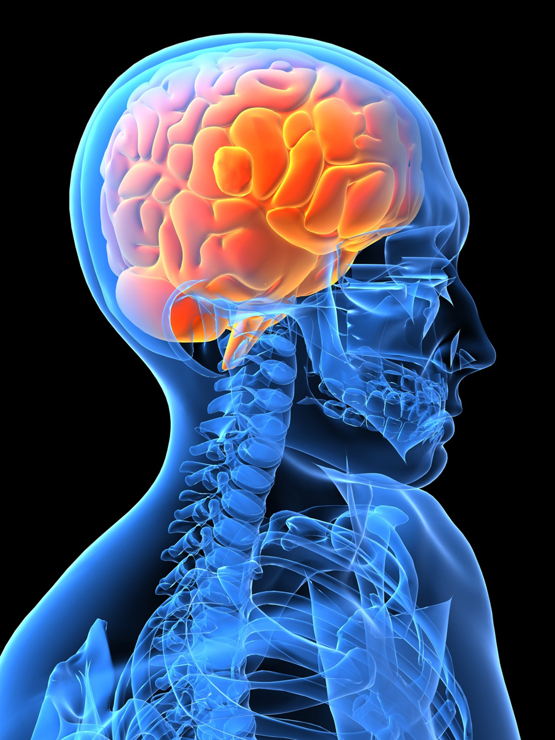
EMPATHY
Empathy opens the mind and heart to thinking.
Empathy, followed by logical consequences, builds responsibility.
Pick an empathetic statement:
1. This is hard.
2. How sad.
3. Bummer.
4. Oh, this is never good.
5. Oh, man.
Must be delivered with sincerity, not sarcasm.
Notes:
6

Slide 7
The Recovery Process
Preserve the learning environment with recovery spots.
Goals: Teacher can teach; students can learn.
Five different recovery locations.
1. A different seat in the same classroom
2. A seat in another classroom.
3. A seat by the principal’s office.
4. A recovery room at school.
5. Recovery at home.
Rules:
Whisper
Choices
Plugging the holes
Notes:
7

Slide 8
The Big Three…
1. Confess what I did wrong or what went wrong.
2. Ask for forgiveness.
3. Come up with my own solution (consequence).
Notes:
8

Slide 9
Developing positive teacher/student relationships
Solid relationships are far more powerful than the sum total of all other techniques.
Build relationships with eye contact, greeting, smile, and touch.
“I noticed….”
The Test... “Will you do .... just for me?”
Notes:
9

Slide 10
Setting limits with ENFORCEABLE STATEMENTS
Tell students what I am willing to do or allow.
Demands produce resistance; Enforceable statements produce thinking.
Make your words GOLD by backing them up with action.
Ask more questions and make fewer statements.
Notes:
10

Slide 11
Using CHOICES to prevent power struggles
Teachers who share control have more of it.
Choices in the classroom, choices for consequences.
Rules for giving choices:
Always give choices that work for you.
Give choices before students become resistant.
If a student doesn’t choose, you choose for them.
Notes:
11

Slide 12
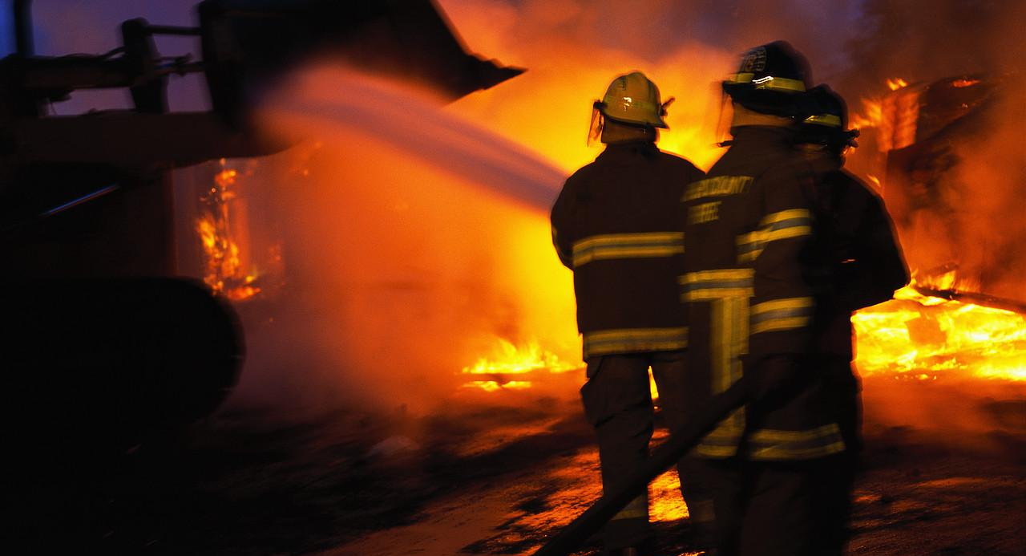
Quick and Easy Preventative Interventions
Give the look…
Prevent problems before they happen, consequences after they happen.
Small fires are easier to extinguish than large ones.
Notes:
12

Slide 13
Guiding students to own and solve their problems….
What are you going to do about it?
Offer a menu of suggestions.
Ask how each one will work out for them.

Slide 14
Have some Fun as Love & Logic CHANGES YOUR CLASSROOM!
Email with any questions: abauer@gardenhomeslutheran.org
jbauer@gardenhomeslutheran.org
Thanks for coming...
Notes:
14

