Slide 1
Ideas for Personalization and Differentiation
Sheri Holcomb

Slide 2
Why? What makes it hard?
Brainstorm together
Pros? Cons?
Survey students (or parents)for interests and strengths

Slide 3
A novel first step--Teaching them ways to learn
Talk tubes, whisper, tablet talk-back
Tactile trace
Cross body (non dominate hand, tap, slide, fist)
Infinity walk
Trace, write, assess
Pattern movements
Music
Notes:
Teach one per week, practice, set guidelines, pics of appropriate behavior

Slide 4
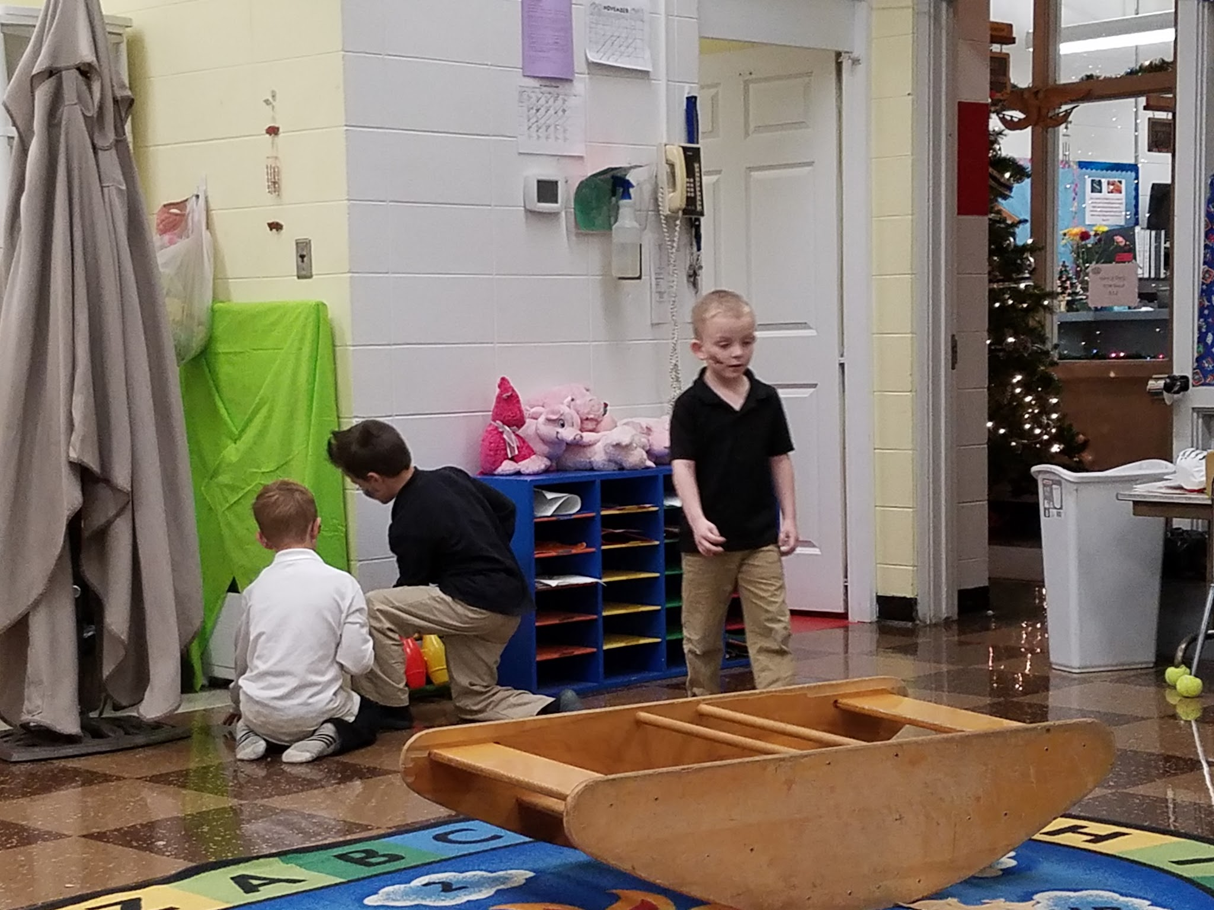
Other easy accommodations that help some students
Weighted items
Cushions or pillows
Standing/rocking/spinning
Tents
Hall or quiet pass
Break cards
Stretchy bags (video)

Slide 5
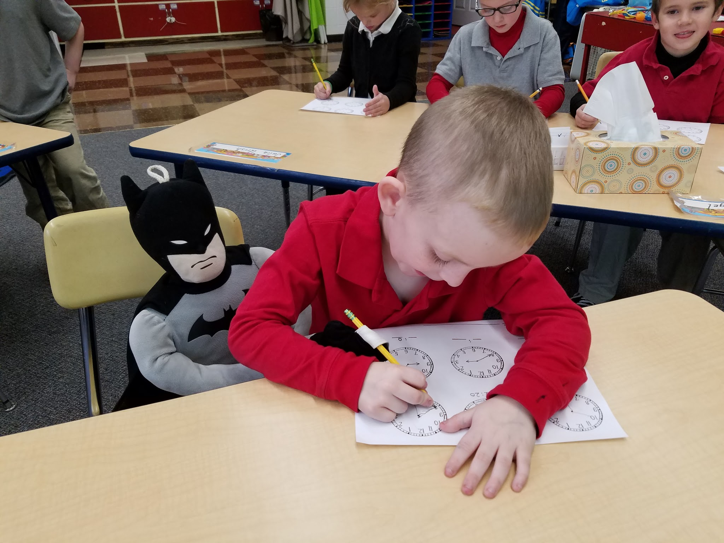
cont...
Bouncy seats/core chairs
Writing in sand, rice, paint bags, pillows, etc.
Carpet squares
Quiet desk
Peddle, band, velcro under table

Slide 6
Objectives
*Post at beginning of lesson.
*Objective activity--different objectives during same lesson.
*Show phonics worksheet, reading books, do post it activity.

Slide 7
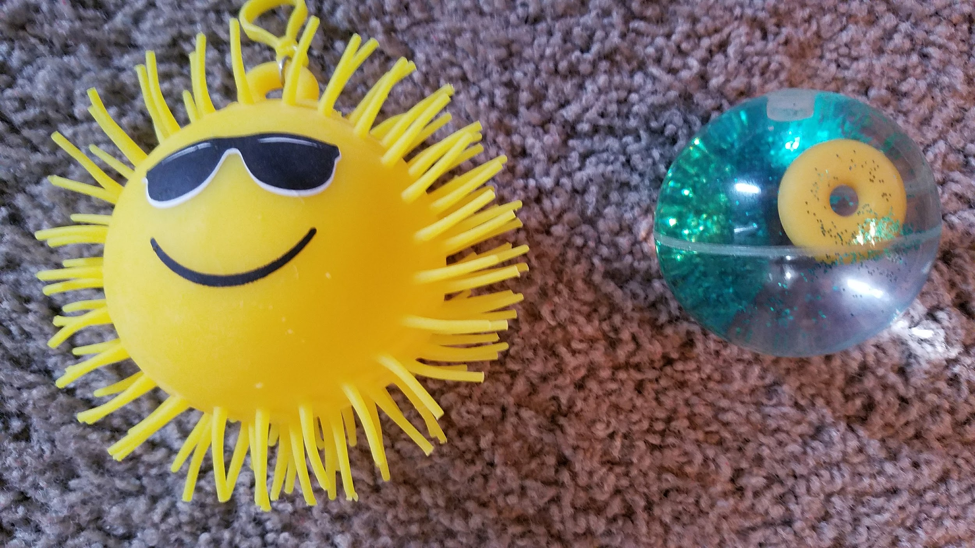
Different objectives
Questioning techniques are easiest!
What? (easy)
How? Compare/contrast (harder)
Why? What else is like? Make a new problem w/info.
You might be surprised with those that struggle with paper/pencil techniques! Keep dated post-its, interviews, say it again to tablet, etc. for portfolio evaluation. Plickers is fun free program to help.
Notes:
Practice-what's the answer 2+6=, show me why? Would 2+7 be more or less? What other questions could we answer from this? 6+2, 5+3, etc.

Slide 8
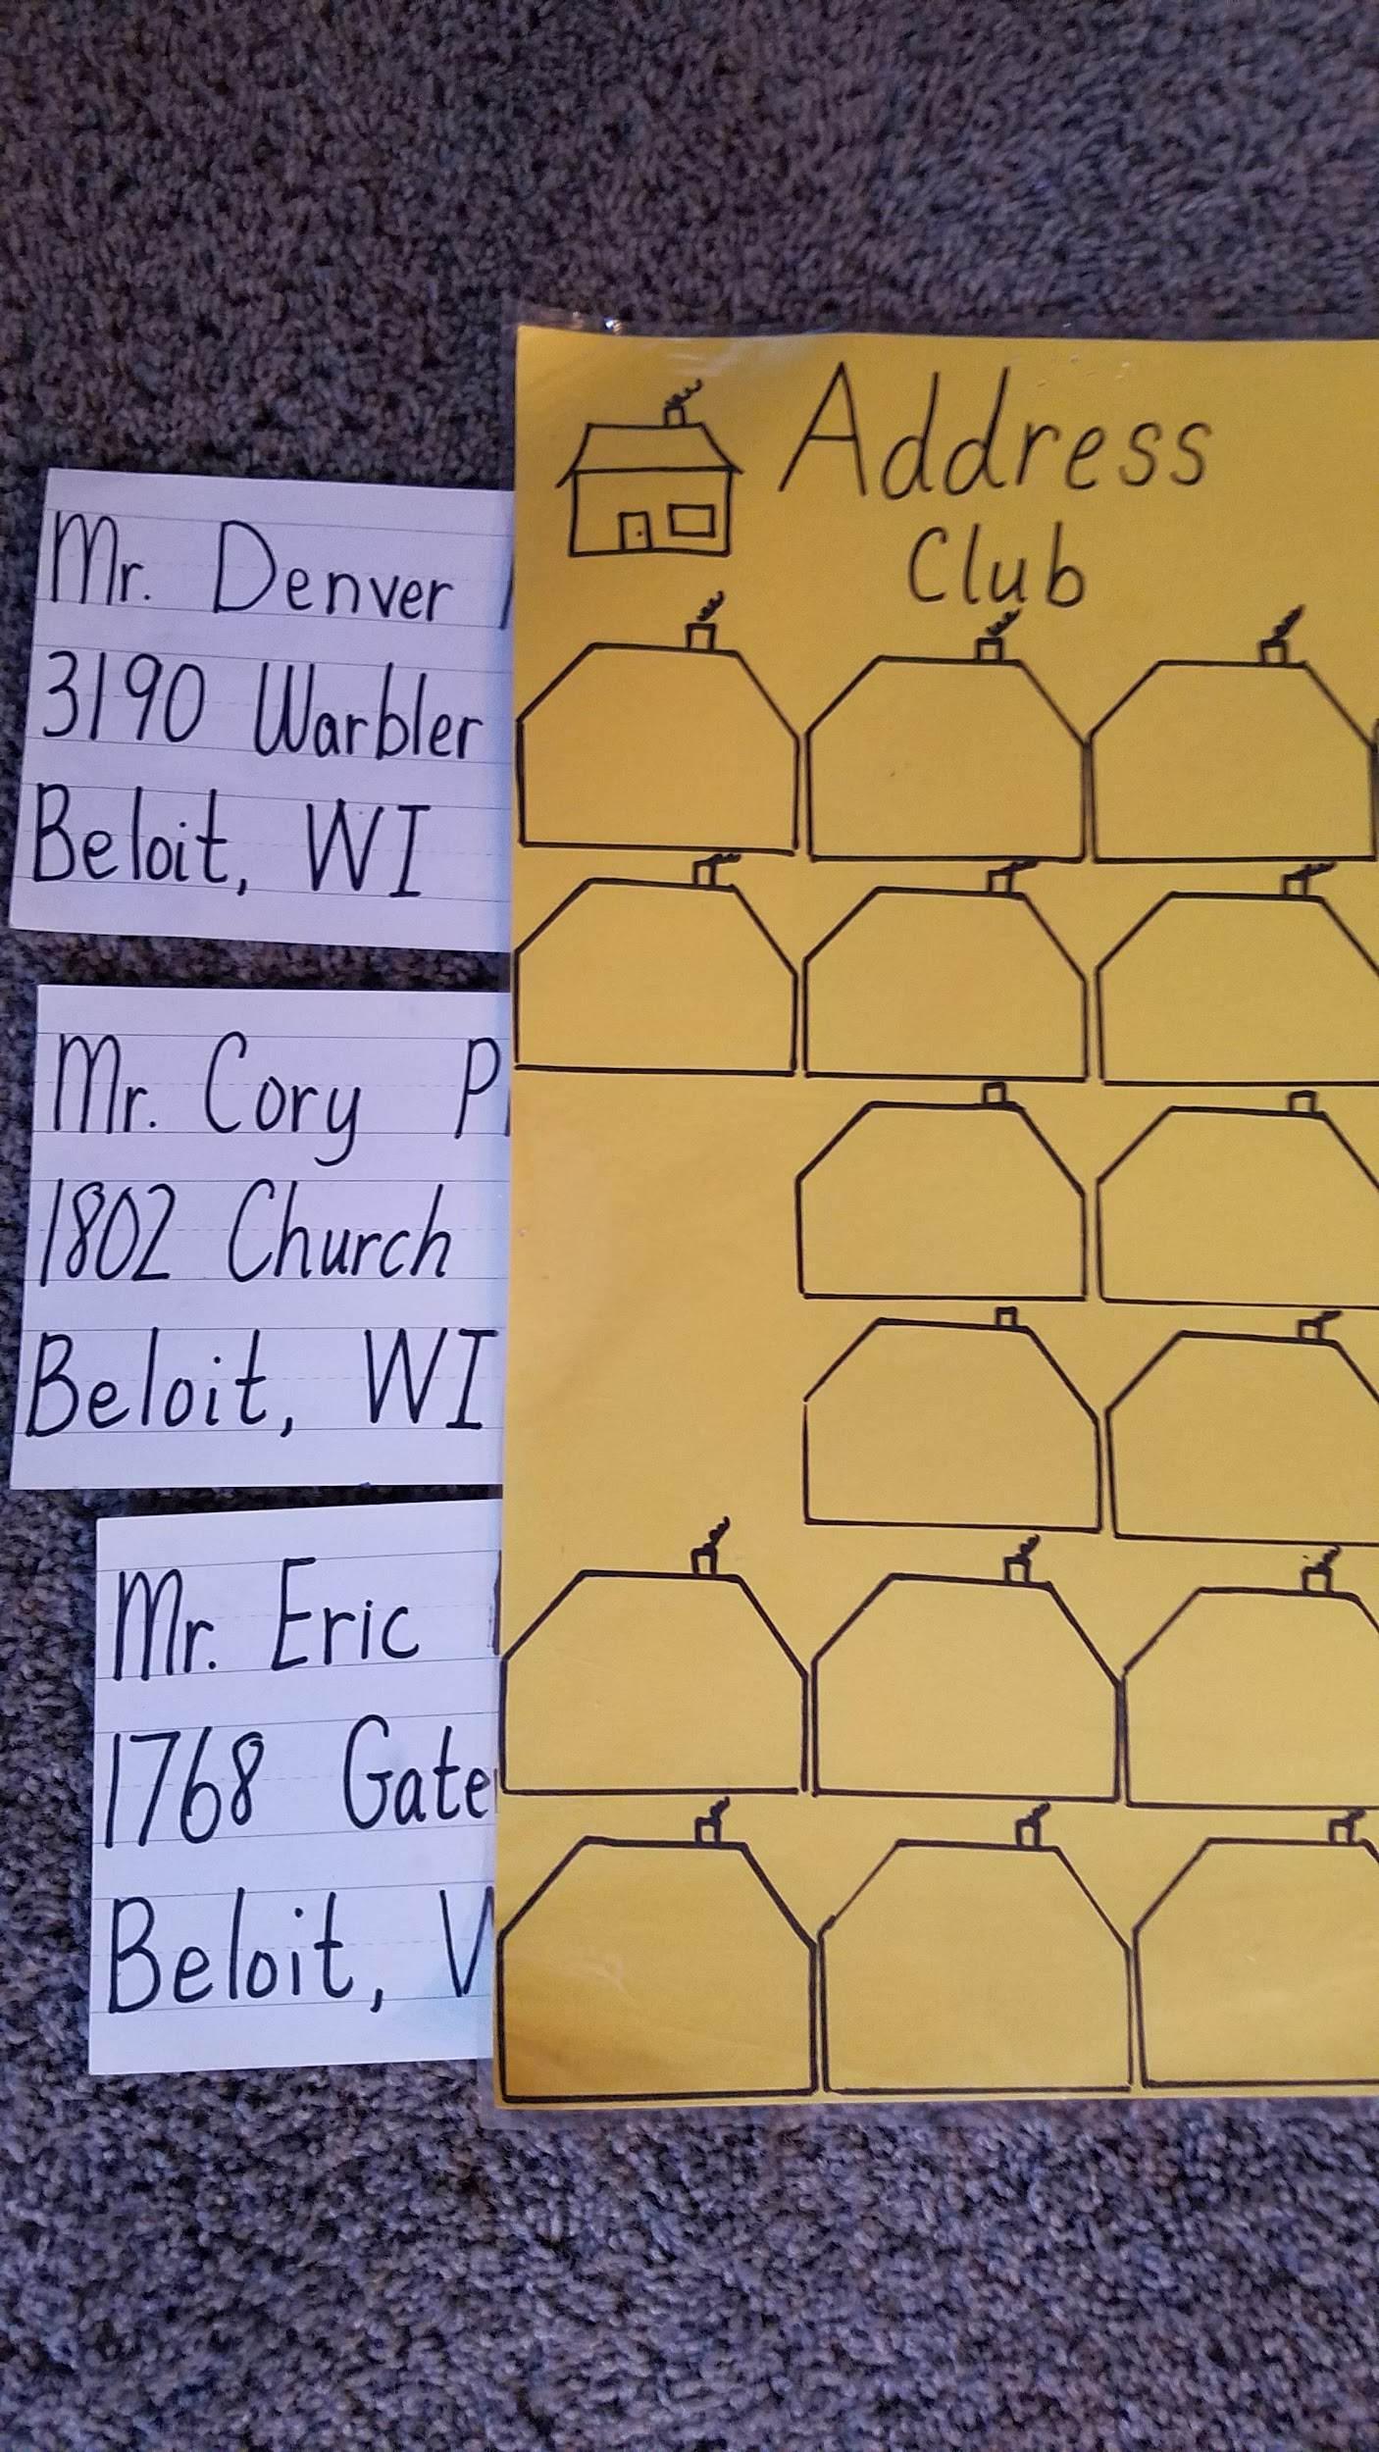
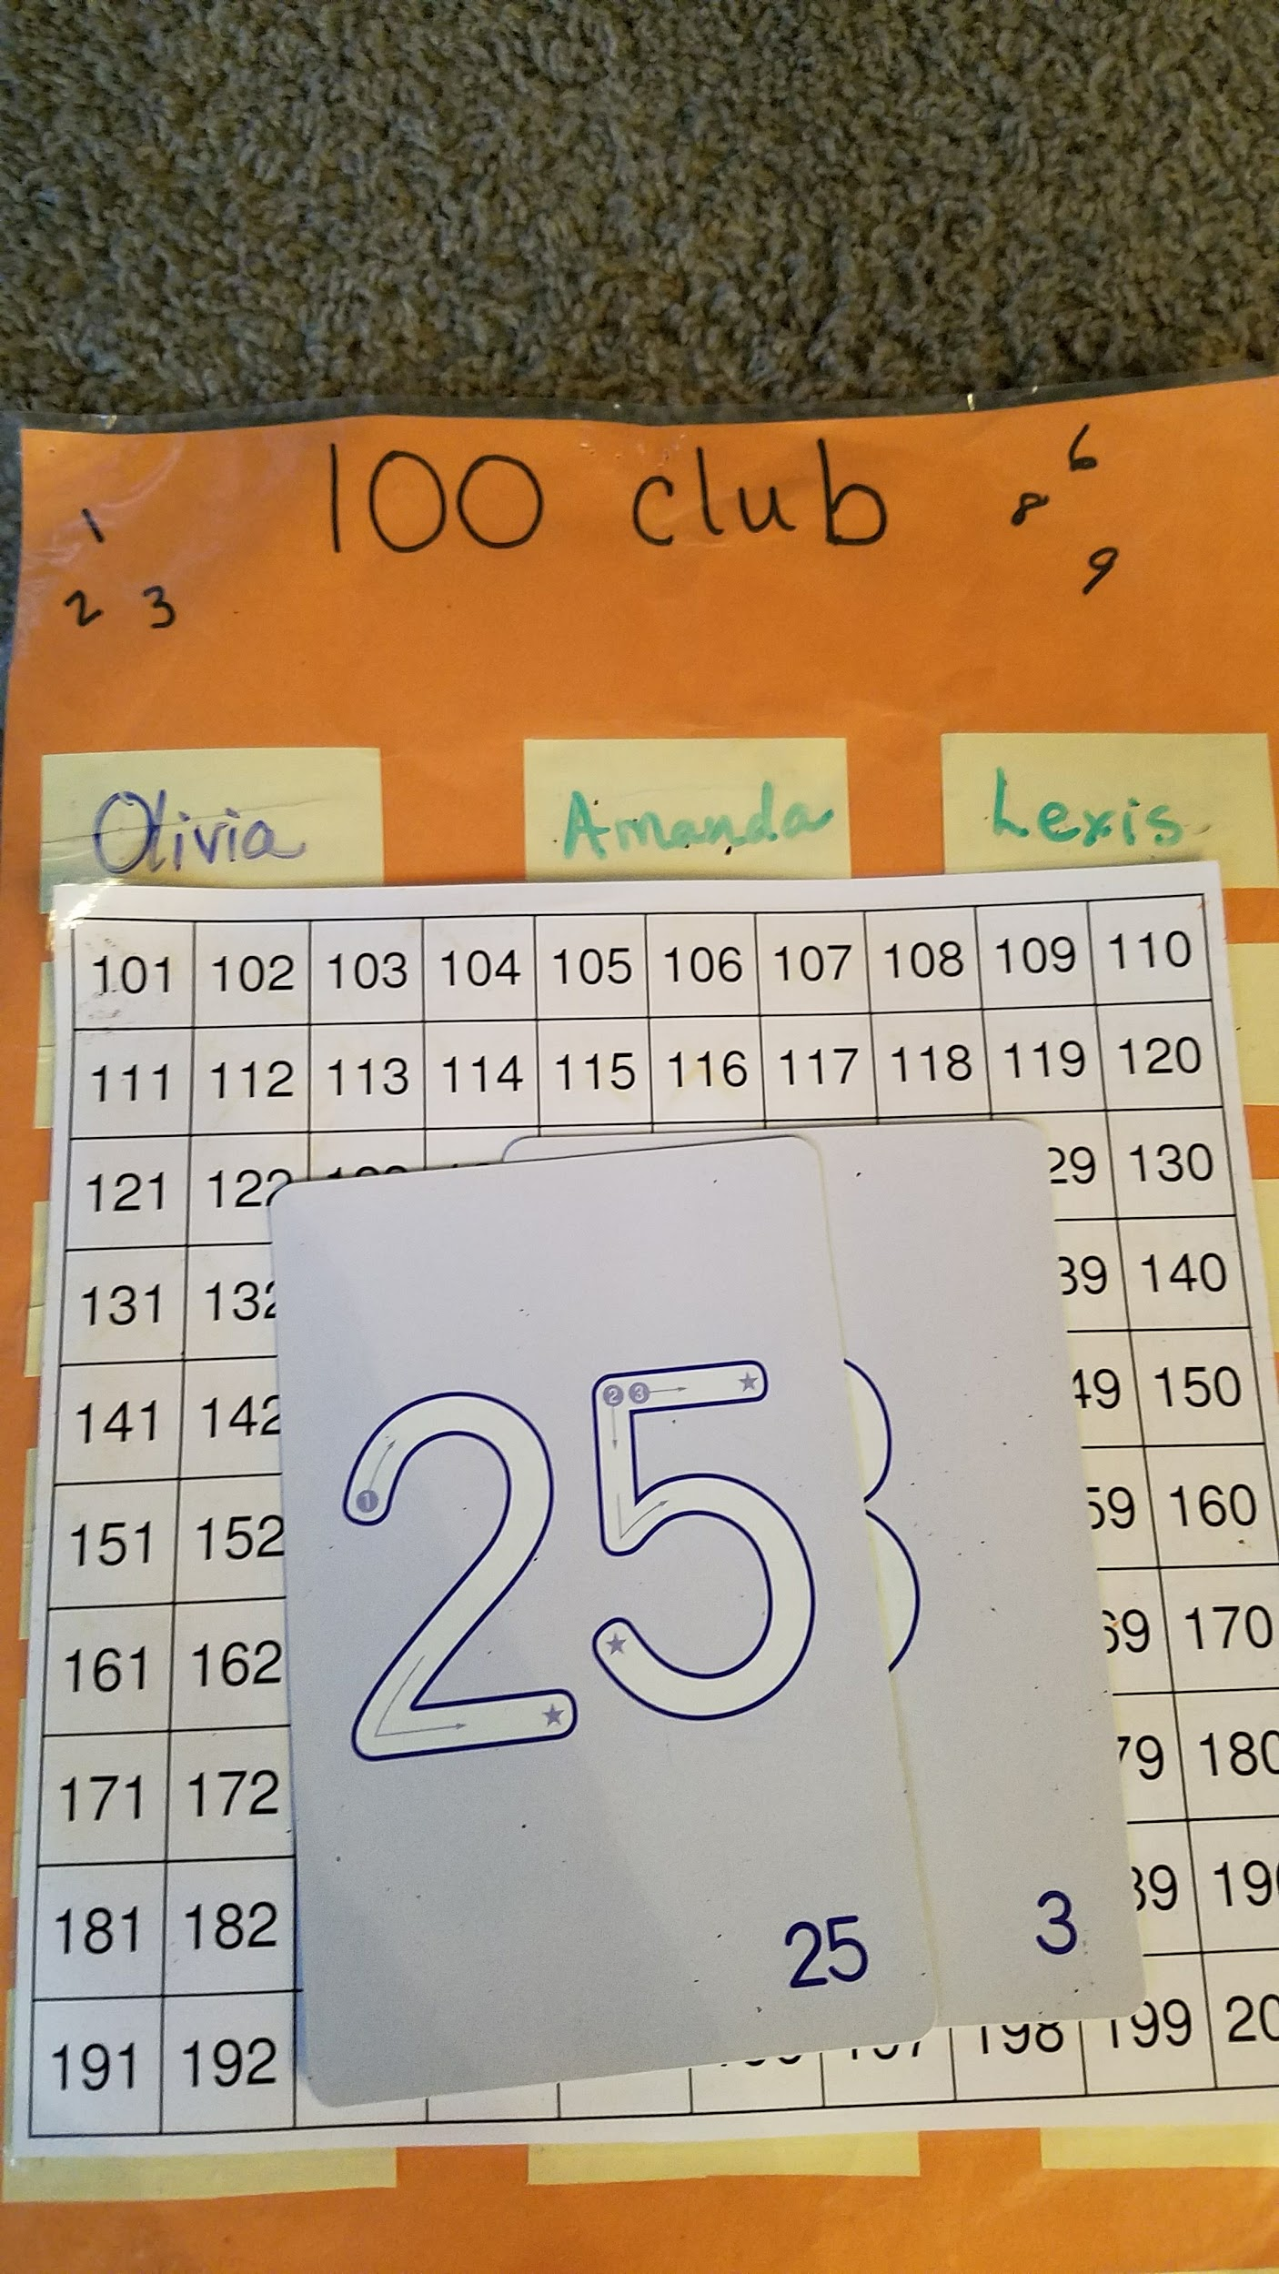
Teach assessment and procedures
Make sure all materials are easy to access and use
Give guides as needed
Teach how to practice
higher objectives
Use others (classmates, tutors)

Slide 9
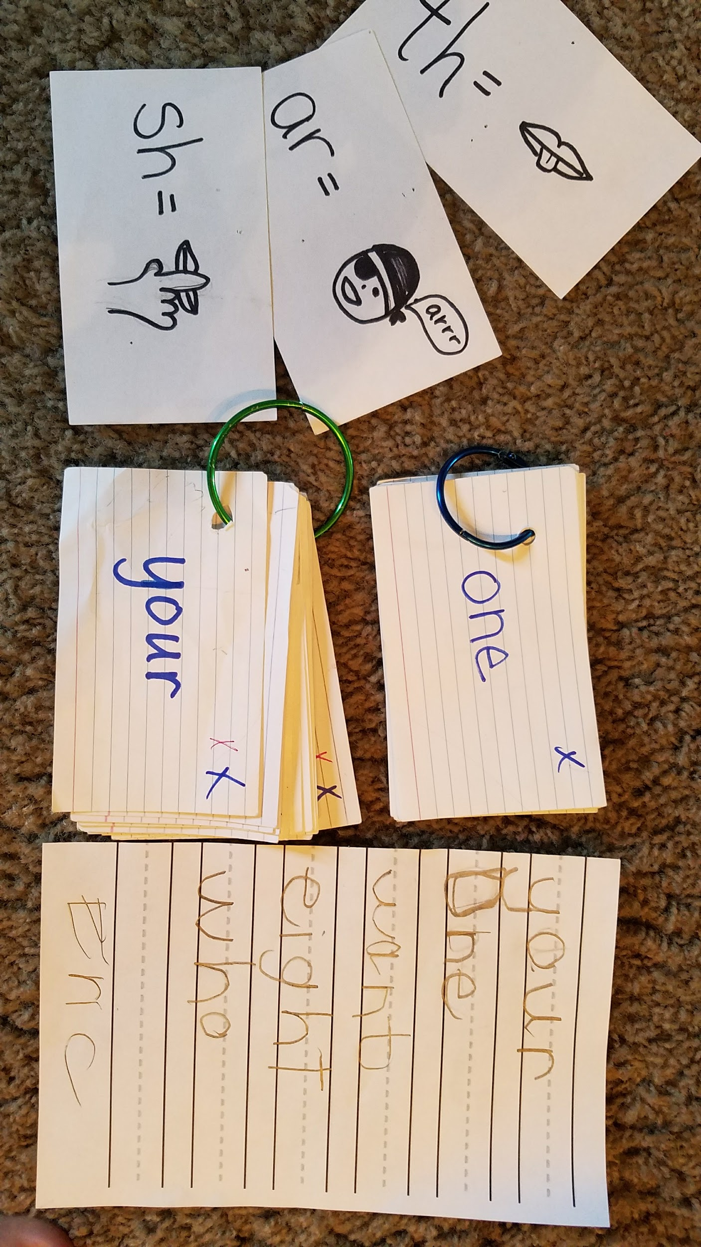
Add and teach self assessment procedures
Sight words, math formulas, special sounds, other ideas?
Self assessment (video)
Practice time with ideas from above.

Slide 10
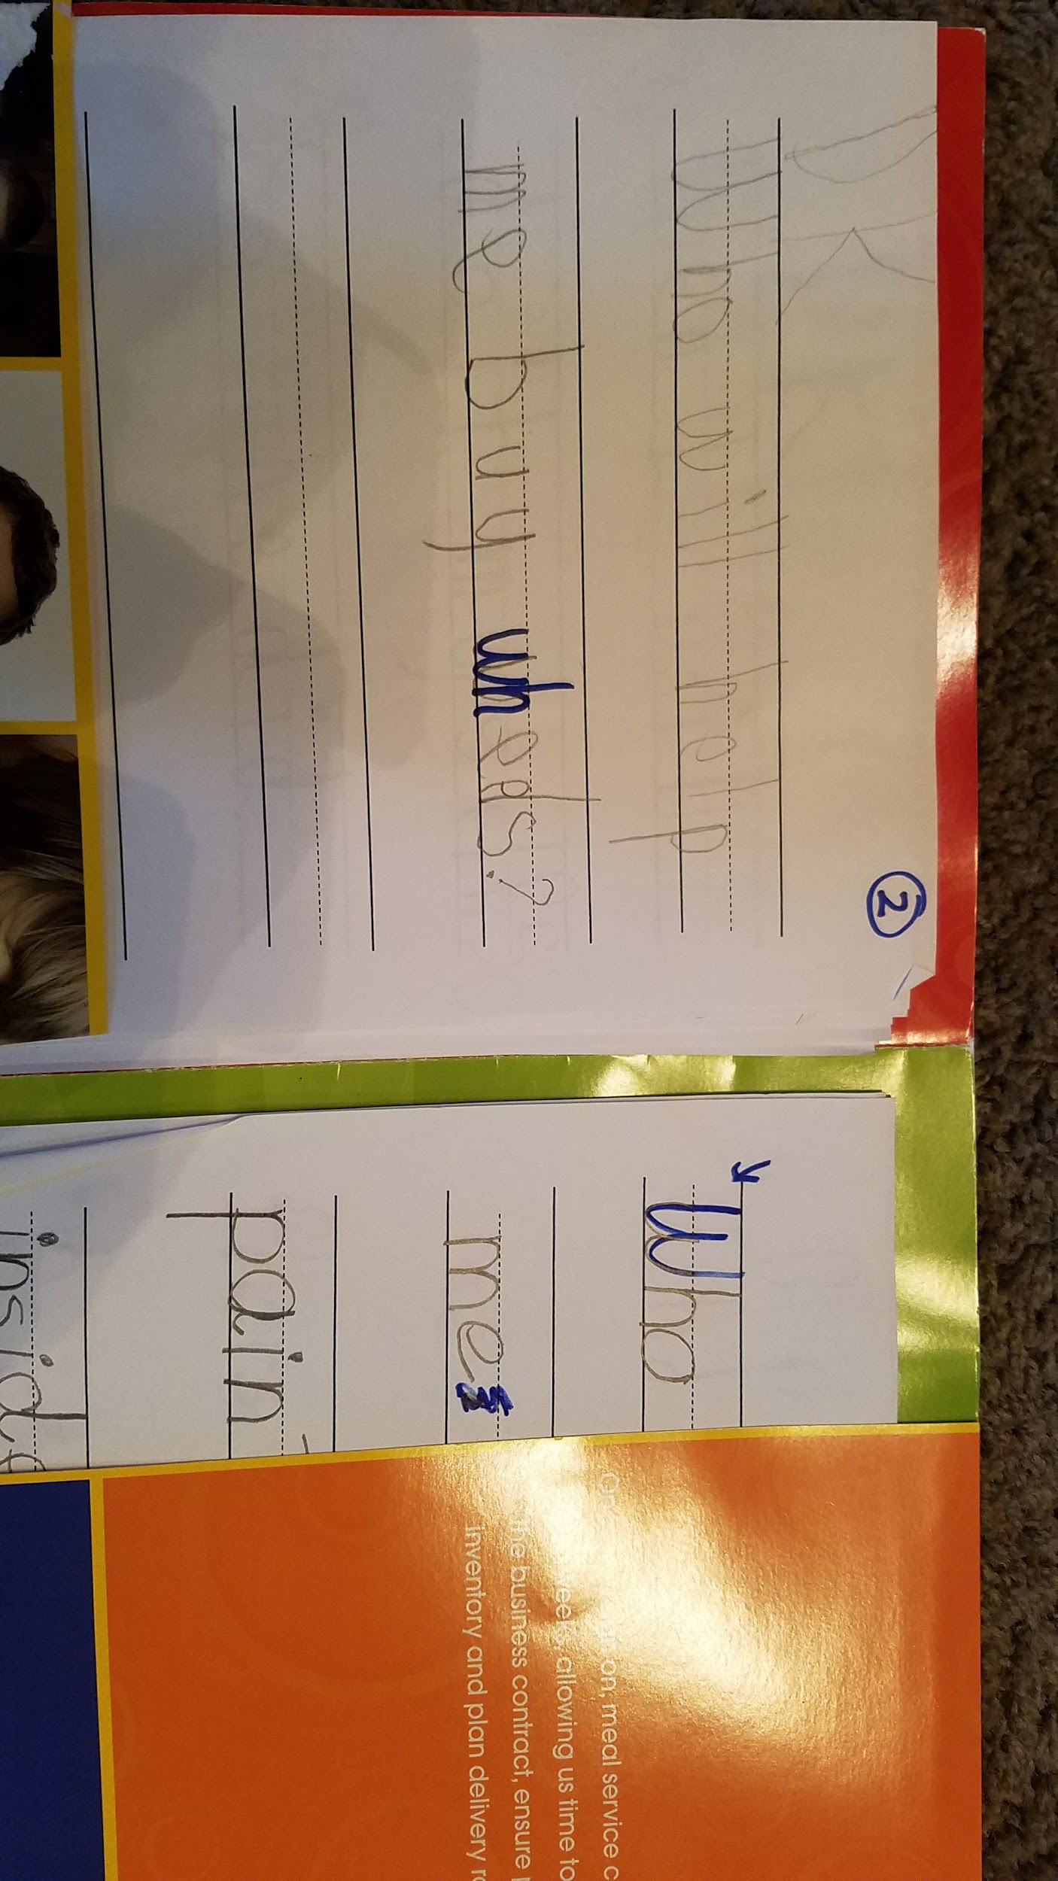
What about non-memorized content?
Folders (or notebooks):
Copy vs. write
Harder ??
Different prompts
Different concepts
Notes:
I like folders so I can slip in the next objective, otherwise they can be taught to paste it in.

Slide 11
Flipped activities
Code.org (free class, website and materials)
Learning farm $
Letter school
Adding with Toothy
Coolmath.com
Abcya.com
Kids Math
Alphabet board
Sight word racer
Sumas para ninos
Spelling for Children
Addition is fun
Racing 9-9
I level tablets w/colors for enriching, on level, remedial
Ted talks
Teacher-made
Student-made (another’s eval)
Teacher options of apps/online

Slide 12
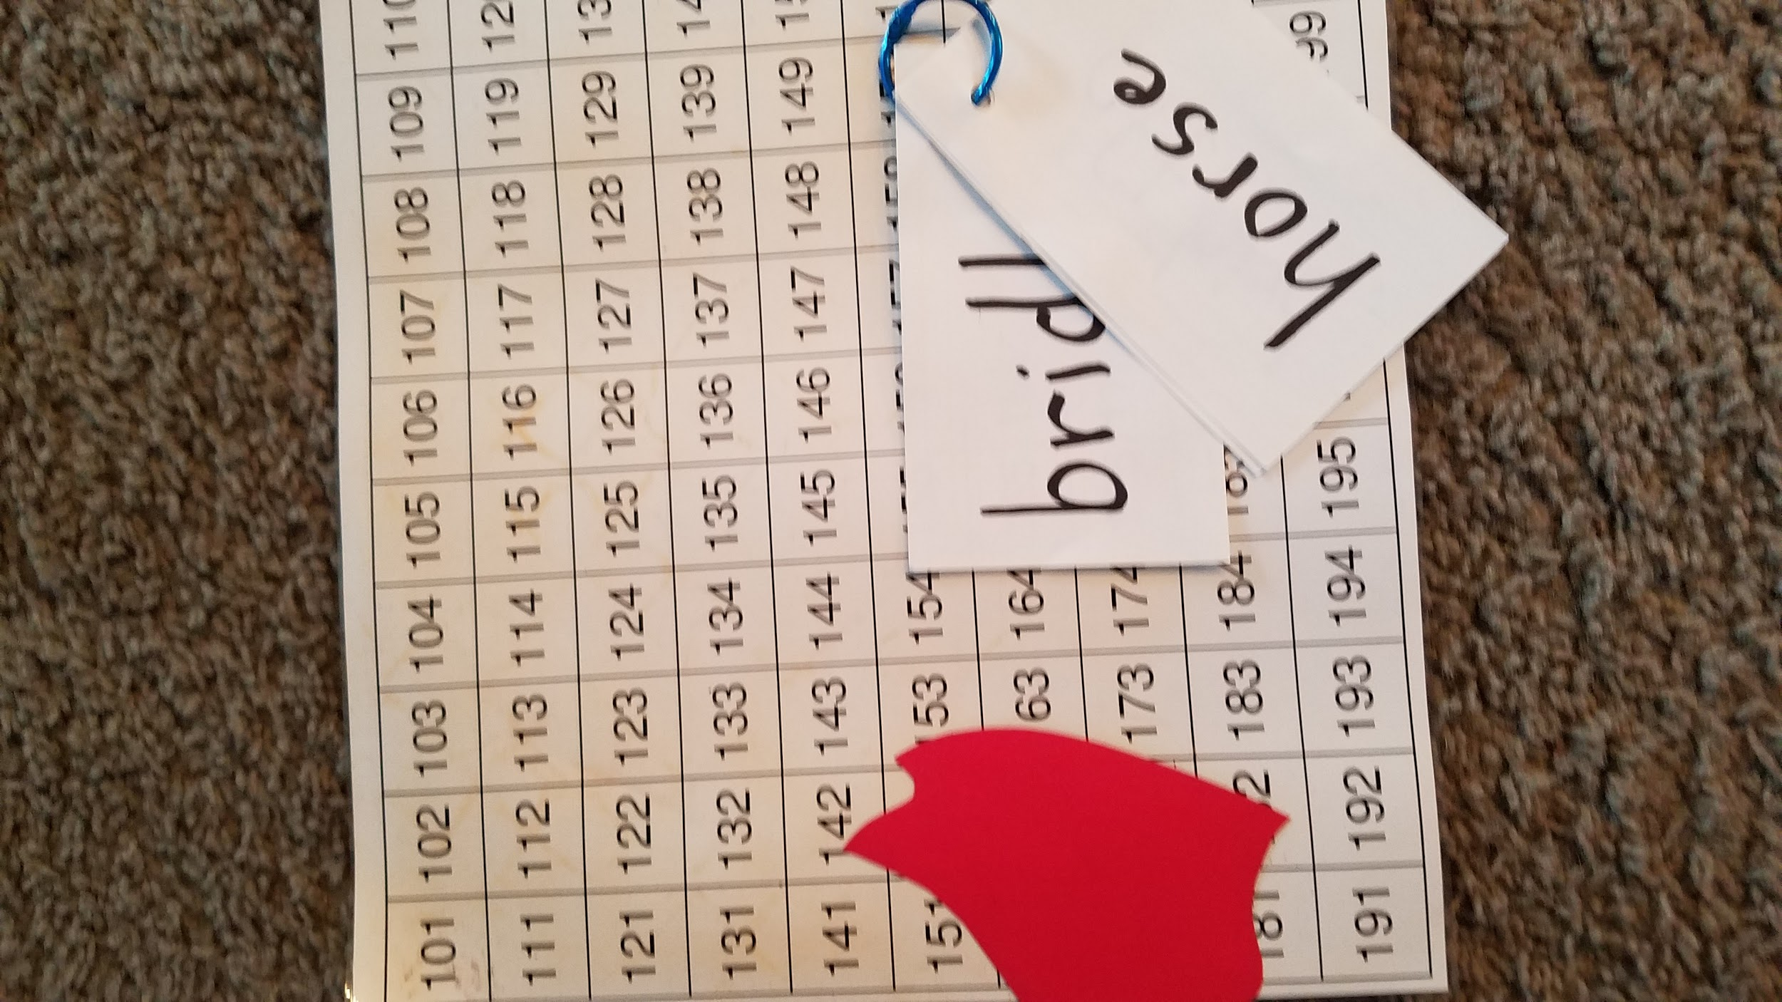
Add student input for excitement/buy-in
What’s something you want to get better at?
How could you show me?
How is teacher recording? Portfolio, notebook, gradebook

Slide 13
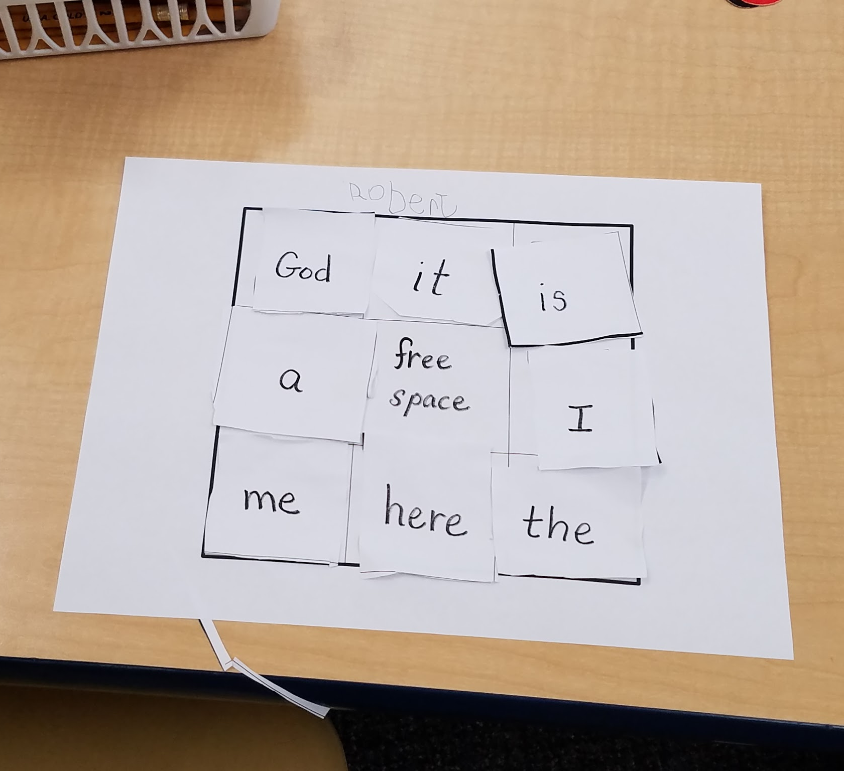
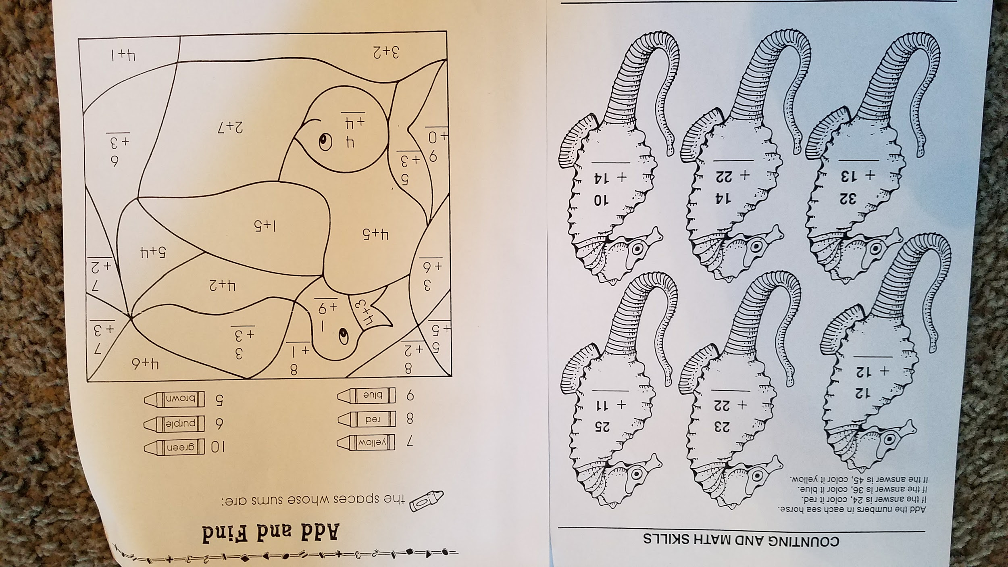
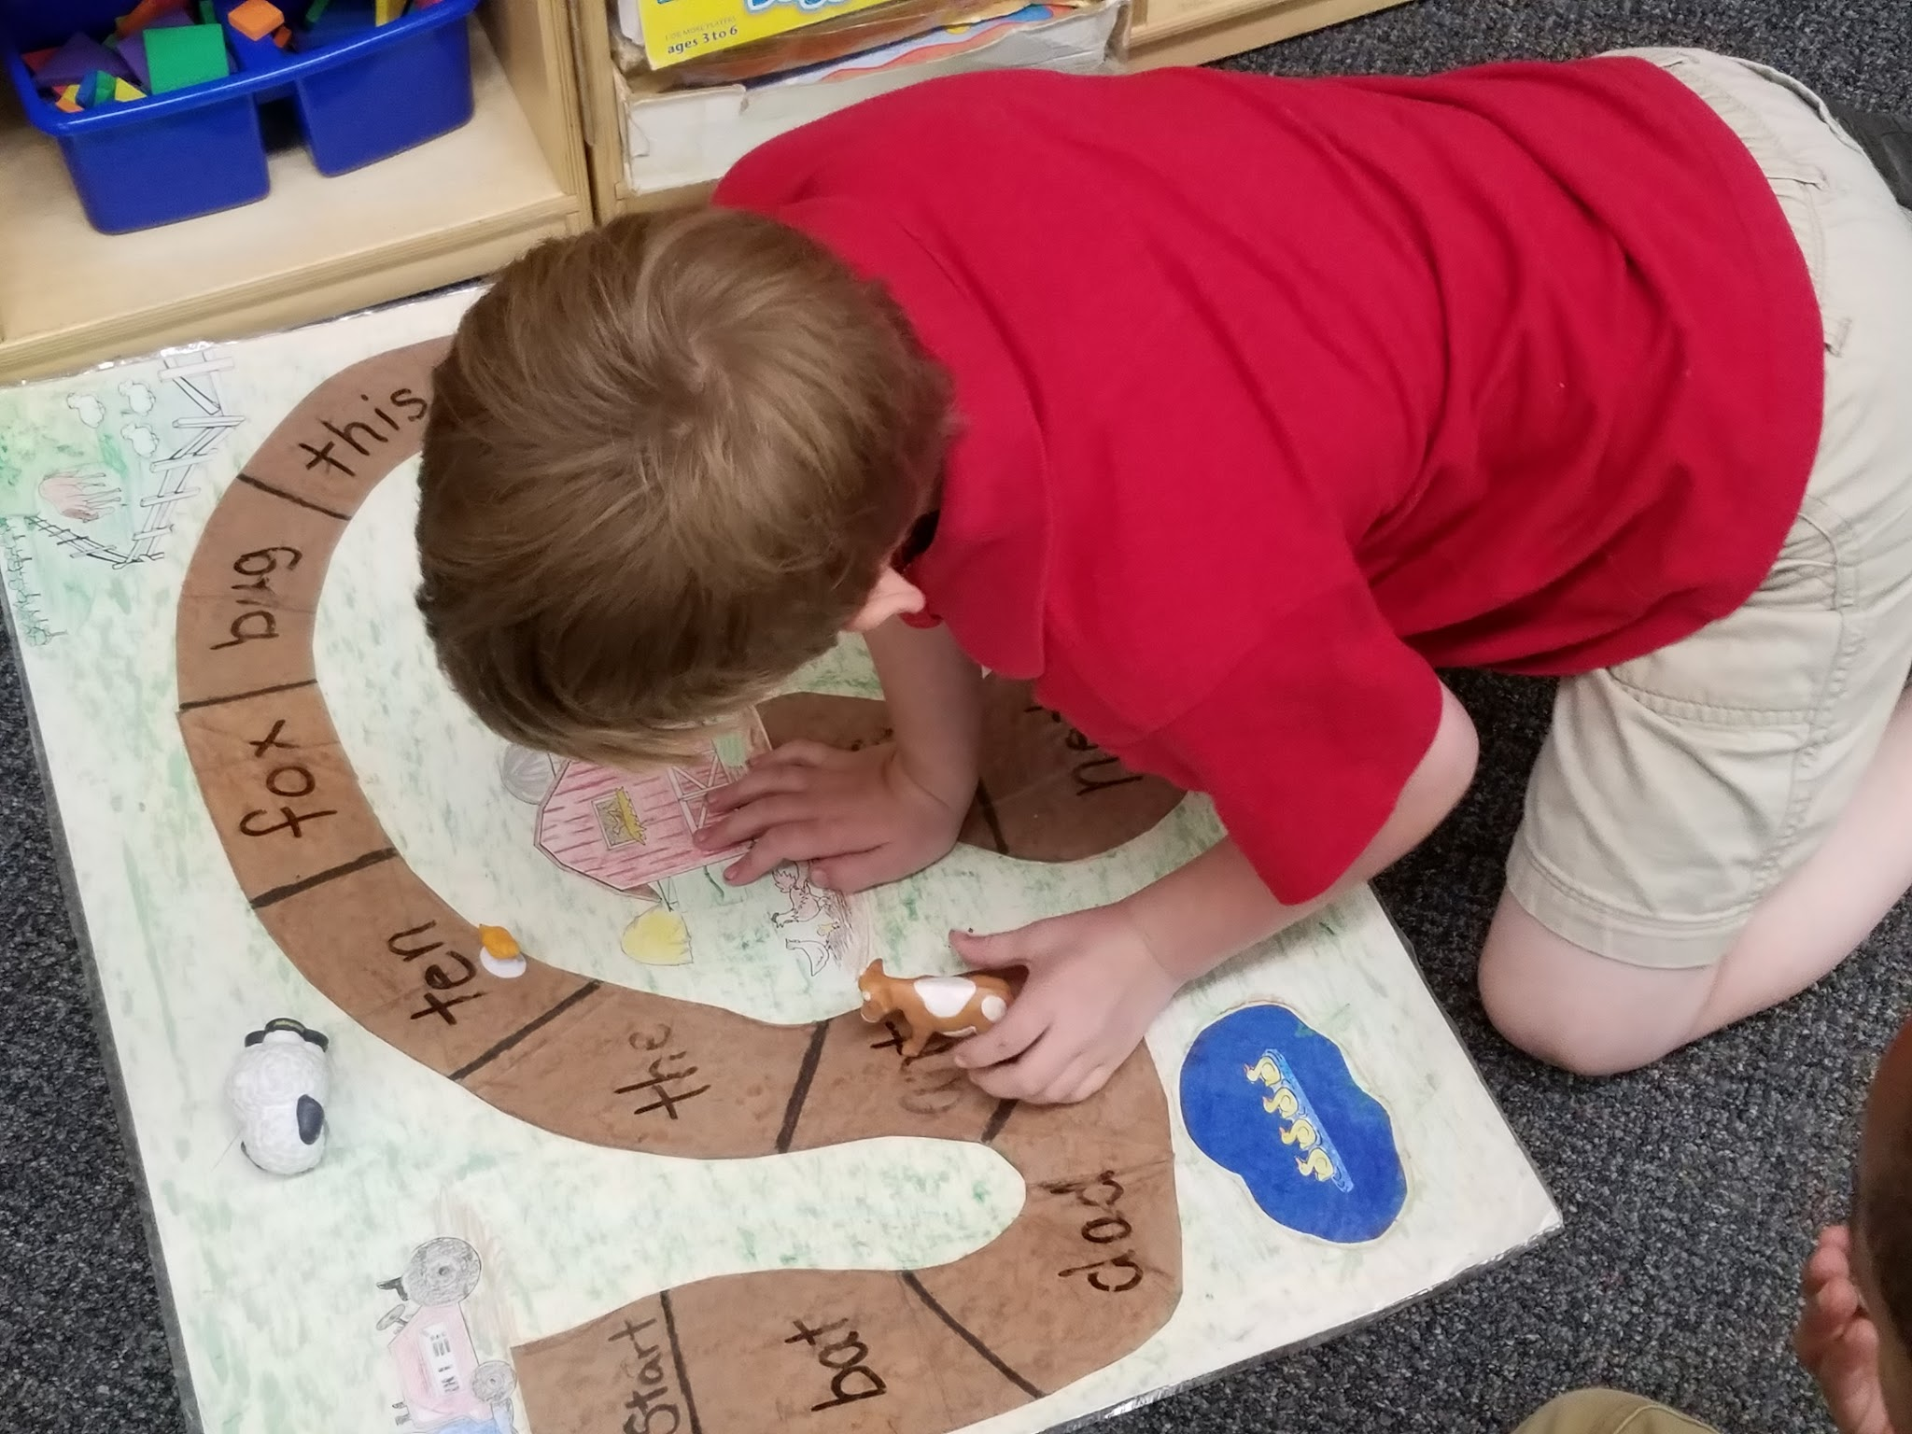
Differing assignments

Slide 14
Similar but deeper activities at same time
Kn, n video (both learning /n/ but harder spelling)
What else could you learn this way? (brainstorm for your classroom and list below)

Slide 15
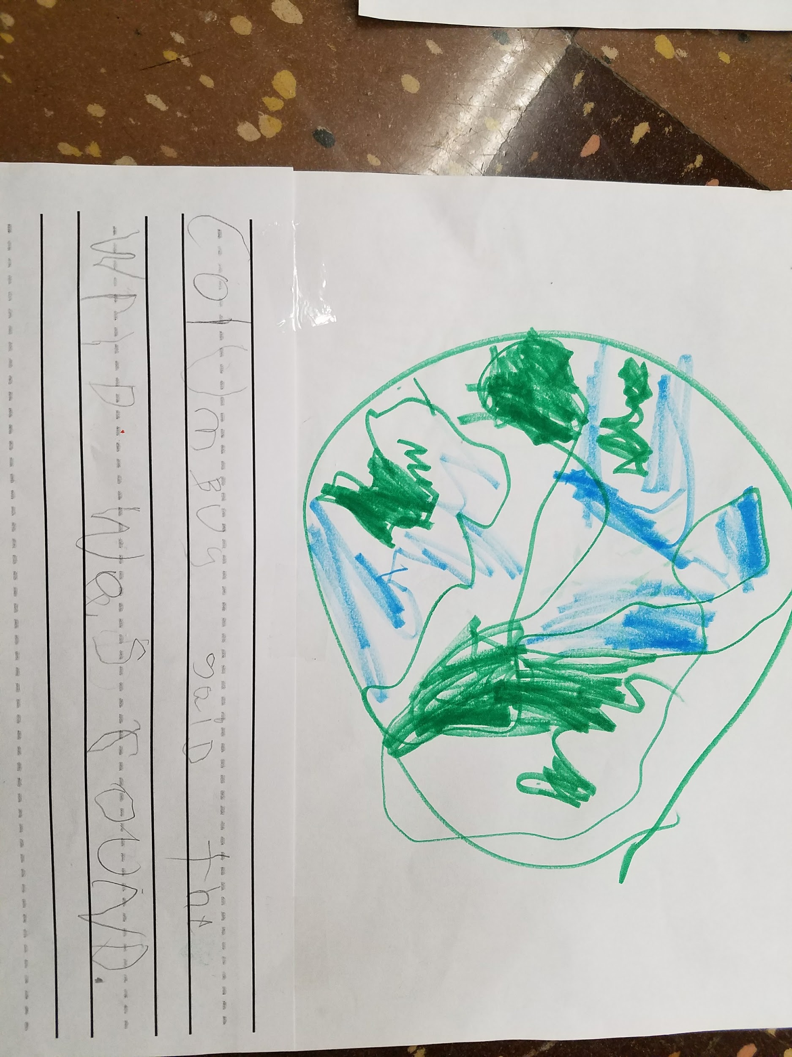
Examples of how this looks:
Kindergarten US history unit.
Review pics and writing.
Evaluation for portfolio or rubric.

Slide 16
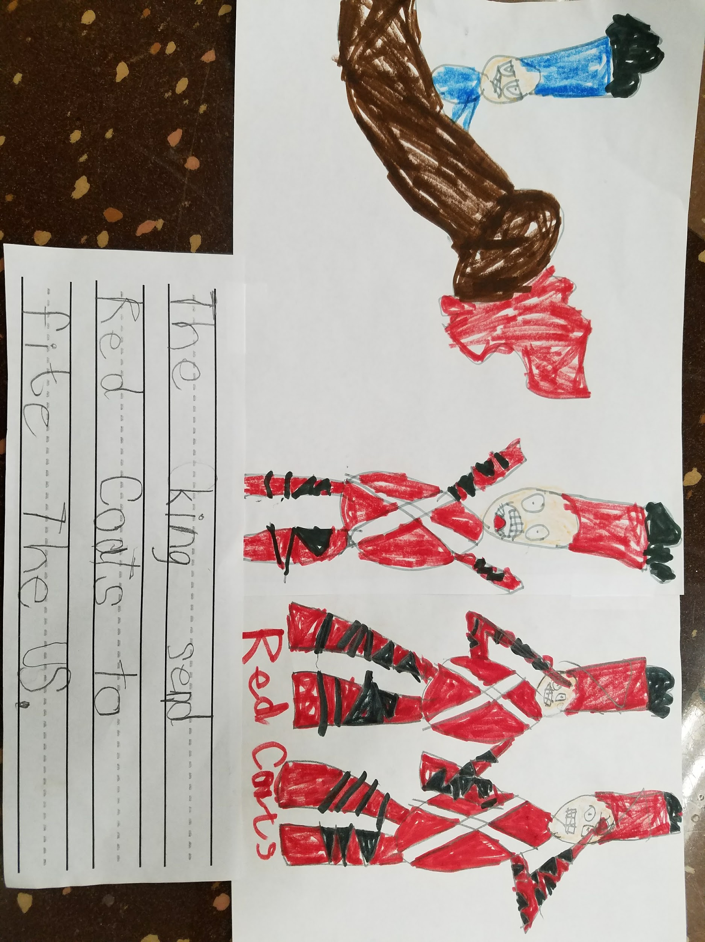
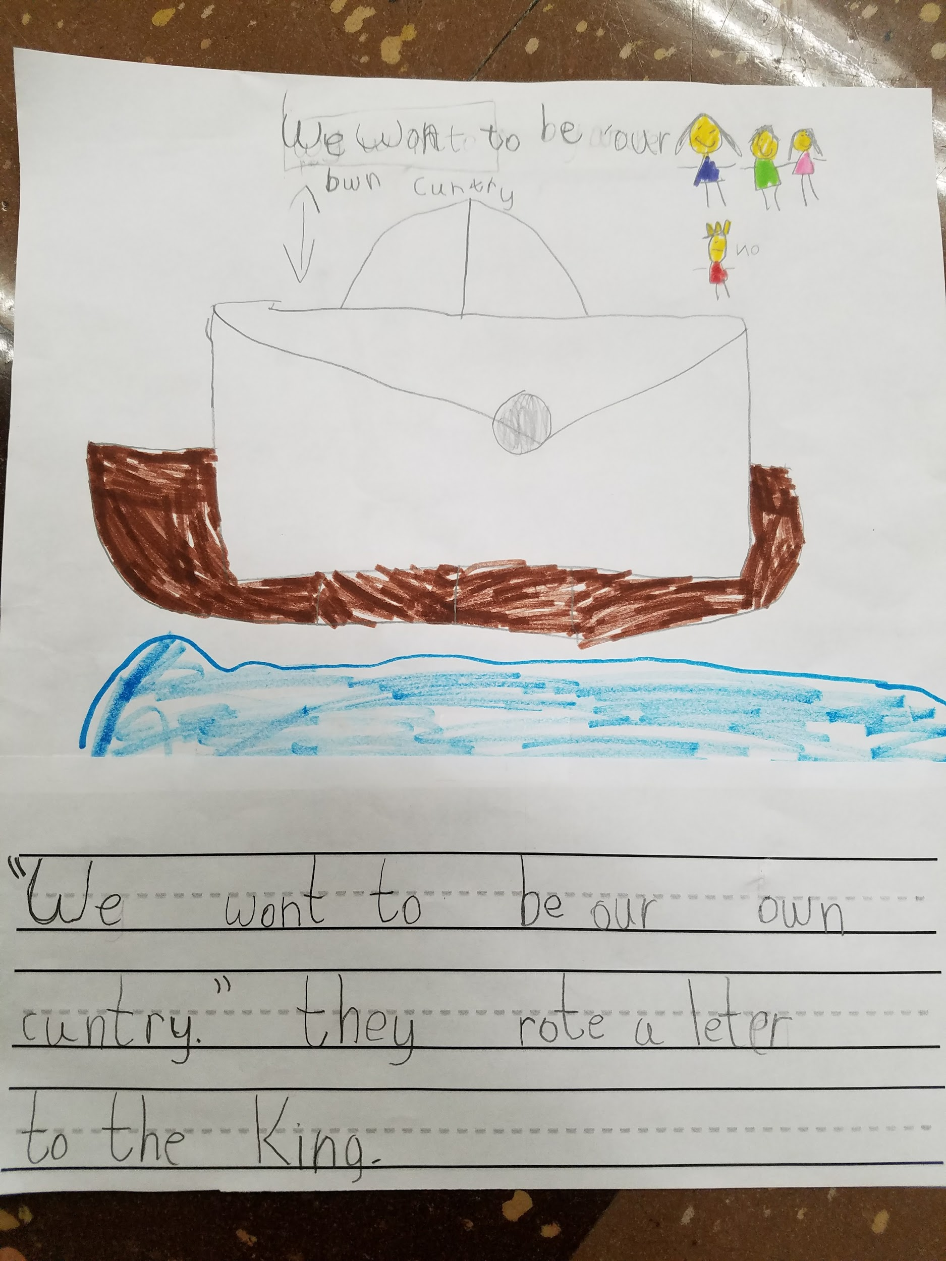

Slide 17
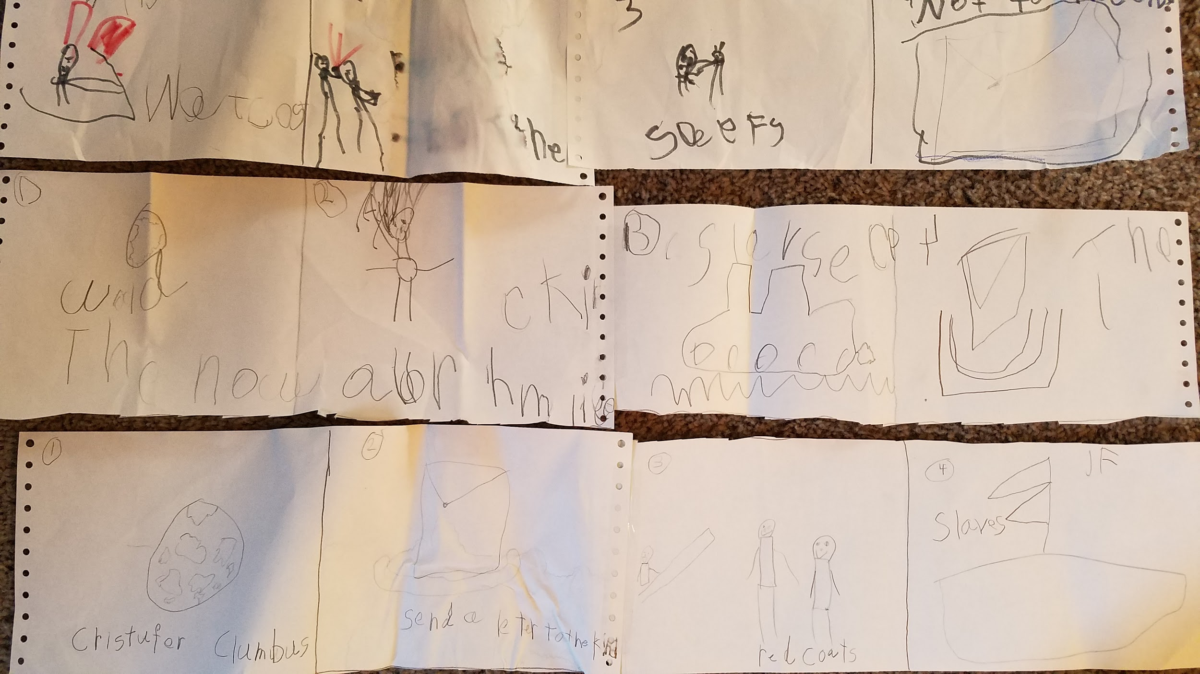
Evaluation can be done this way too

Slide 18
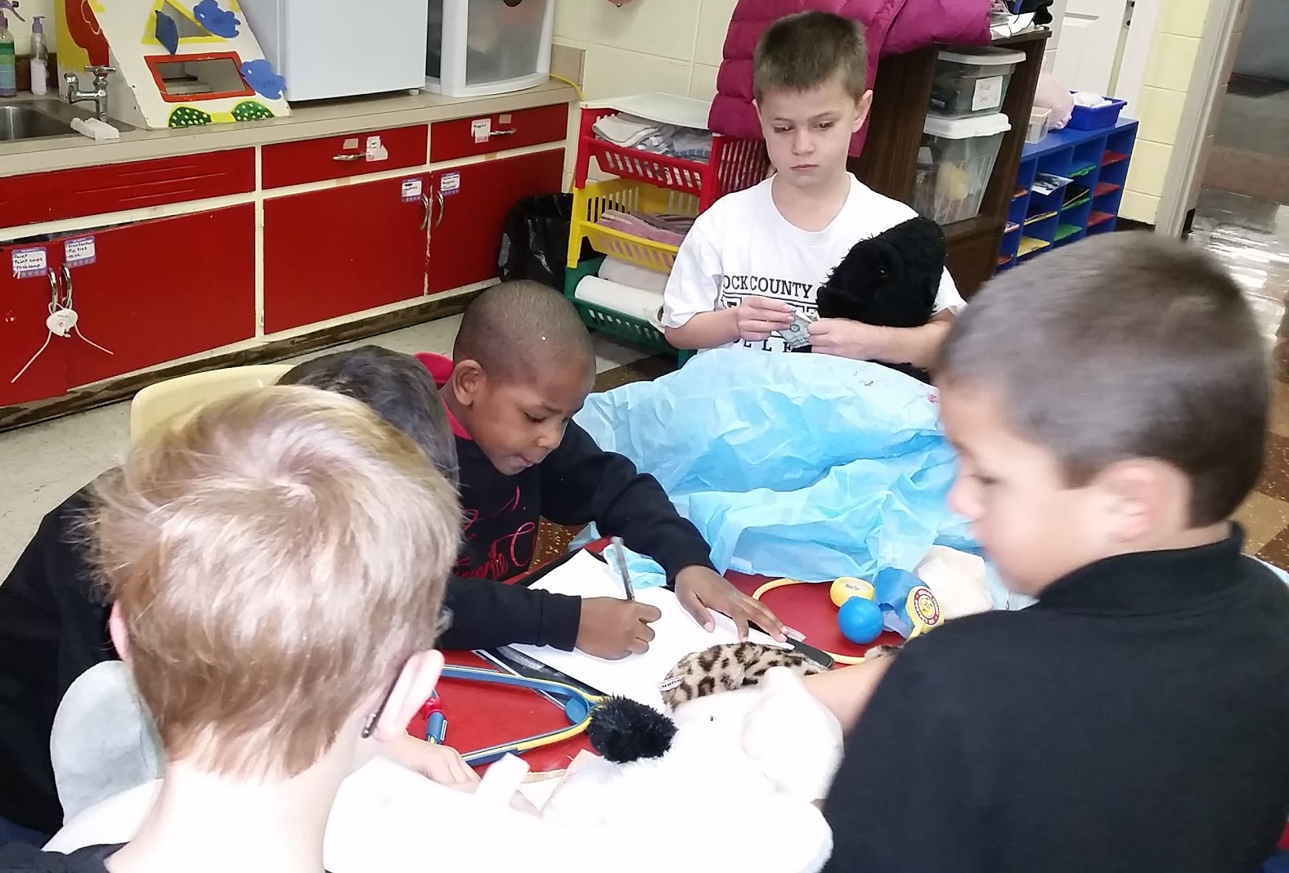
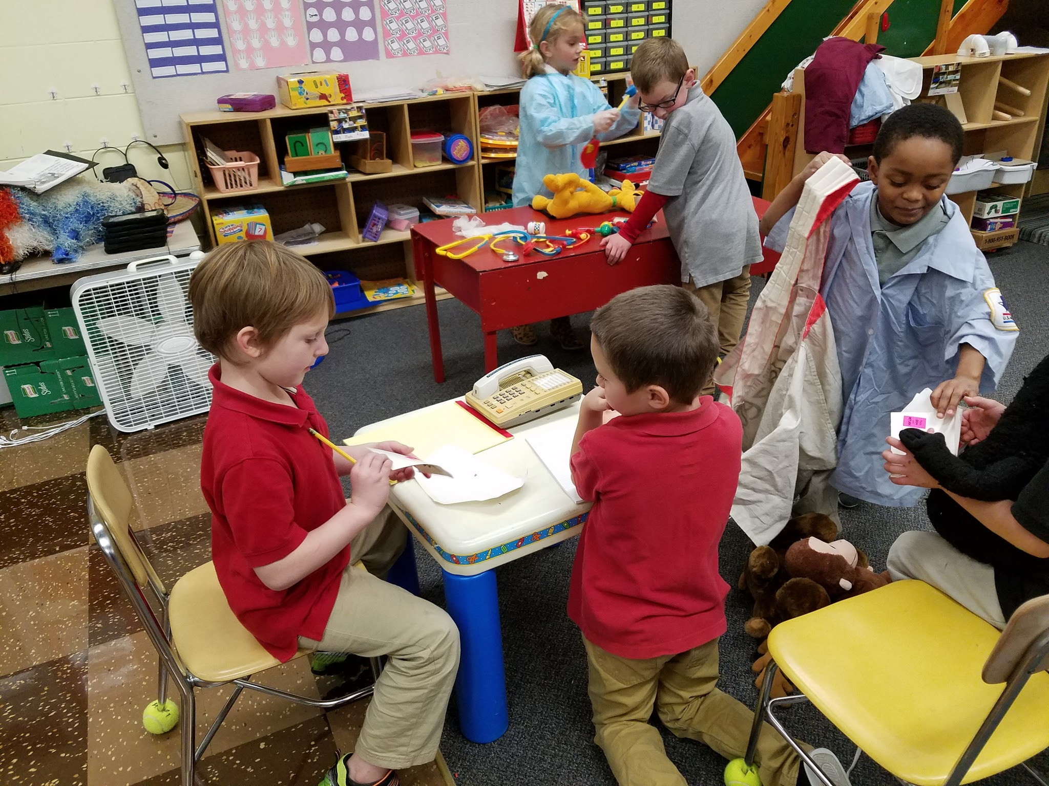
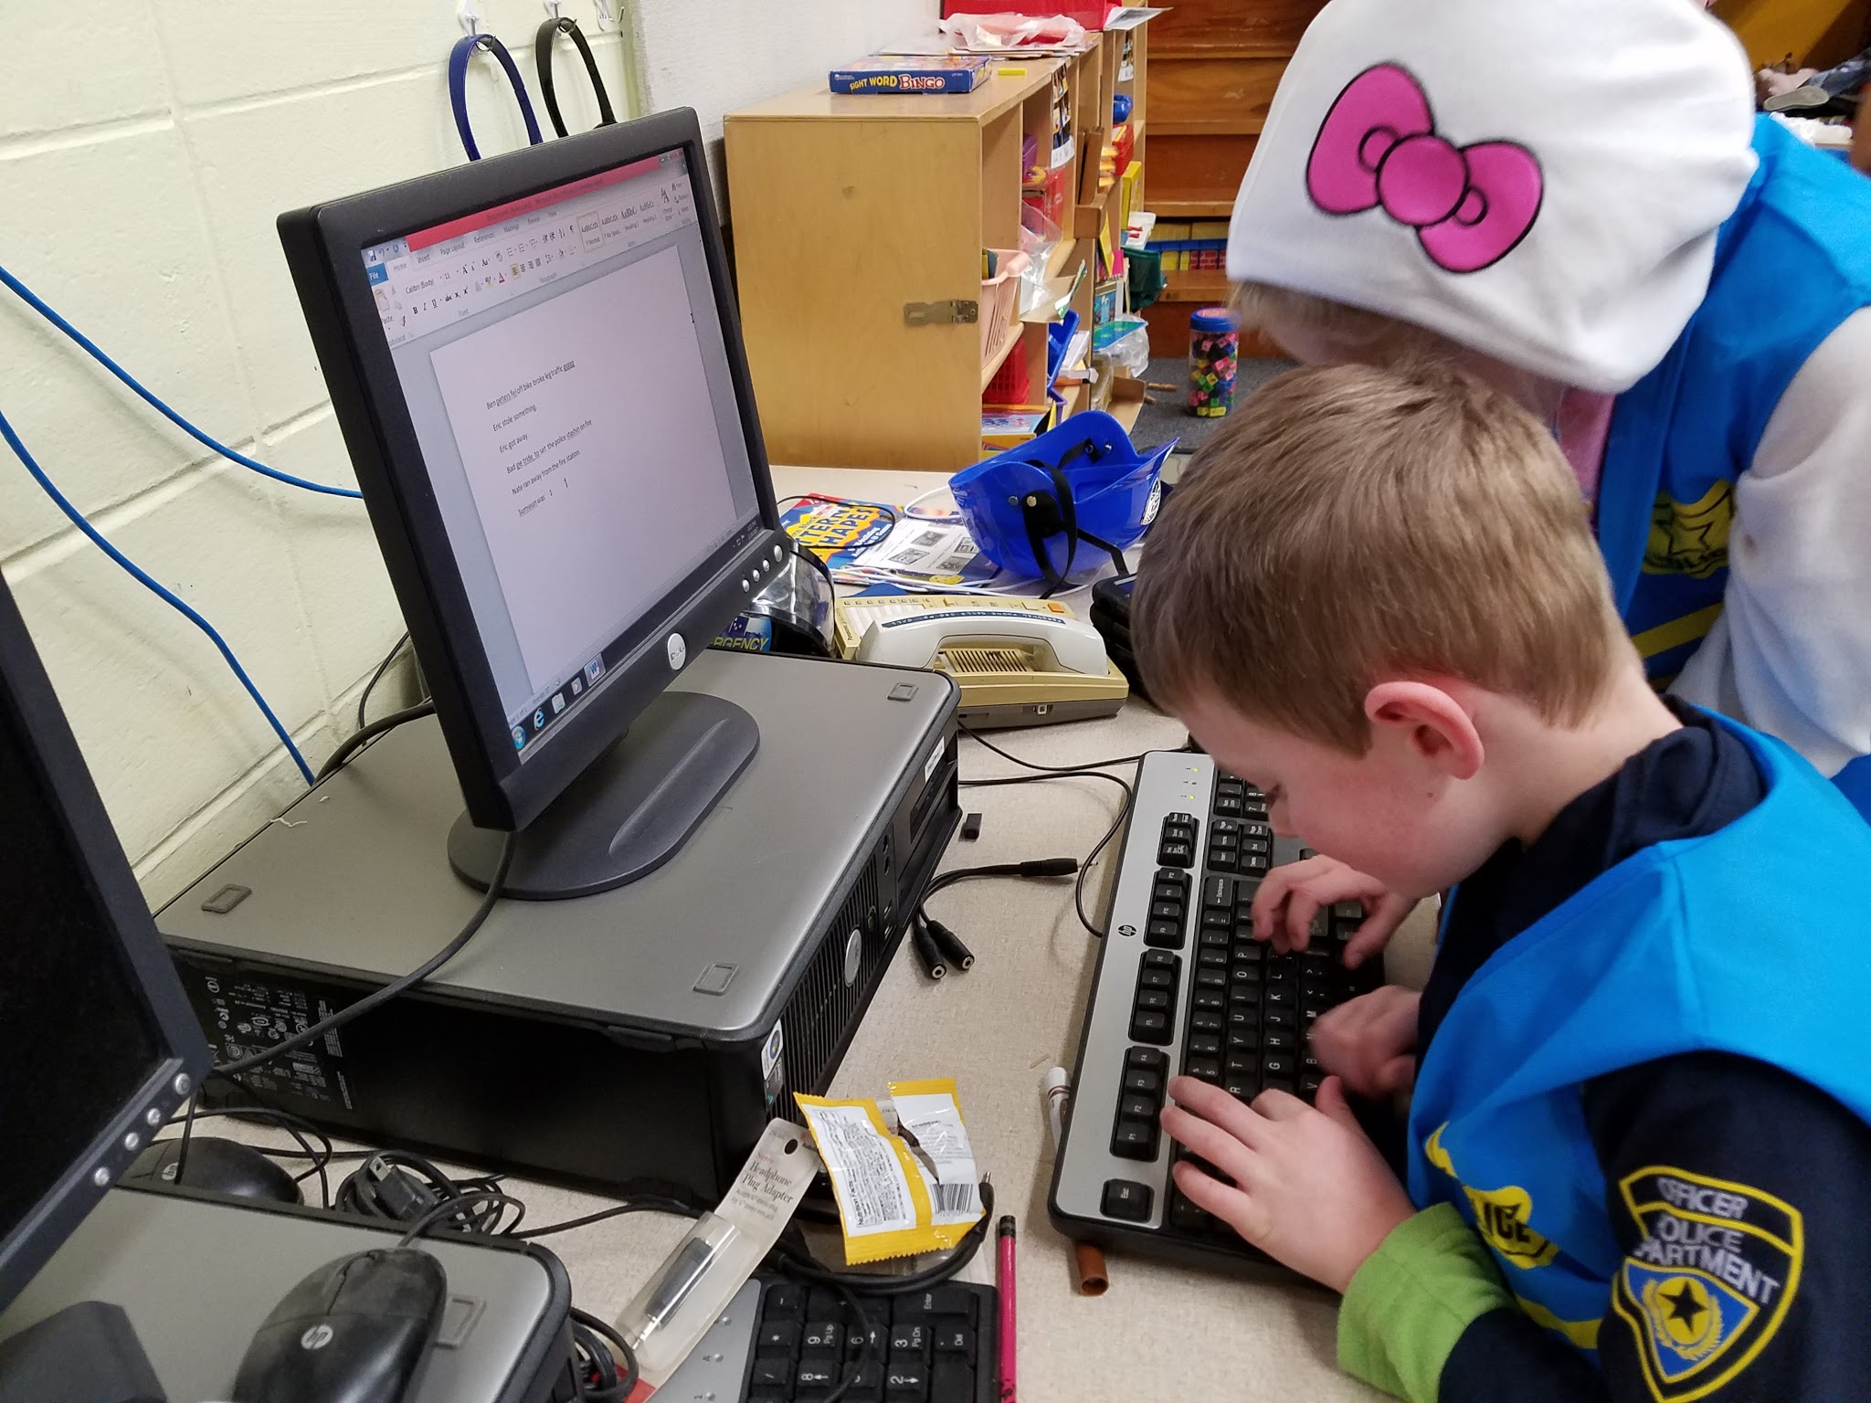
multi/cross curricular activities

Slide 19
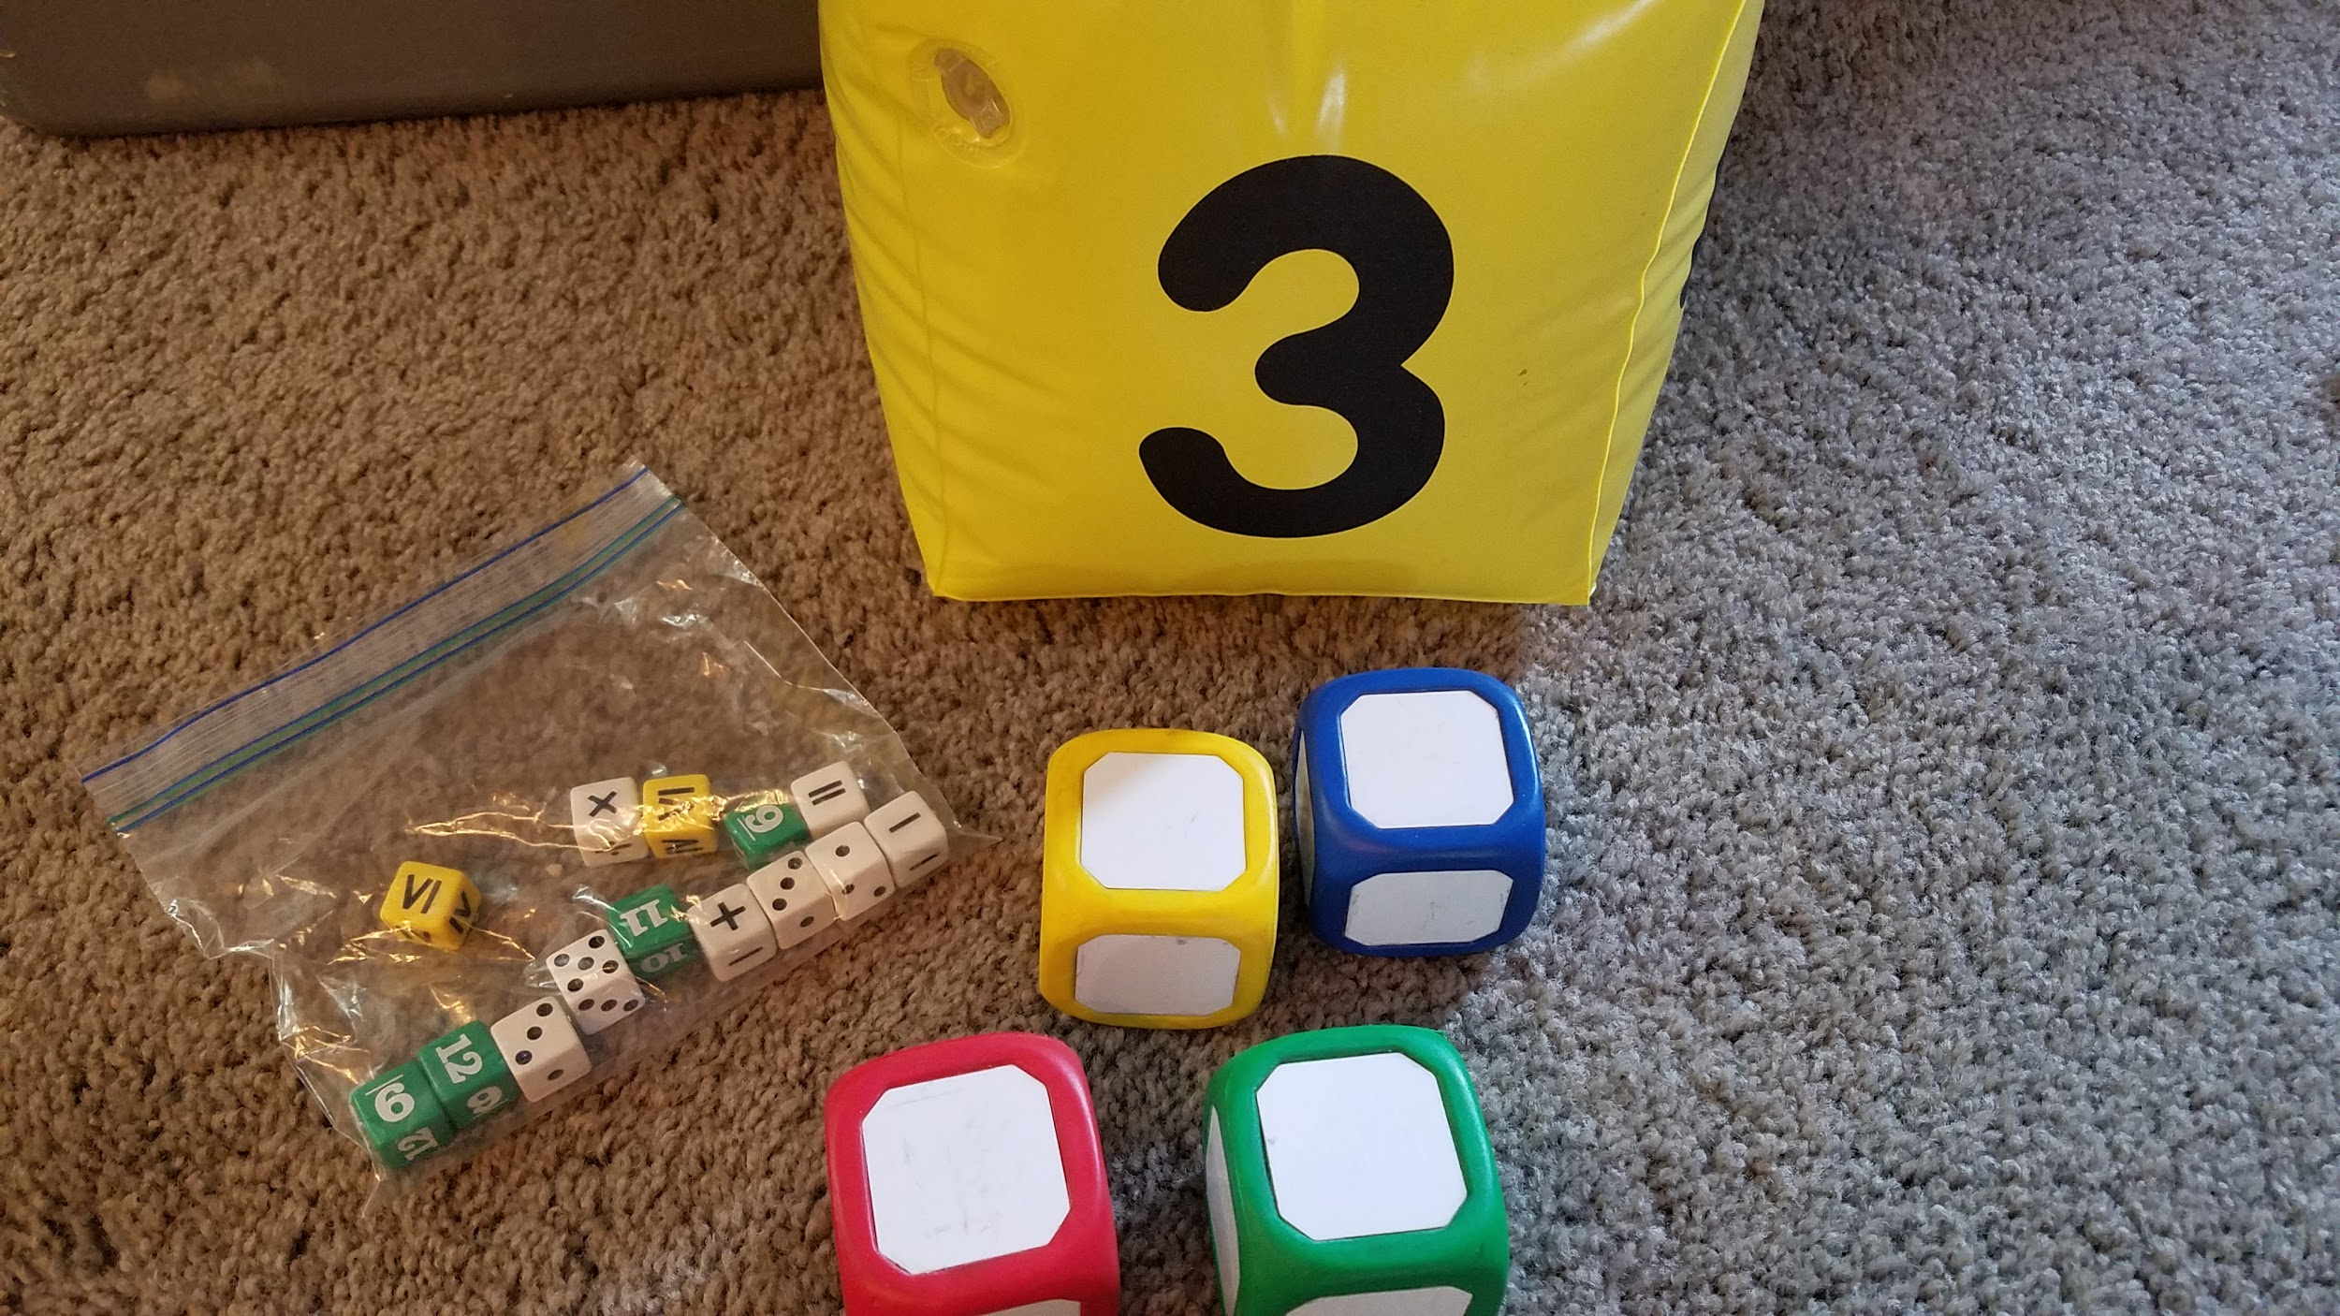
Dice for problems

Slide 20
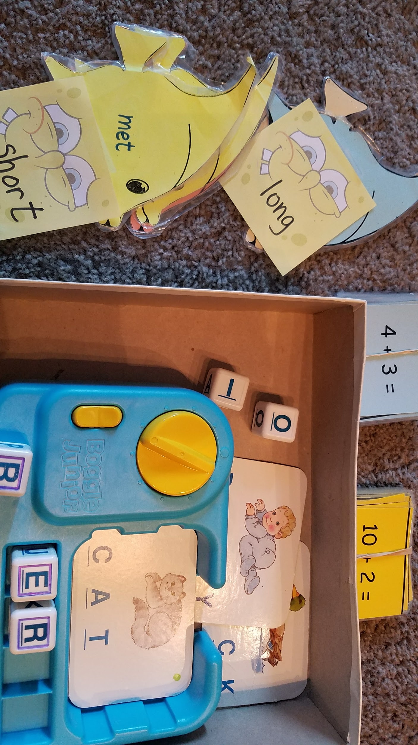
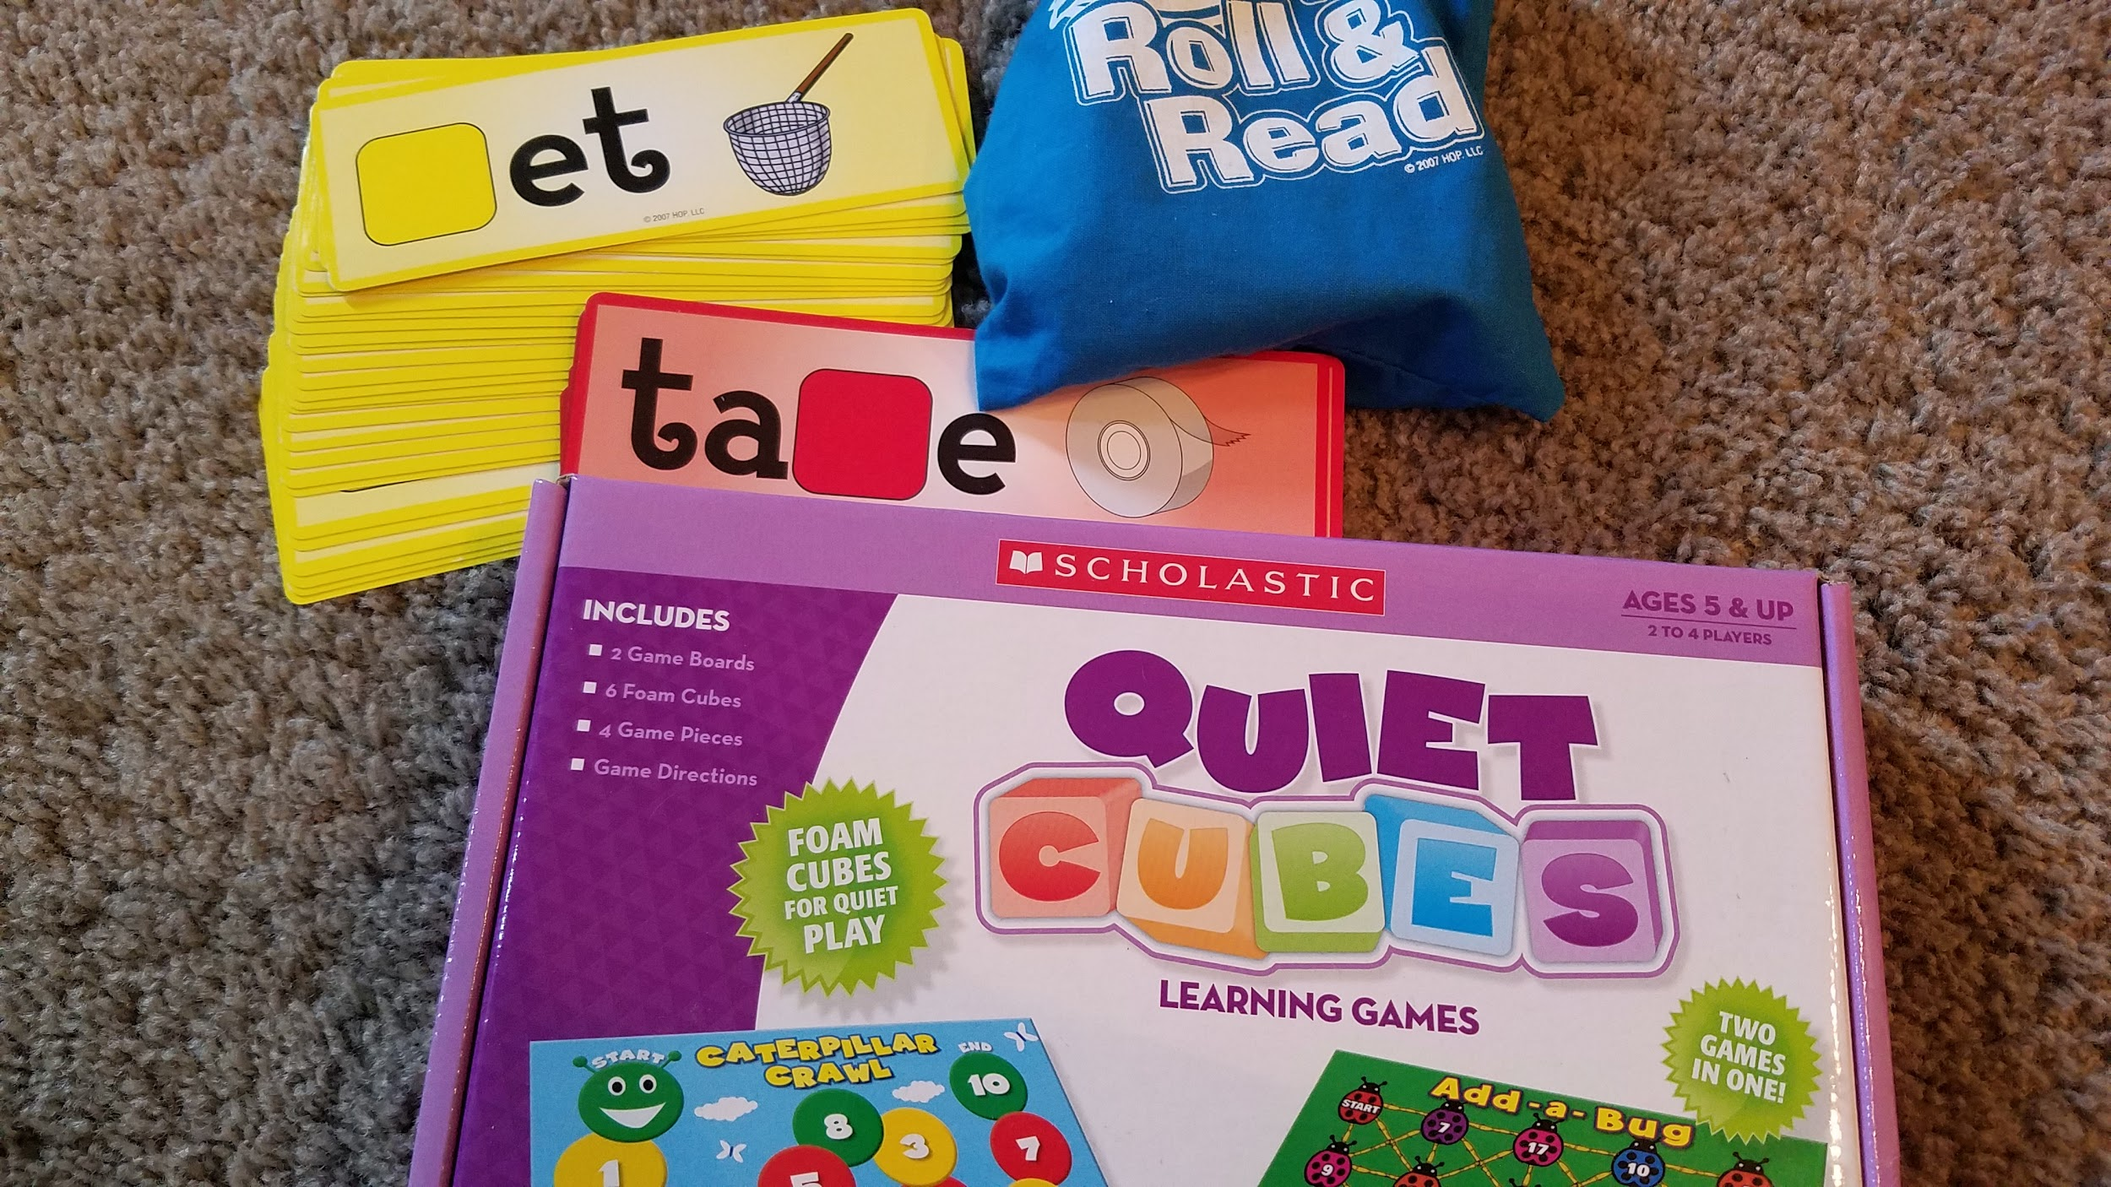
Color code activities

Slide 21
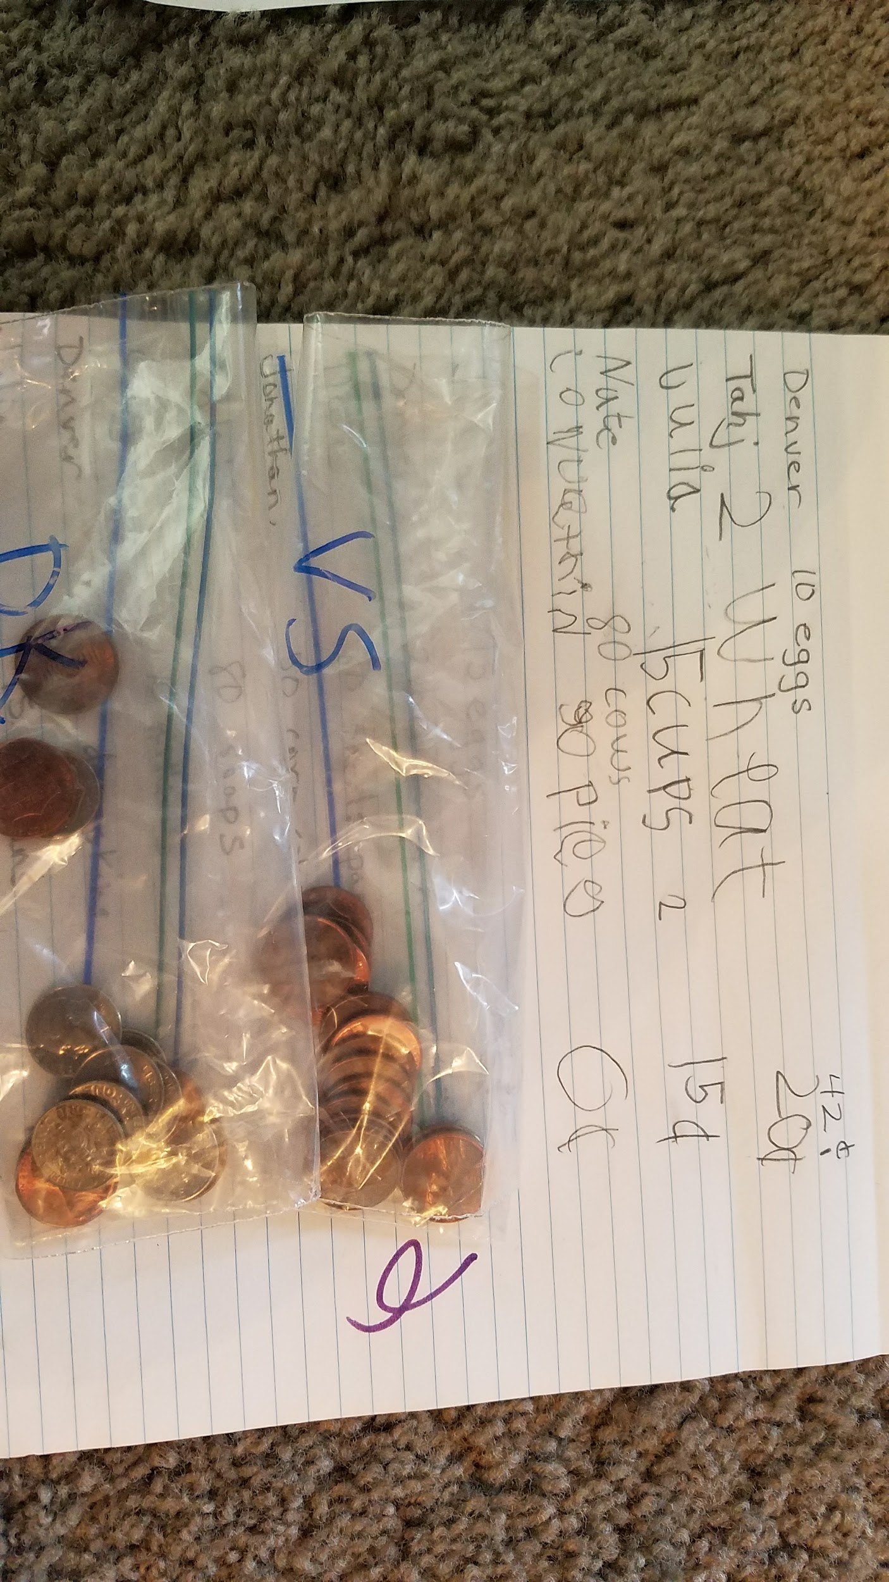
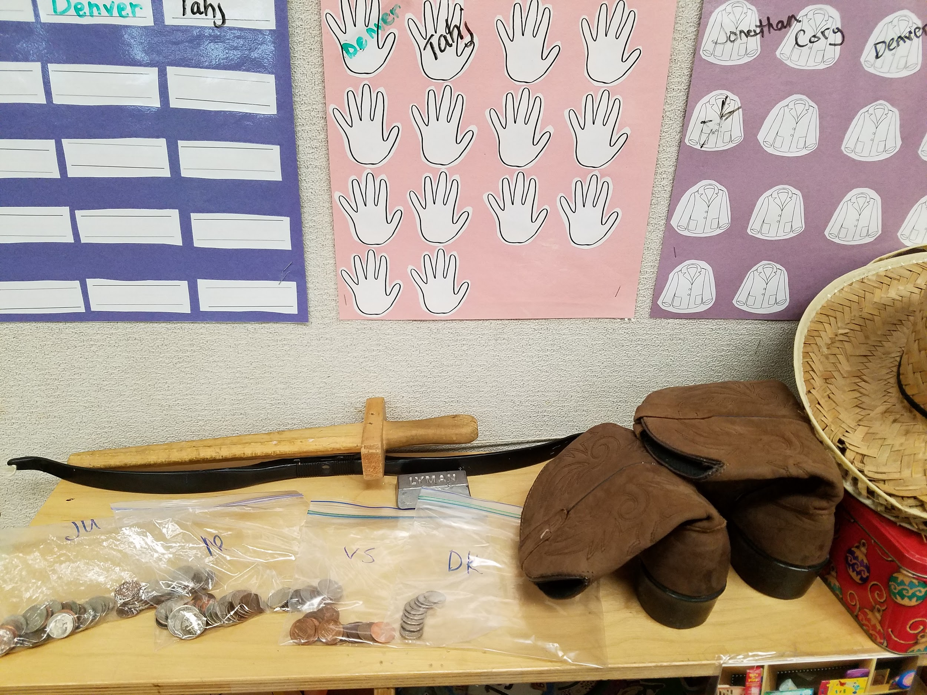
Personalized materials

Slide 22
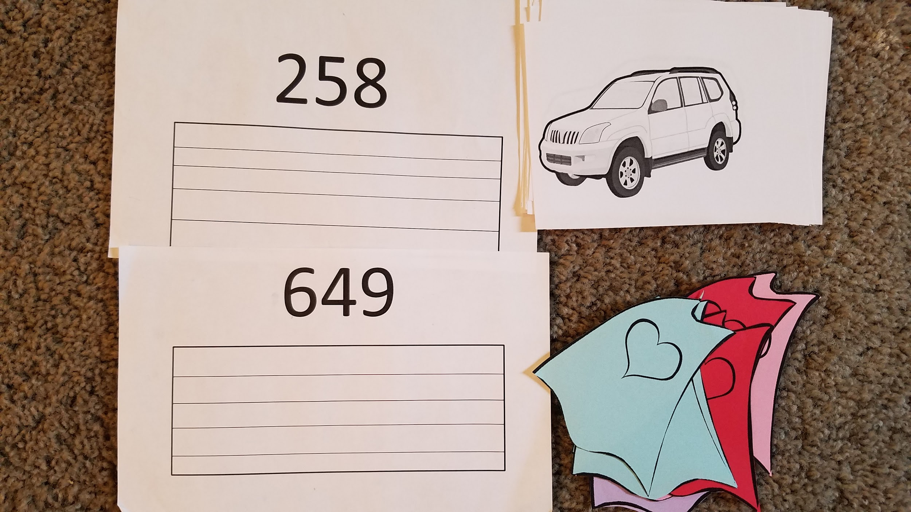
List of activities for week
E-mail
Portfolio
Folders
Notebooks
Track meet, cars superheros, interest

Slide 23
Put it together for your classroom!
Ideas from others
Get in groups of age/topic
Work together and share ideas so it’s ready for this fall.
Share something with me and I’ll share info with you :)
greglovessheri@yahoo.com

