Slide 1
Growing Leaders of Literacy

Slide 2
Hello!
Theresa Dixon
tdixon@saintcats.org Twitter: @TheresaKDixon
Rachel Lantz
rlantz@saintcats.org Twitter @Rachel_Lantz

Slide 3
Do you want to follow the presentation on your own device?
schoolyardjunkies.com

Slide 4
“Adolescents entering the adult world in the 21st century will read and write more than at any other time in human history. They will need advanced levels of literacy to perform their jobs, run their households, act as citizens, and conduct their personal lives.”
~ Richard Vacca
Notes:
Literacy is critical - we are not born knowing how - it must be learned.

Slide 5
Set a School Wide Literacy GOal.
Notes:
Rachel: Set a school wide goal

Slide 6
How do you know where your students are?
Collect Data
Reflect
Data Informed Instruction
Analyze Data
Plan
Adjust Instruction
Notes:
Rachel -

Slide 7
Triangulated Data
Self Assessment
Standardized Assessments
Classroom
Grades
Notes:
We can talk about classroom grades and standardized assessments (this is what we used to set our goal) then highlight student self-assessment.

Slide 8
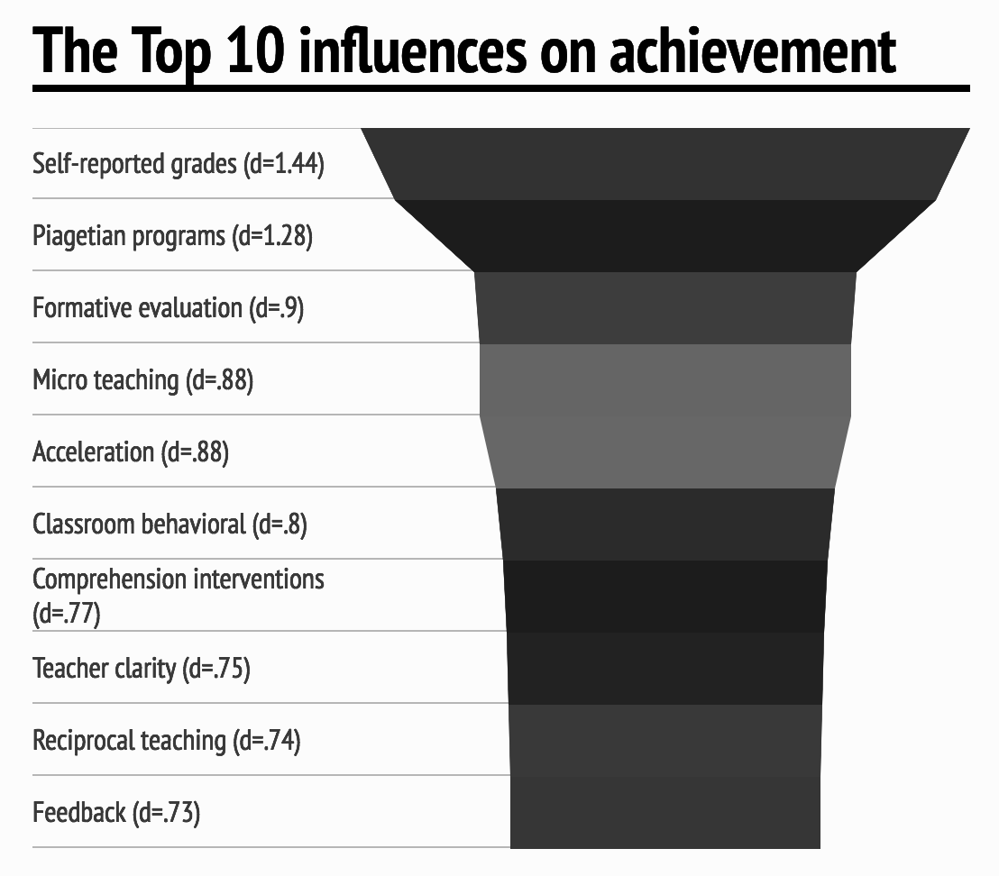
Self Assessment
https://visible-learning.org/glossary/
Place your screenshot here
Data: J. Hattie (2003, 2009) - Infographic: www.visible-learning.org
Notes:
Theresa + Video

Slide 9
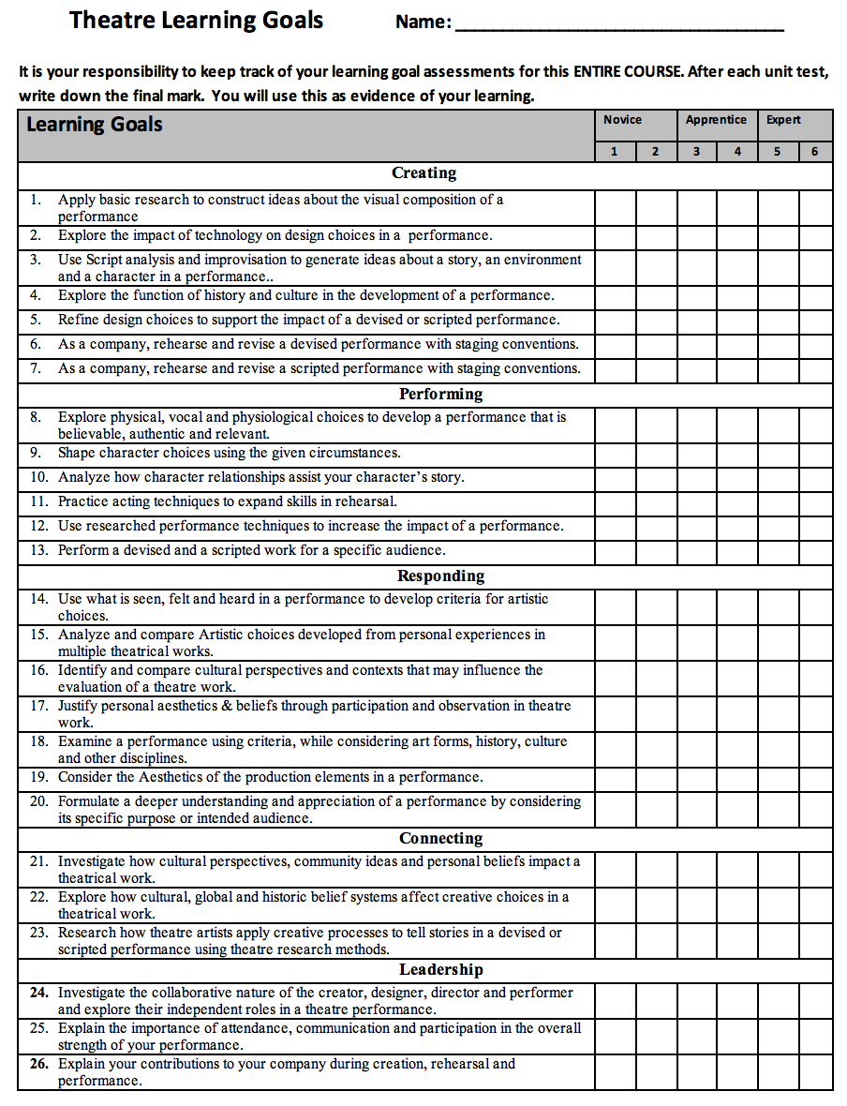
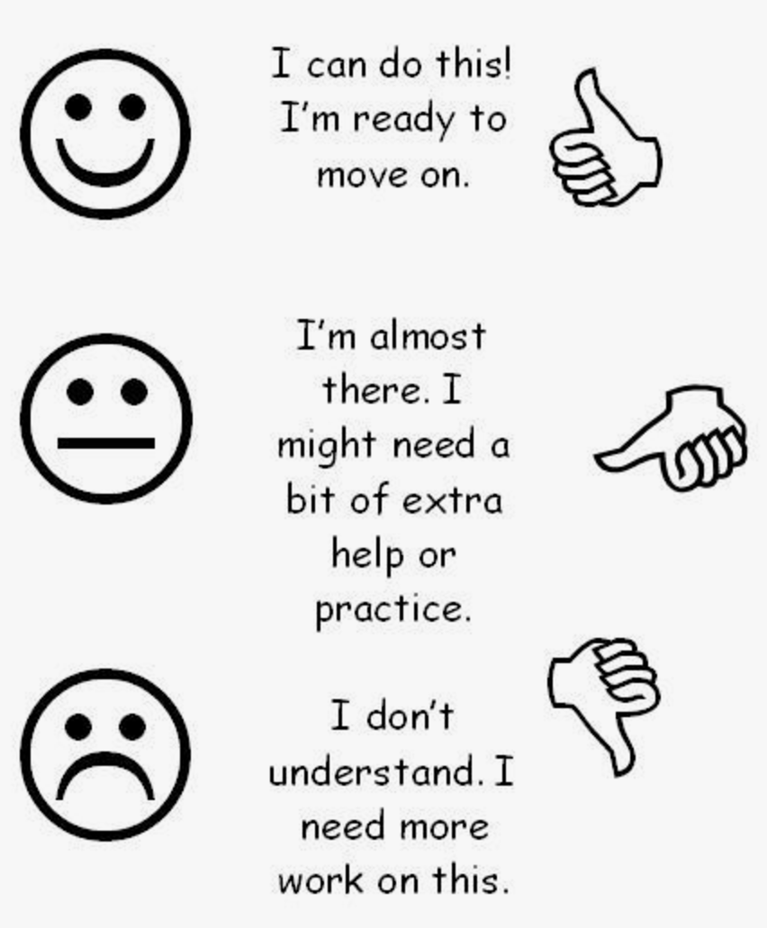
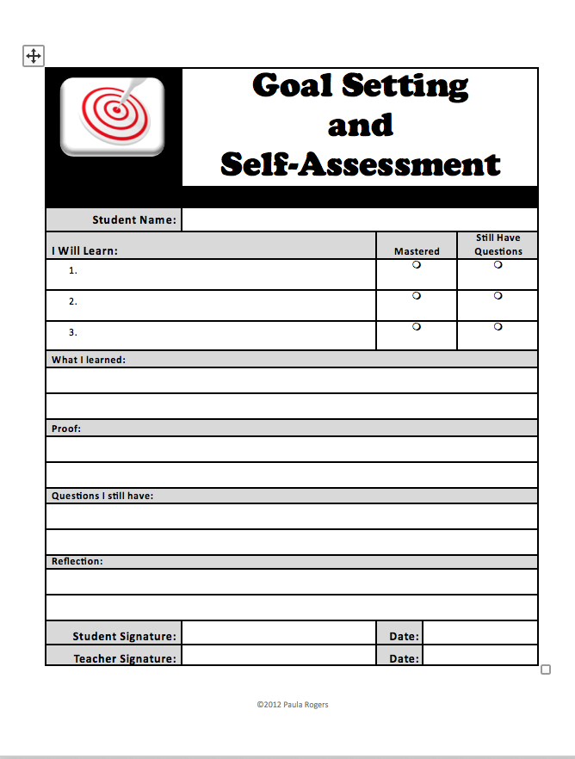
Samples of Self assessment
Notes:
Rachel - examples

Slide 10
Define what it means to be literate in every curricular Area.
Notes:
Rachel

Slide 11
Literacy Includes
Reading
Writing
Speaking
Listening
Vocabulary
Technology
What else?
Notes:
Rachel - In your content area - what do they need to know

Slide 12
Welcome to the 21st century...
Develop proficiency and fluency with the tools of technology;
Build intentional cross-cultural connections and relationships with others so to pose and solve problems collaboratively and strengthen independent thought;
Design and share information for global communities to meet a variety of purposes;
Manage, analyze, and synthesize multiple streams of simultaneous information;
Create, critique, analyze, and evaluate multimedia texts;
Attend to the ethical responsibilities required by these complex environments.
1998-2017 National Council of Teachers of English.
Notes:
Theresa

Slide 13
What does a literate student in your content area look like?
Create a literate person
Jot down your ideas
Share with a neighbor
Keep adding your new ideas
Notes:
Rachel

Slide 14
Activity
time
Create Literate People
Stand Up-Get Ready to Create
Notes:
What does the grade level standard call for? Notice the verbs. Where is meets the standard? (Regardless of the scale you use.)

Slide 15
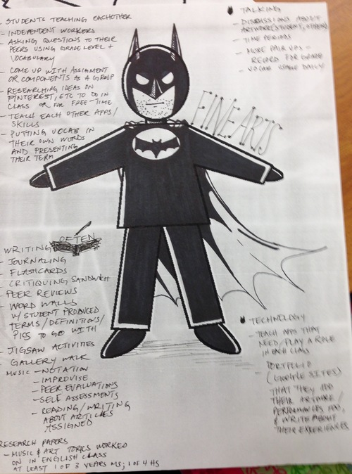
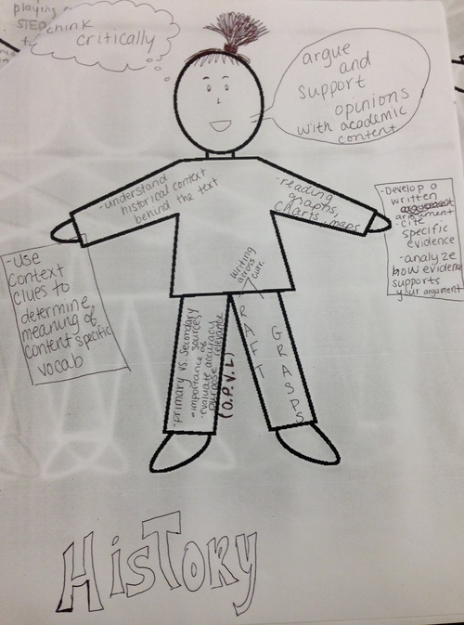
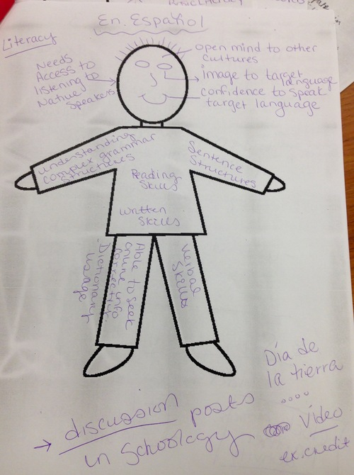
Notes:
Exemplars from our faculty...

Slide 16
Adopt Strategies that work.

Slide 17
Marzano Thinking taxonomy
Myron Dueck Thinking….
Useful Verbs
Level 4
Level 3
Produce
Level 2
Demonstrate
Level 1
Reason
Know
Analysis
Knowledge
Utalization
Comprehension
Retrieval
Thinking Processes
Notes:
This is what we keep hearing and seeing in the educational world. Marzano Sheets…
Rachel: Tell the story about final exams.

Slide 18
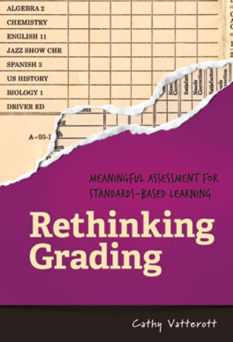
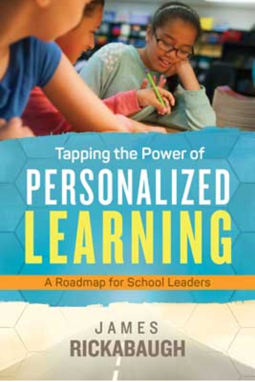
For a Global Society, Students need...
Application
Creativity
Competencies
Notes:
Theresa - Have you drank the Kool Aid yet?

Slide 19
Proficiency Scales
How do we do that?
Breaks down a standard into smaller and more specific skills and abilities.
Notes:
Rachel

Slide 20
Build A Proficiency Scale
4
3
2
1
0
Success with more complex content
Mastery of learning goal
Success with less complex Skills / Content
Vocabulary &
Foundational Skills
Partial Success with Help
No Success With help
Notes:
Theresa

Slide 21
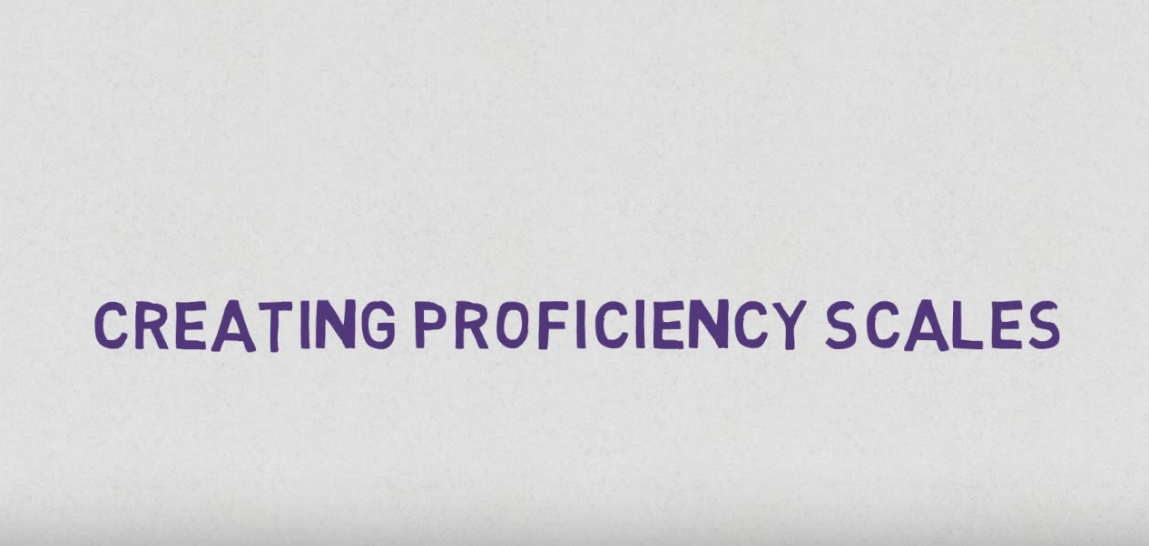
Place your screenshot here
Let’s Review
Notes:
Rachel - Review

Slide 22
Activity
time
Build a Proficiency Scale
Stand Up and Get Ready to Build
Notes:
Take a look at the level…
Compare your standard to the Marzano sheet - what is required to meet the standard - level 3
On the Analysis side - fill in the margins… what would your students have to know or be able to do?
Build your 2 - what foundation did they need?
1 & 0 is all about help
4 - here is the opportunity to go up the thinking scale...

Slide 23
Let’s turn to the expert!
Even easier…
Marzano did some of the hard work!
Place your screenshot here
Notes:
Rachel log in and show an example. English Language Arts, Reading, Common Core, Grade 6

Slide 24
Content Standards & Performance Standards
Incorporate Content Standards and define the level of work that demonstrates achievement of the standards.
Performance standards isolate and identify skills needed for problem-solving, reasoning, communicating, and making connections with other information.
They provide all constituents with the evidences that students have met the content standards, helping teachers define what level of work is satisfactory.
Notes:
Theresa - “But I love my content…”

Slide 25
Choice and Voice
Place your screenshot here
Notes:
2nd strategy! Don’t be afraid of giving kids choice and voice & here is why...

Slide 26
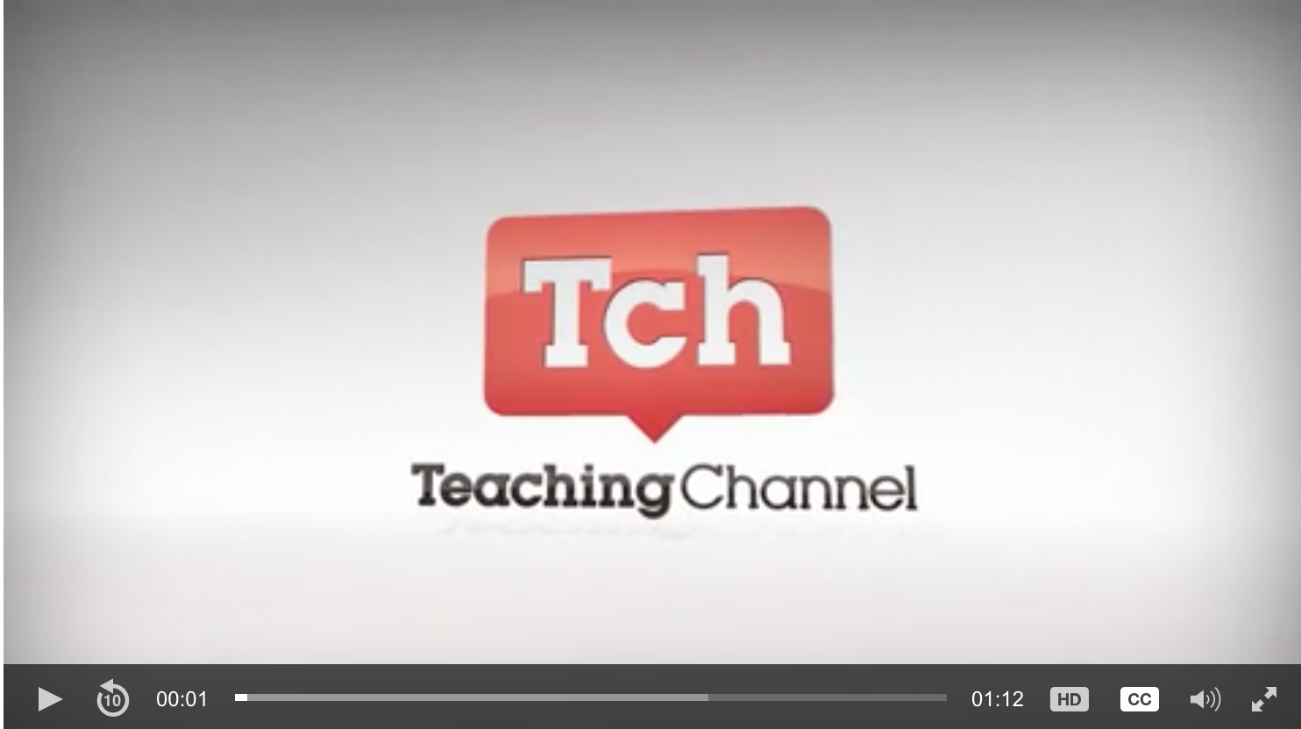
share learning objectives
Notes:
Theresa - How do we prevent going the wrong way? You have done the hard work and the students are aware.

Slide 27
Build Literacy Capacity.
Notes:
Grow your teachers!

Slide 28
Tear down the silos
Develop whole-staff involvement in a process of intensive reflection
Focus on instructional practices
Know the desired student benchmarks
Monitor outcomes to ensure success
Notes:
Rachel - Get people talking inside you building. Tell the story of 1 day overpaid...

Slide 29
How do you know where your students are?
Collect Data
Reflect
Data Informed Instruction
Analyze Data
Plan
Adjust Instruction
Notes:
Rachel

Slide 30
Find your Tribe
Notes:
Theresa - Let’s take the show on the road...

Slide 31
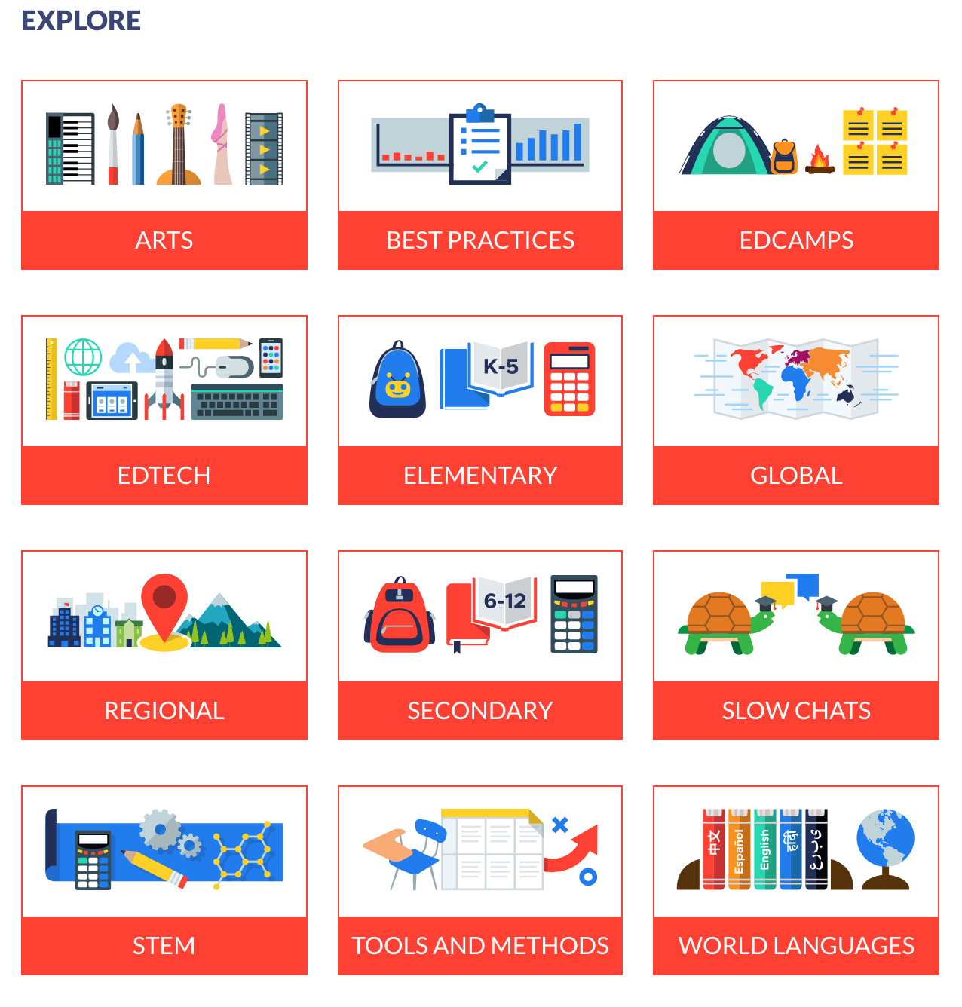
What are you interested in?

Slide 32
How to Chat
Follow the hashtag #SchoolYardJunkies
Use a site: Tweetdeck.com and Tweetchat.com
Introduce yourself
Answer Questions after Introductions (A1 or A2 etc.)
Engage with Others
Be Courteous
Share Your Ideas & Follow Others

Slide 33
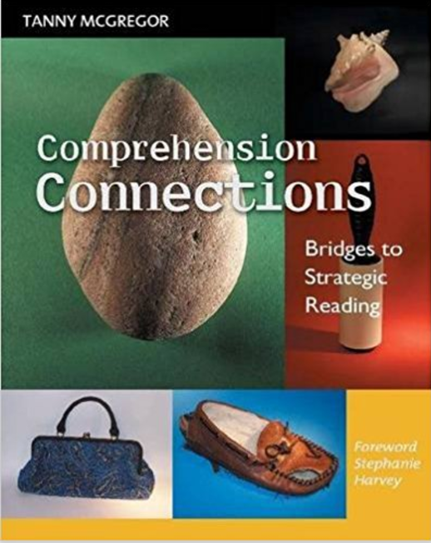
Read a good book
Notes:
The third way to grow capacity - READ of course!

Slide 34
Setting Goals with Students
Notes:
Finally, once we have the school wide goal, the knowledge, the strategies, and the capacity, we can set goals with our students.

Slide 35
“ The most successful students are those who feel real “ownership” of their education. In all the best performing school systems… “students feel they personally can make a difference in their own outcomes and that education will make a difference for their future.”
~ Uncommon Learning
Notes:
Read quote.

Slide 36
Notes:
Why should we plan and set goals with students? They know what the proficiency scales are asking them to do, but you still planned it.

Slide 37
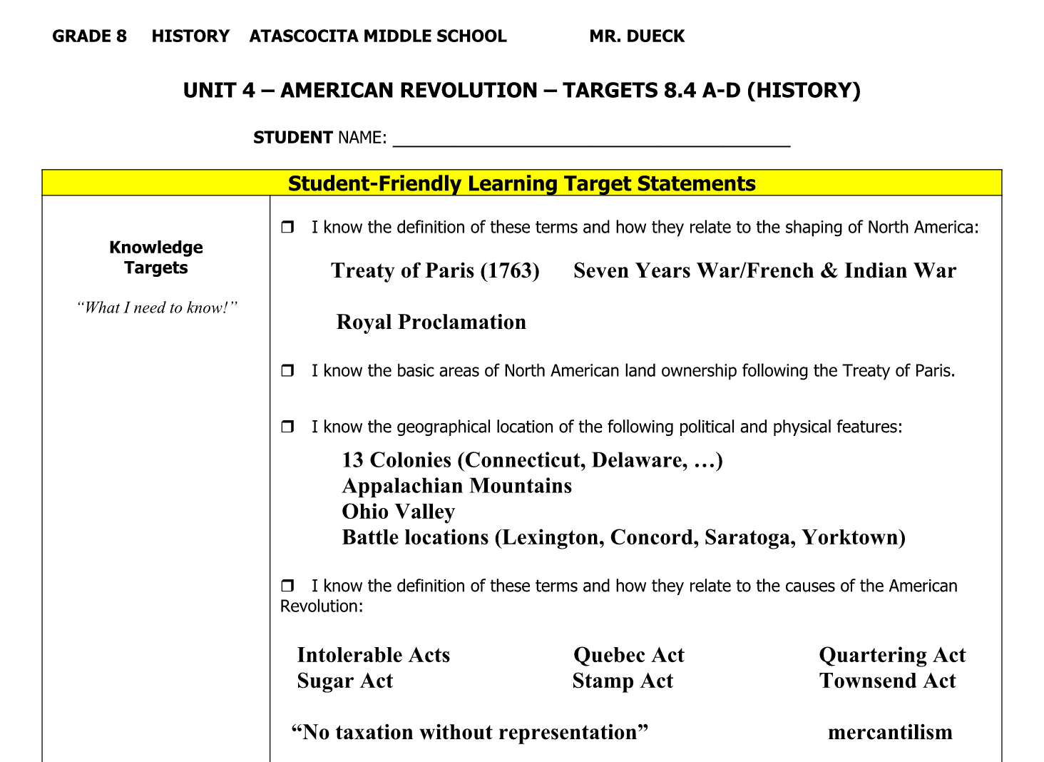
Self Reporting Assessment Readiness
Notes:
Theresa

Slide 38
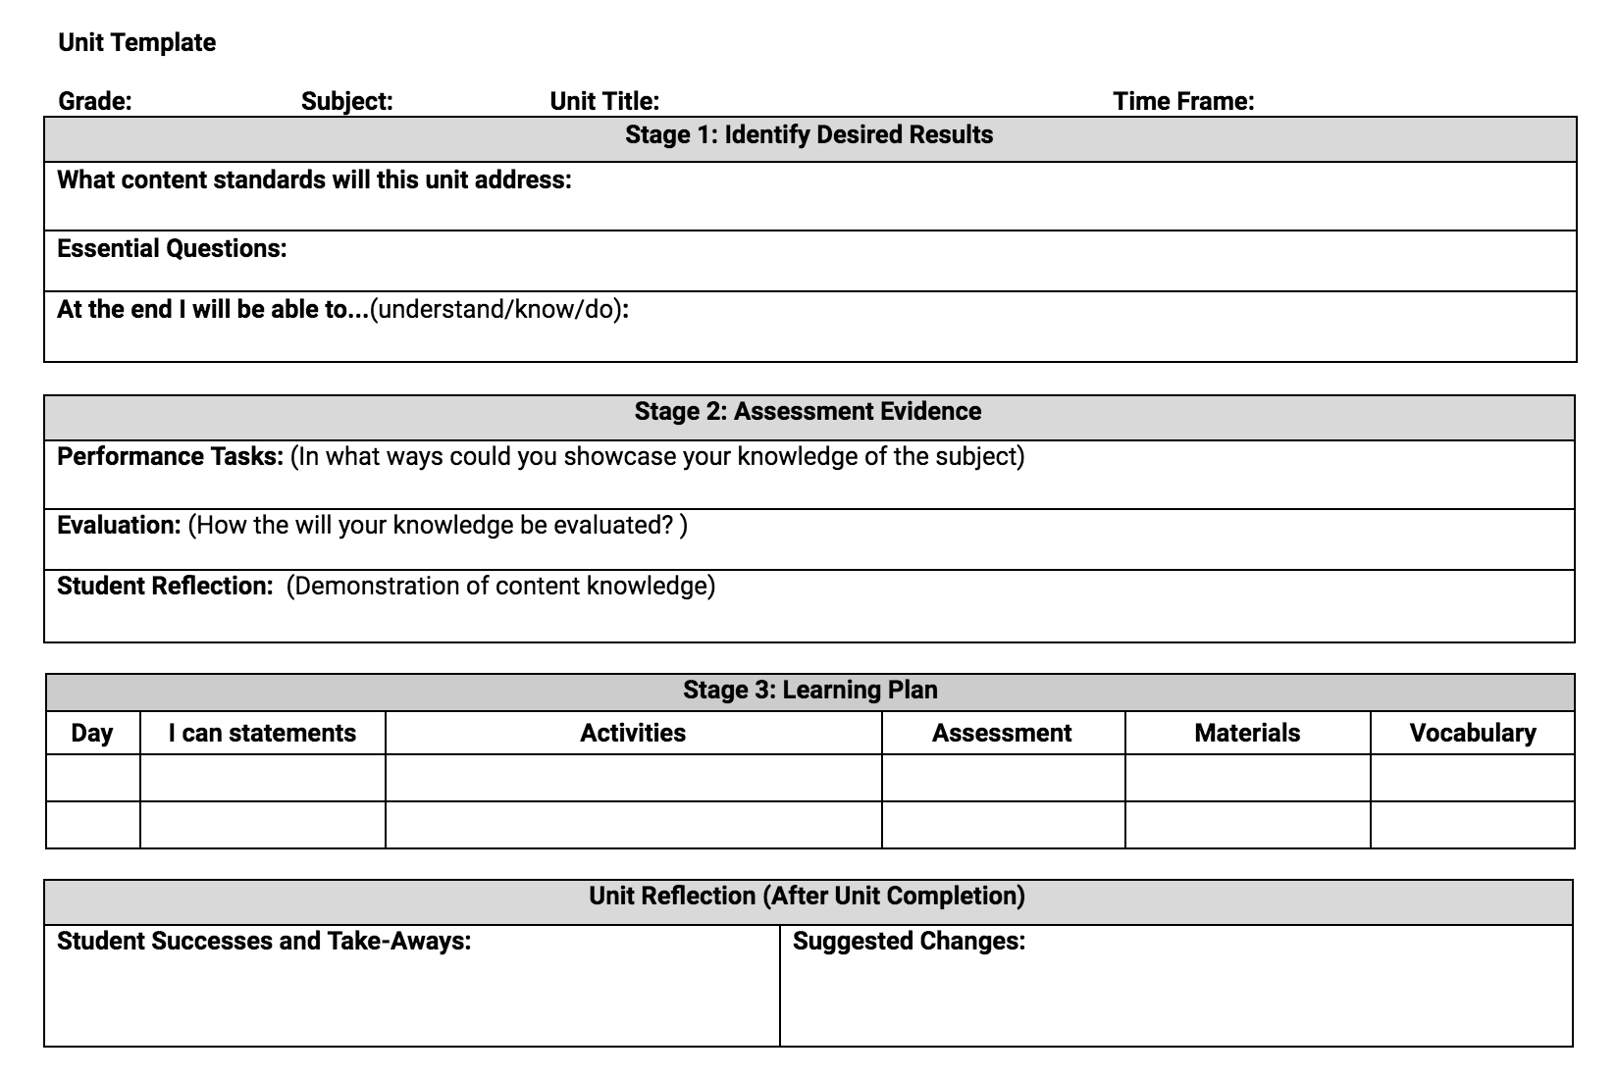
Student
Created
Unit … Pair
Content &
Skill Standards
Notes:
Theresa

Slide 39
THANKS!
Any questions?

