Slide 1
Full S.T.R.E.A.M. Ahead!
Presented by the Notre Dame Senior
TRUSTEY STEM Fellows

Slide 2
Meet the Fellows
Anneleisa Gruber – Middle School Science Teacher Assumption Catholic School, Durand, WI misgruber@gmail.com
Shirley Stoltz – Middle School Science Teacher
St. Mary School in Richland Center, WI shirley.stoltz@stmarysrc.com
Mary Cooper – 5th grade Teacher
St. Mary School in Richland Center, WI mary.cooper@stmarysrc.com

Slide 3
What is S.T.R.E.A.M.?
S.T.R.E.A.M. is the integration of all disciplines into a given activity.
S – Science
T – Technology
R – Religion
E – Engineering
A – Arts, Music, Dance, Language Arts etc.
M - Math

Slide 4
Monarch iMovie
This movie was designed by the St. Mary School 8th grade students in Richland Center, Wisconsin

Slide 6
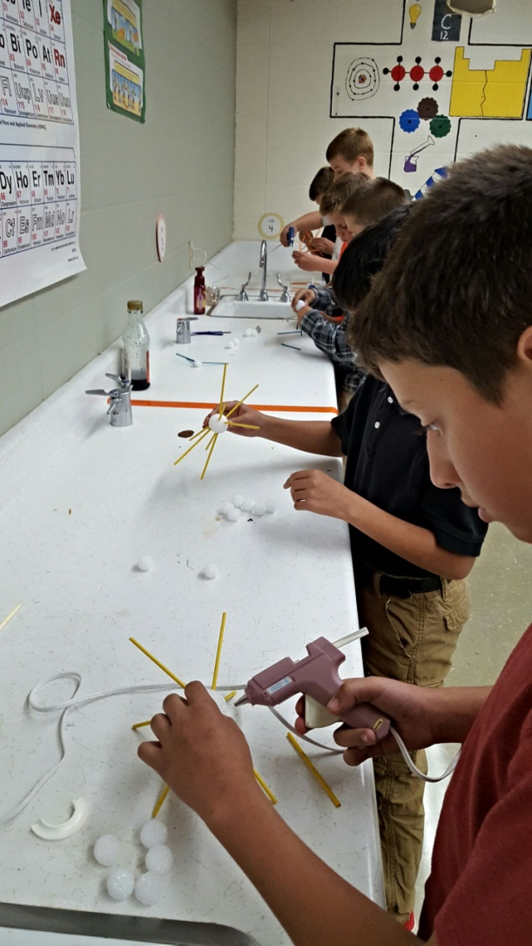
Engineering Design Process
Identify the problem
Investigate
Imagine
Plan
Create
Test
Improve
Communicate

Slide 7
Engineering Design Process and Mini Breakout Sessions
Garden/Pea Shoots with Shirley Stoltz
Monarchs with Mary Cooper
Biodegradable Cars with Anneleisa Gruber

Slide 8
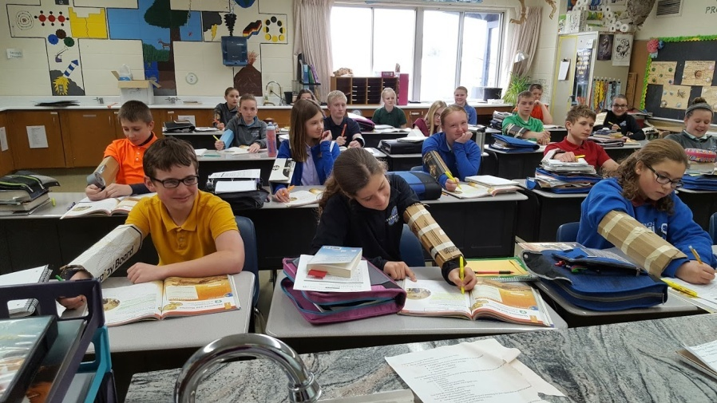
What is it?
The TRUSTEY Family STEM Teaching Fellows is a unique and competitive program that seeks school-based teams of three to five STEM teachers from the middle grades (grades 5 – 8) who desire to change STEM education in their schools and communities.

Slide 9
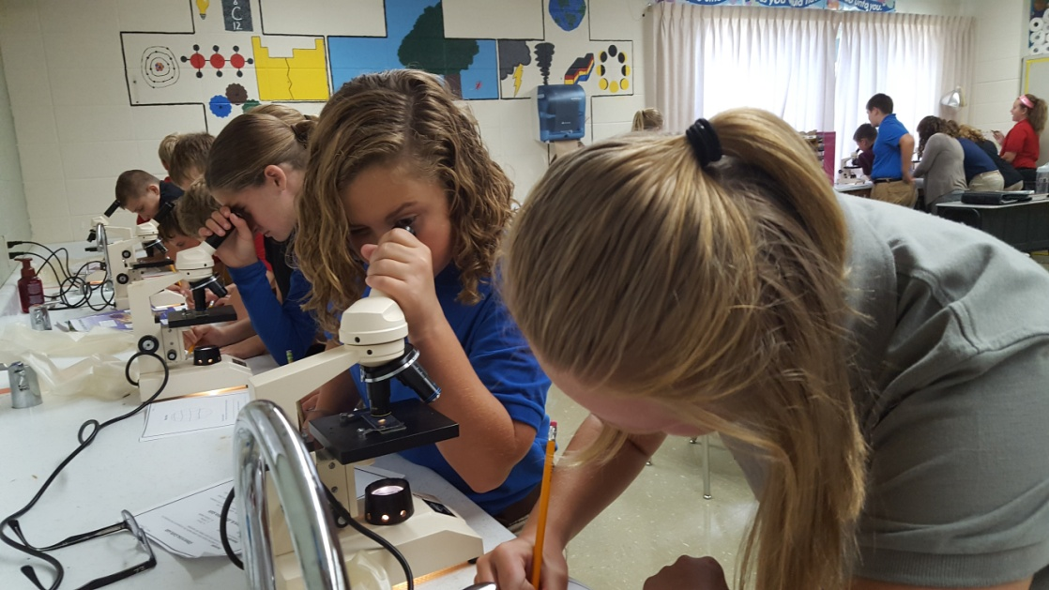
What are the requirements?
Fellows attend three summer institutes at the University of Notre Dame and engage in school-year activities focused on increasing student interest in, identity with, and learning of the STEM disciplines.

Slide 10
Why should I apply?
Extensive professional development in STEM integration and teaching practices.
A national community of STEM educators
Content-specific coaching
100 hours/year of professional development
Paid travel, lodging, and meals for summer institutes and mid-year summits.
$6000 stipend over a three-year Fellowship

Slide 11
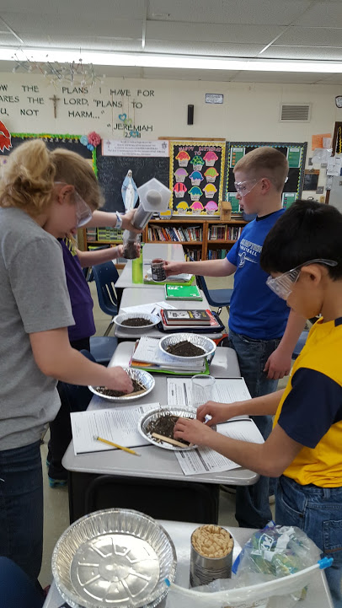
Who are they looking for?
Teachers passionate about improving STEM education for all children
Teachers of the STEM disciplines
Teaching grades 5th – 8th
School-based teams of 3 – 5 teachers

Slide 12
How to apply
https://stemeducation.nd.edu/trustey
Email: stemeduc@nd.edu
Phone: 574-631-1131
Check us out on Twitter @ STEMatND

Slide 13
Any Questions?
All presentation materials will also be posted on the WCRIS website.
Our session title was “Full S.T.R.E.A.M. Ahead”
Thank you for joining us today!

