Slide 1
Technology and Reinventing K-12 Education
Susan Patrick
President & CEO
International Association for K-12 Online Learning

Slide 2
What is the Appropriate Role of Technology in Reinventing K-12 Education?
“Technology is intervention by design: the use of practical and intellectual resources to develop products and systems (technological outcomes) that expand human possibilities by addressing needs and realizing opportunities. Adaptation and innovation are at the heart of technological practice.”

Slide 3
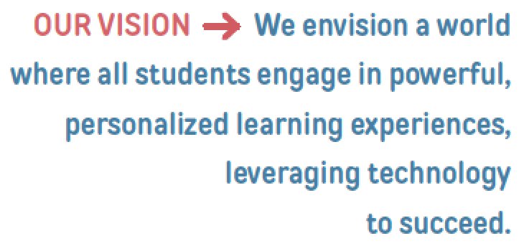
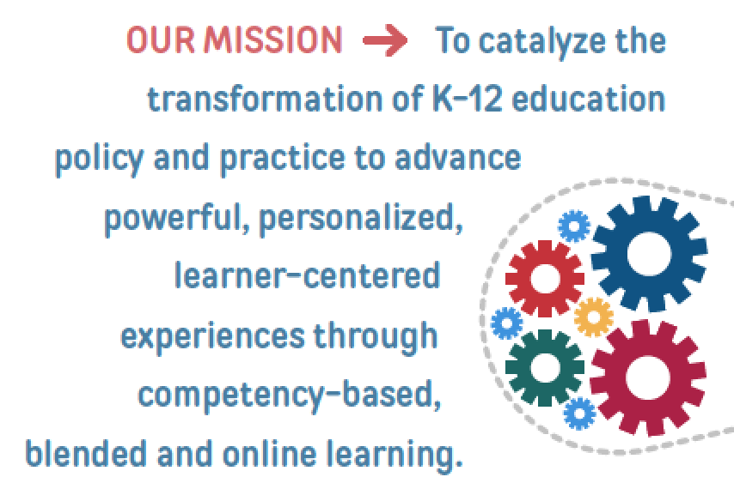
Notes:
Jason Zimba’s chart

Slide 4
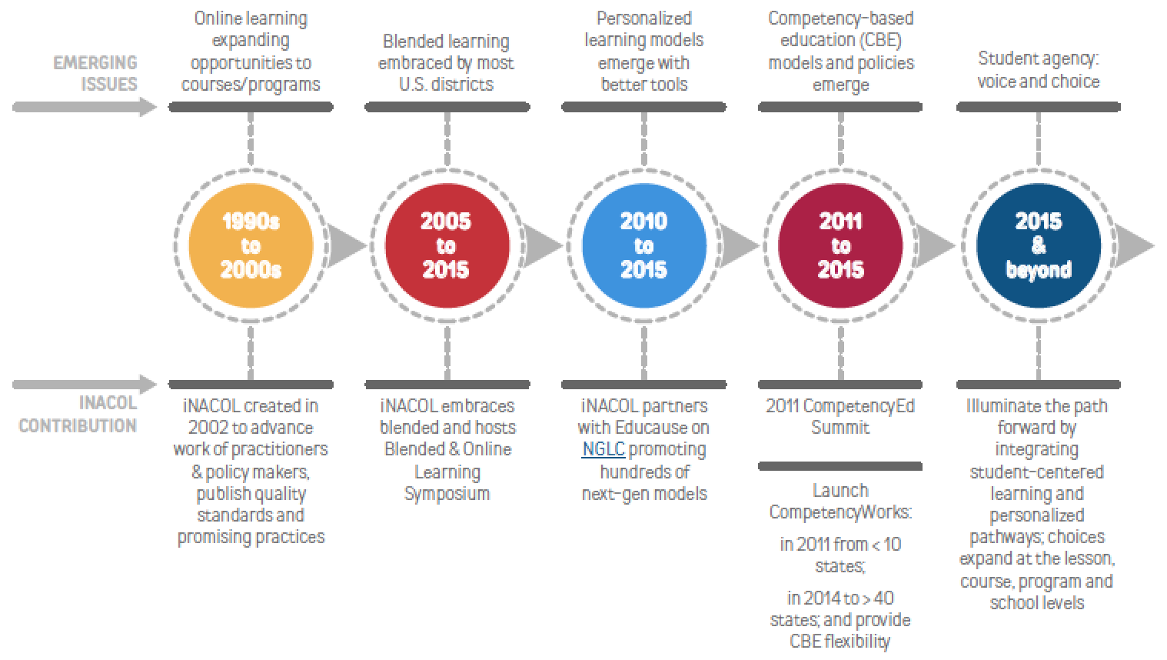
iNACOL’s Evolution

Slide 5
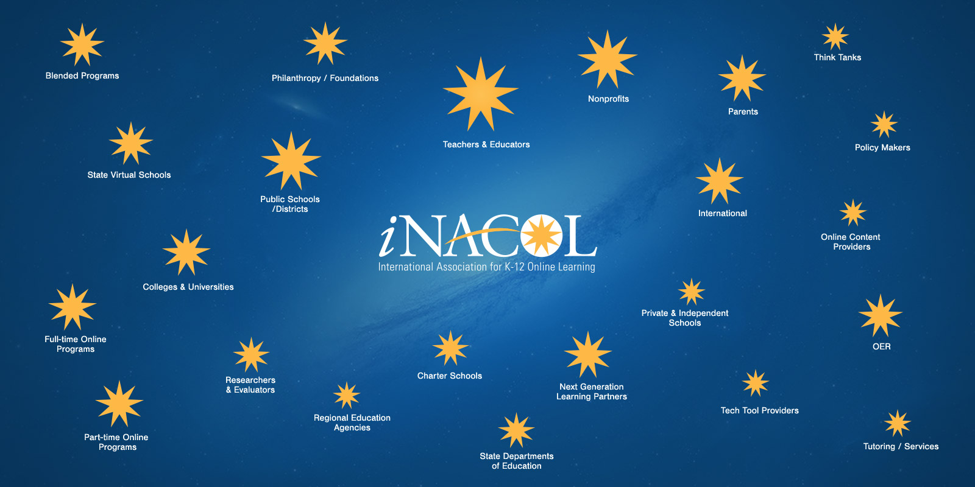
Our Community
We are supporting the largest, active community of innovative practitioners transforming the future of learning.

Slide 6
Transforming to
Student-Centered Learning
Notes:
To be clear, personalized learning is not equal to competency-based learning — but they are related and terms are often (mistakenly) used interchangeably.
Competency-based learning is a system of education, often referred to as proficiency or mastery-based, in which students advance and move ahead on their lessons based on demonstration of mastery.
In order for students to progress at a meaningful pace, schools and teachers provide differentiated instruction and support.
People across the field of K-12 education are using the terms competency-based, proficiency- based, mastery-based, performance-based interchangeably in their own contexts — however, we use the term competency education.

Slide 7
10 Trends
Student-centered learning
Personalized – student voice, choice
Online Learning/Blended Learning
Mobile Learning - Anytime, Everywhere
Project-based and Challenge-based (Finland 2016: “Phenomenon-based”)

Slide 8
10 Trends
Adaptive Technologies
Bridging Formal & Informal Learning
Awarding Credit - Badging
Competency-based/Performance-based
Student Personalized Learning Plan and E-Portfolio

Slide 9
Student-Centered Learning
Students at the Center (JFF)
Critical and distinct elements of student-centered approaches to learning challenge the current schooling and education paradigm:
  Embracing the adolescent’s experience and learning theory as the starting point of education;
  Harnessing the full range of learning experiences at all times of the day, week, and year;
  Expanding and reshaping the role of the educator; and
  Determining progression based upon mastery.
Notes:
approach

Slide 10
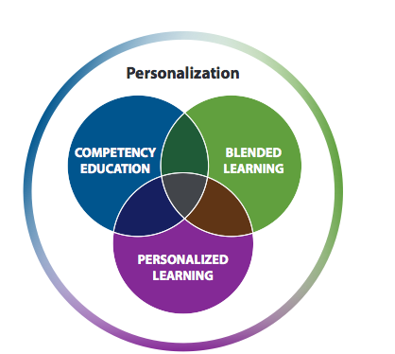
Differences and Commonalities:
Personalized Learning, Competency Education, and Blended Learning?
Notes:
Susan
These concepts are individual concepts that are often used synonymously. Foundations and organizations are merging the concepts but that doesn’t mean that they have merged in districts and schools. In order to do it well it is important to think of them as separate approaches as we become more skilled in implementing them.
Think of asking the question In What Way Are You Personalizing? In what way are you competency-based (and not)?

Slide 11
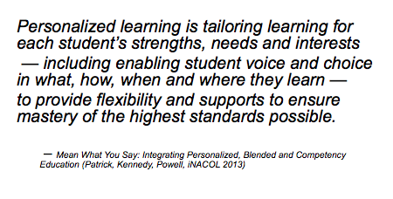
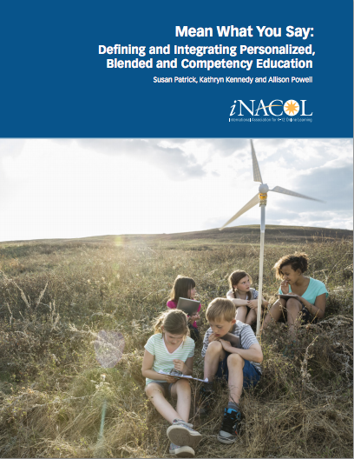
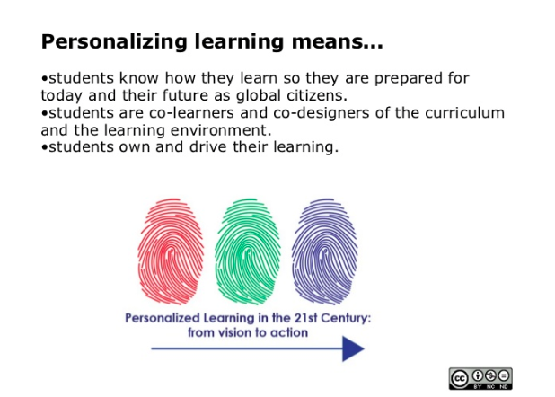
Personalized Learning

Slide 12
Personalized Learning 4 Attributes
Four essential attributes for a personalized learning model:
  Learner Profiles: Captures individual skills, gaps, strengths, weaknesses, interests & aspirations of each student.
  Personal Learning Paths: Each student has learning goals & objectives. Learning experiences are diverse and matched to the individual needs of students.
  Flexible Learning Environment: Multiple instructional delivery approaches that continuously optimize available resources in support of student learning.
  Individual Mastery: Continually assesses student progress against clearly defined standards & goals. Students advance based on demonstrated mastery.
Notes:
Personalized learning is an instructional strategy.
Compare these essential attributes to what most traditional one-size-fits-all classroom environments look like: learner profiles with precise knowledge and skills, students with personal learning paths versus a lecture-based learning experience; flexible learning environments with a variety of modes, resources and modalities (e.g. connectivism, as illustrated in Figure 1) versus one approach for all students at the exact same pace using a single textbook. Today, with these contrasts, the vast majority of traditional classrooms in the K-12 education system are far from realizing the promise of personalized learning. However, this is where the shift to blended learning instructional models can begin to incorporate the essential elements for personalized learning — providing a roadmap and solution as a method or modality for delivery — and a means to transform education to student-centric learning. Realizing this transformation requires highly personalized, blended learning environments designed and built upon competency education.

Slide 13
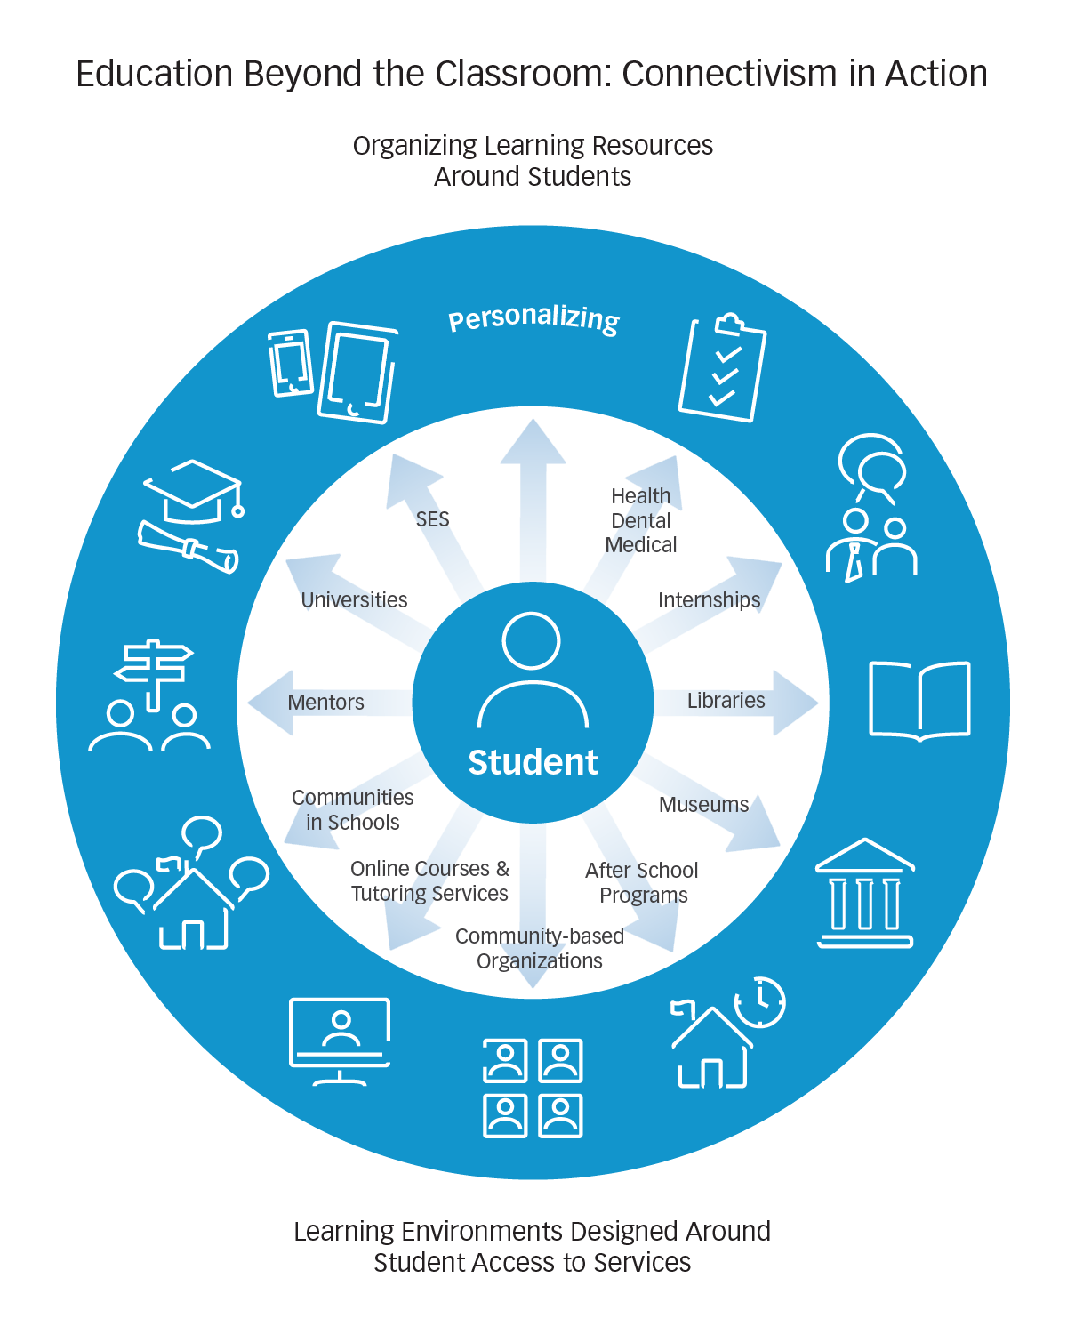

Slide 15
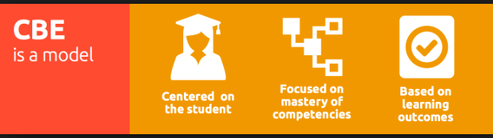
Competency-Based Education & Mastery
Principles from 5-part working definition:
Students advance upon demonstrated mastery.
Competencies include explicit, measurable, transferable learning objectives that empower students.
Assessment is meaningful and a positive learning experience for students.
Students receive timely, differentiated support based on their individual learning needs.
Learning outcomes emphasize competencies that include application and creation of knowledge, along with the development of important skills and dispositions.
- CompetencyWorks.org

Slide 16
What It Looks Like
Every student with a personalized learning “map”
  Standards into Competencies and Rubrics for each level - academic+ (what a student knows and can show)
Data systems to support teachers and students clearly indicating level of progress on each academic standard and efficacy standards to monitor student progress
Rubrics to help teachers understand what mastery looks like
Students know their targets; collaborate w/each other
Adults shifting roles
  Personalization, grouping, teacher specialization
Classroom, online, expanded learning opportunities
  After school, museum, projects, formal & informal learning

Slide 17
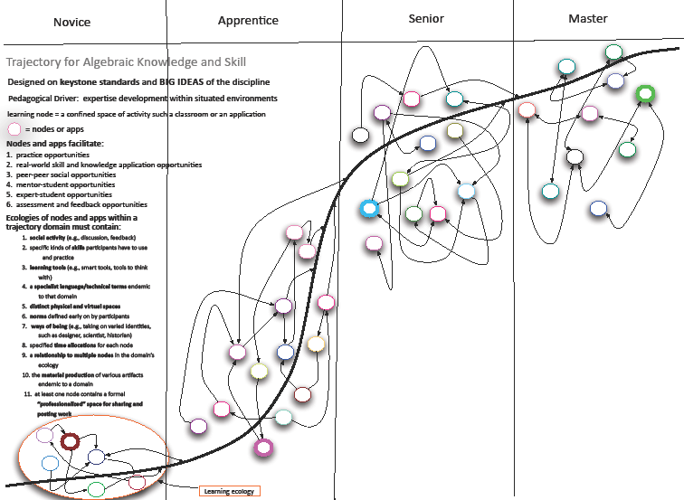
Applications and Tools within Learning Trajectories
Notes:
Jason Zimba’s chart

Slide 18
Competency-based learning
Performance or competency based learning is fundamental to personalizing learning at scale
and
It challenges almost all of our assumptions about the present system

Slide 19
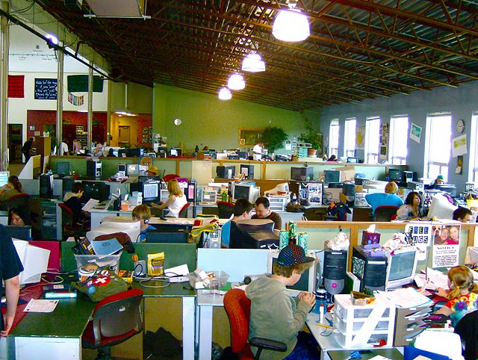
How Students Learn

Slide 20
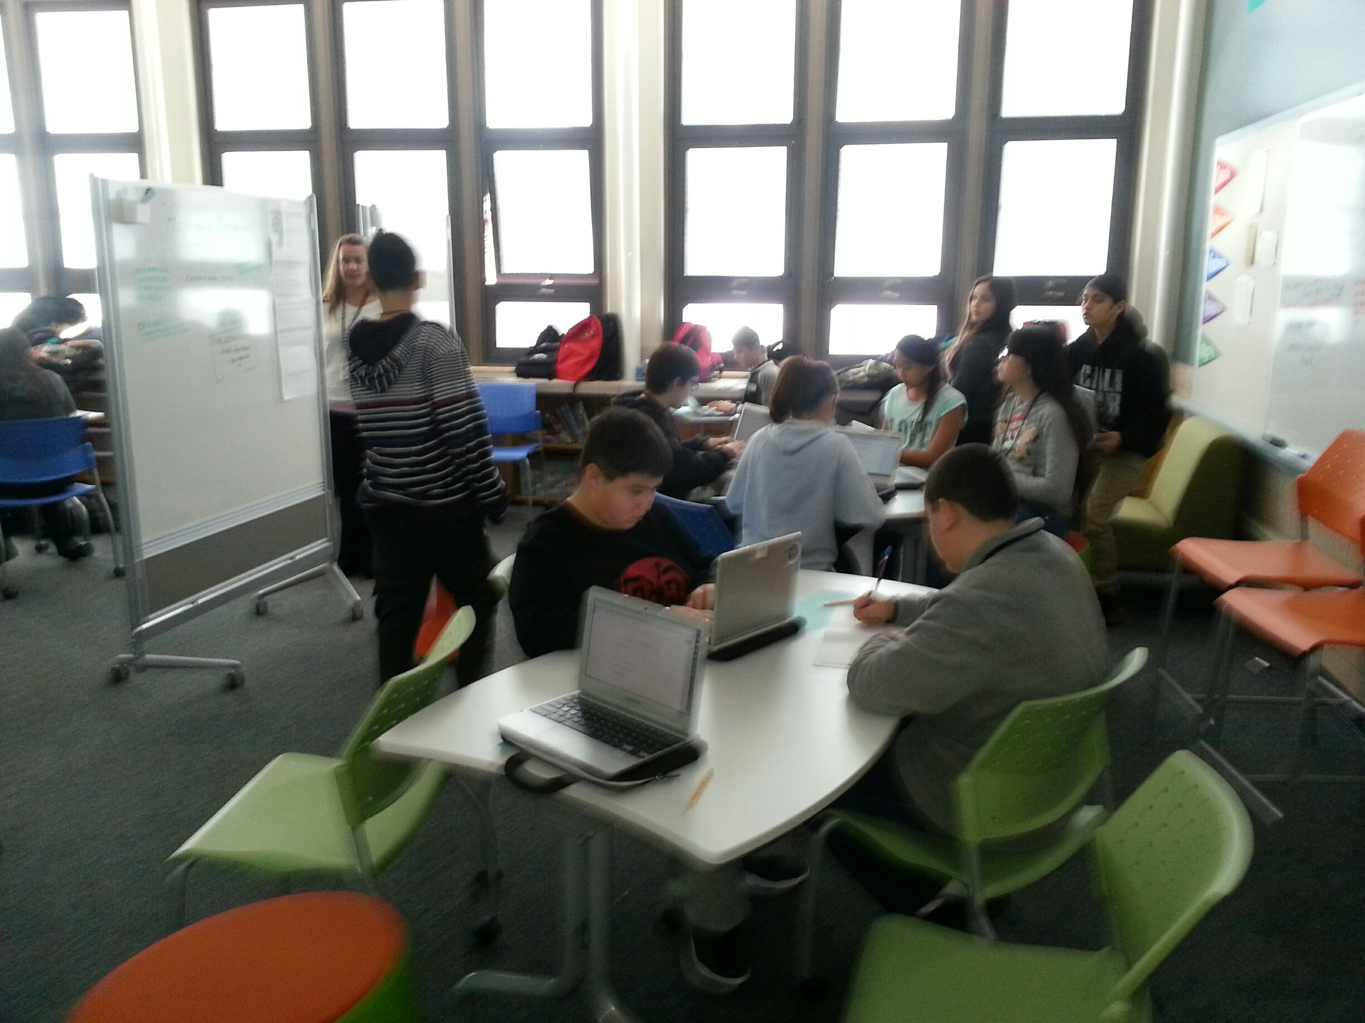

Slide 21
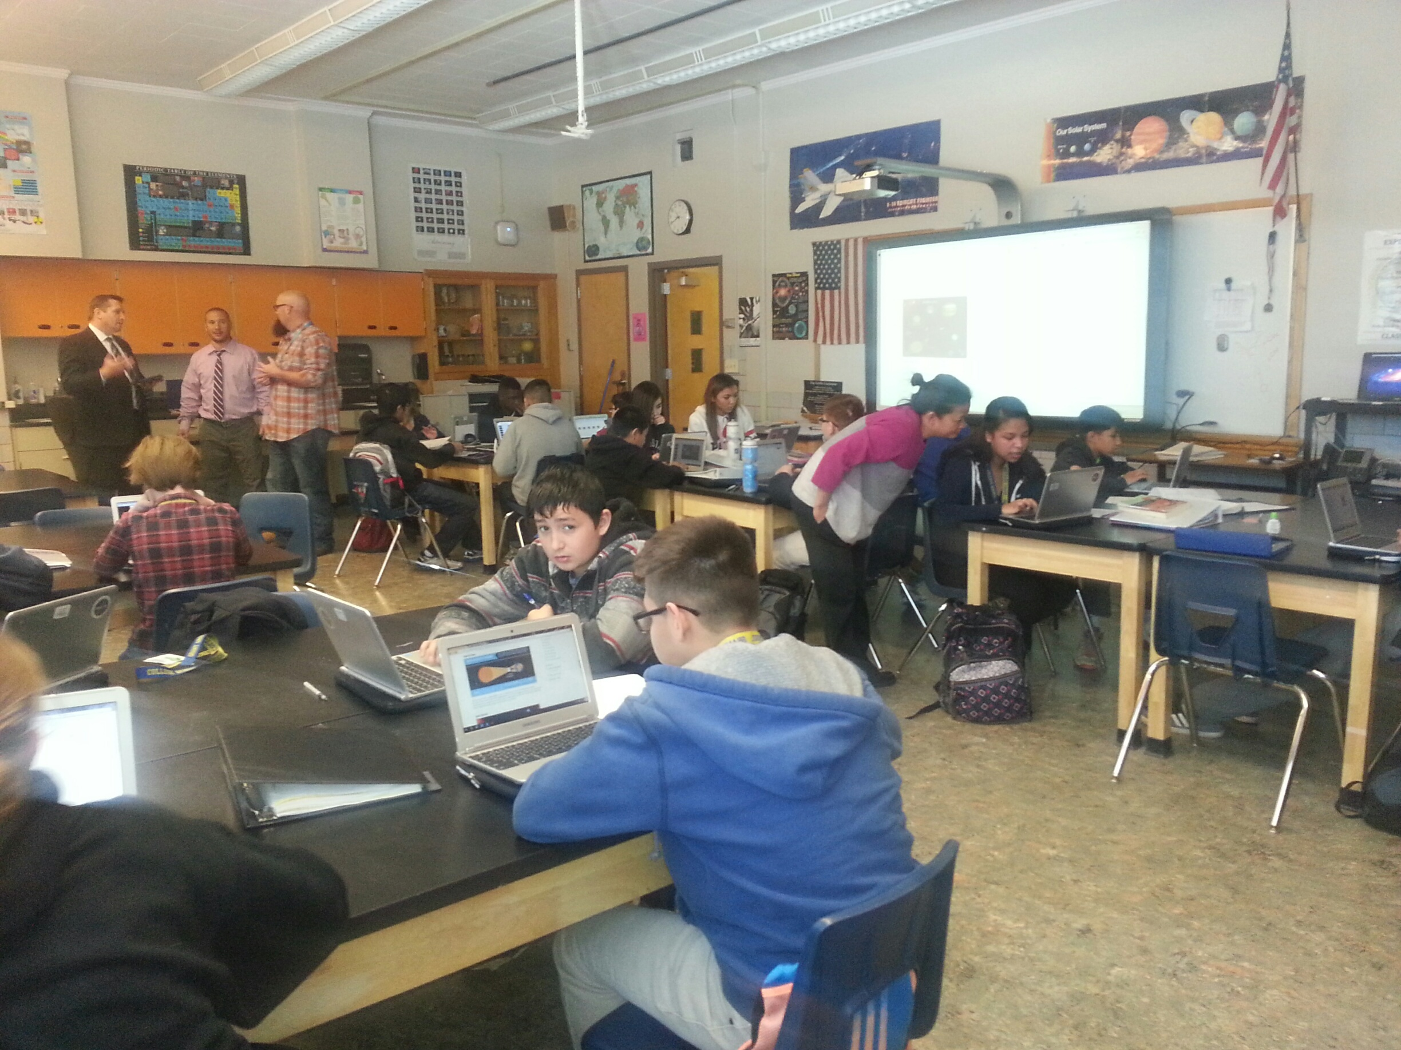

Slide 22


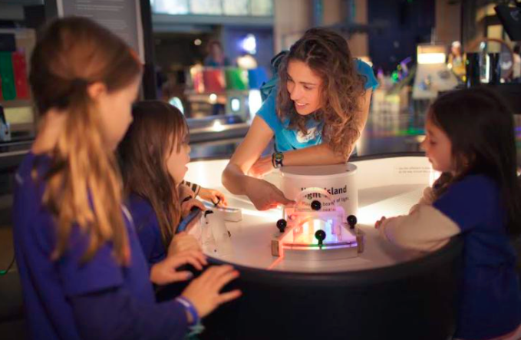

Slide 23


Rethinking Education Towards a Global Common Good? (2015). United Nations Educational, Scientific and Cultural Organization (UNESCO). Retrieved from http://en.unesco.org/world-education-forum-2015/research.
Irina Bokova, Director-General of UNESCO

Slide 24


Slide 25
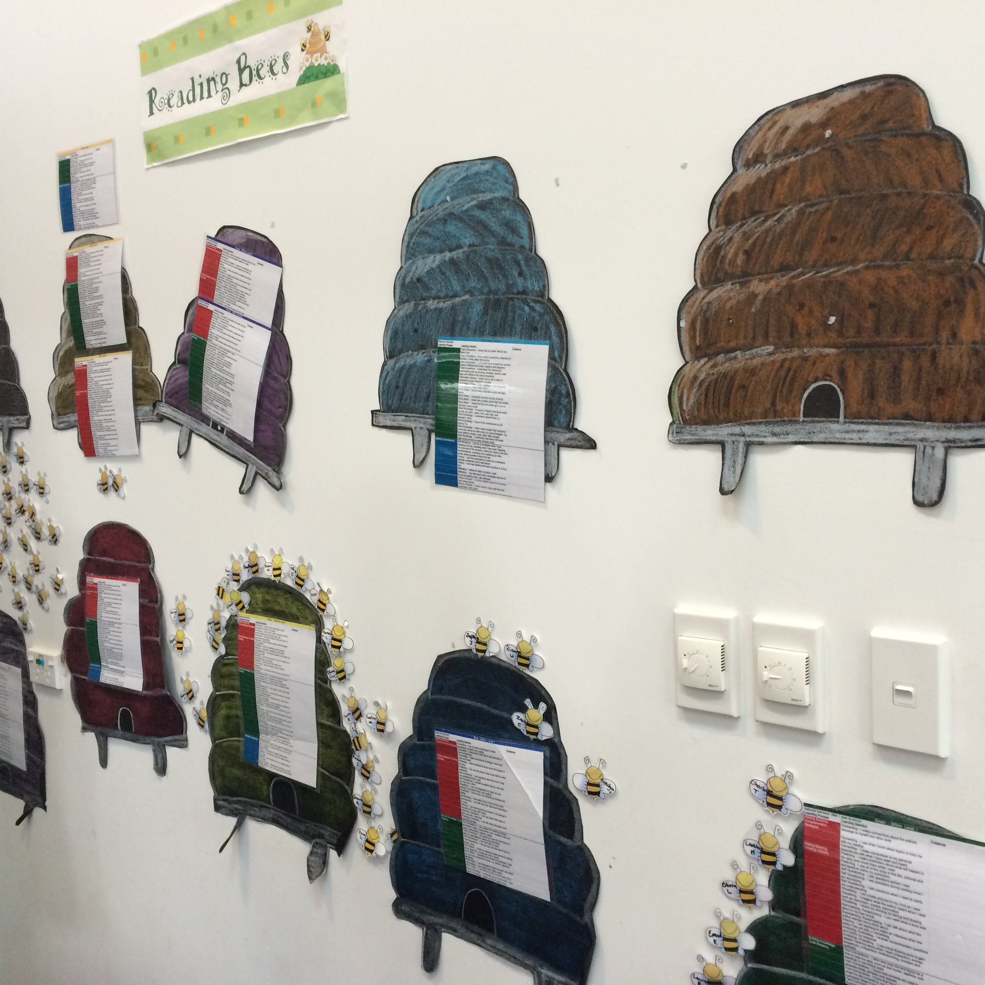
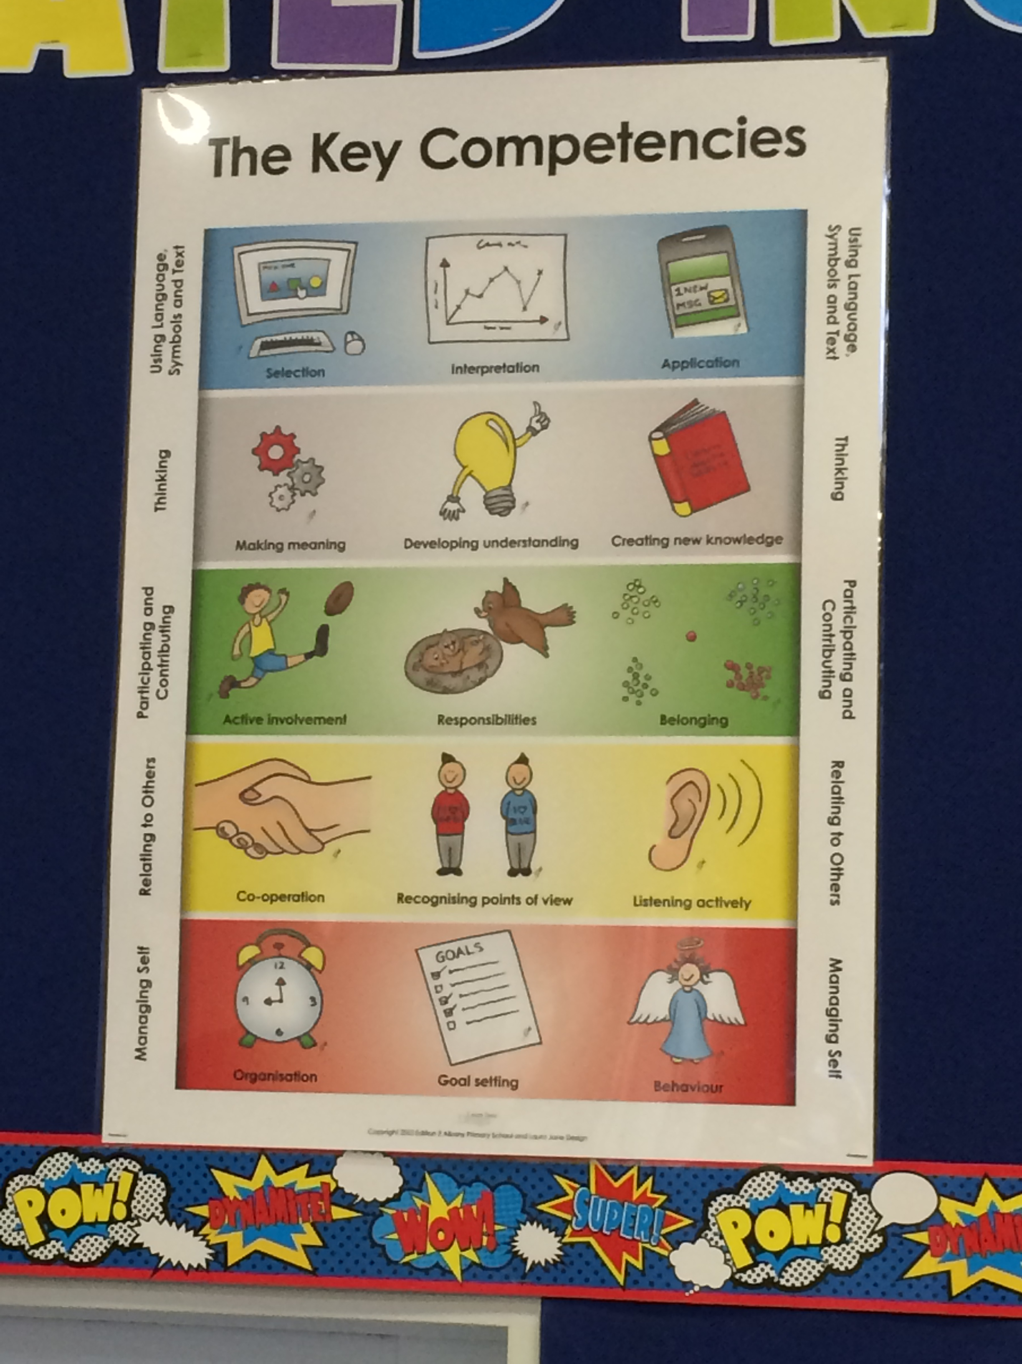

Slide 26
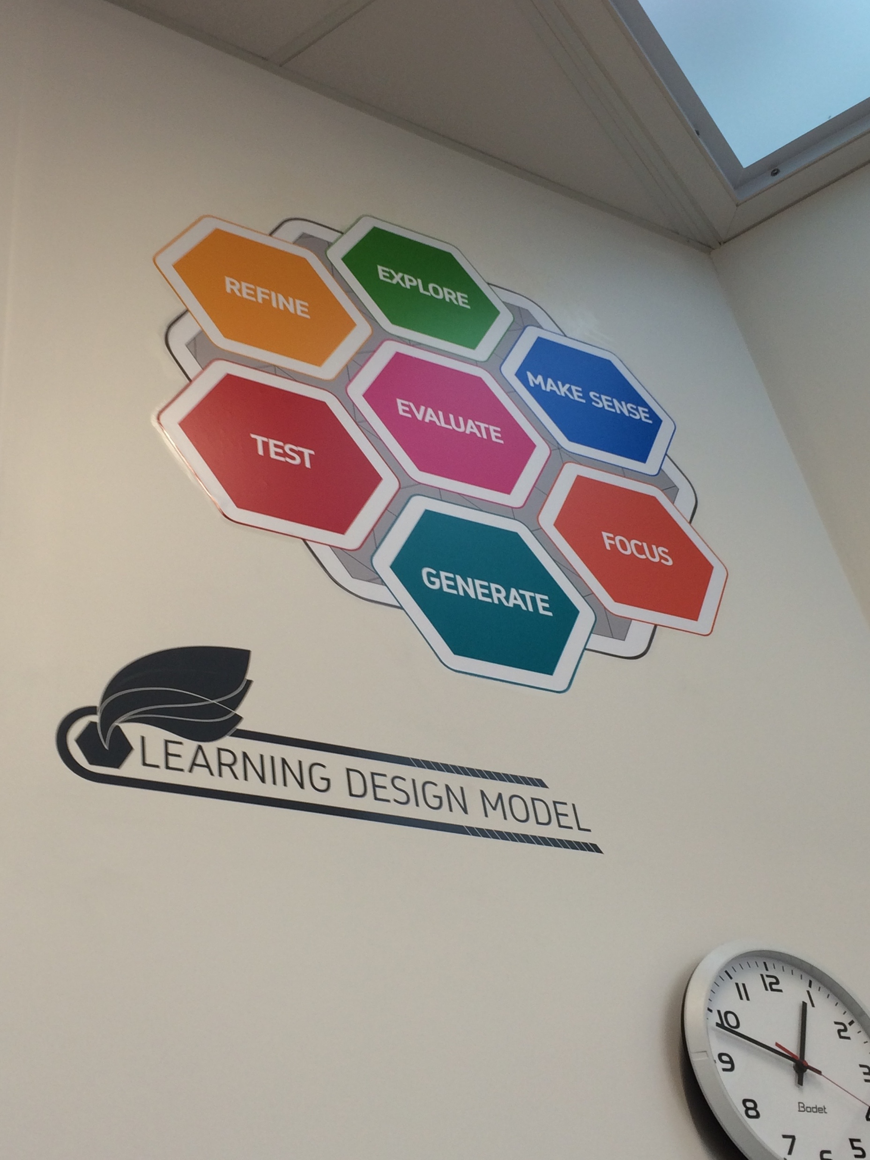

Slide 27
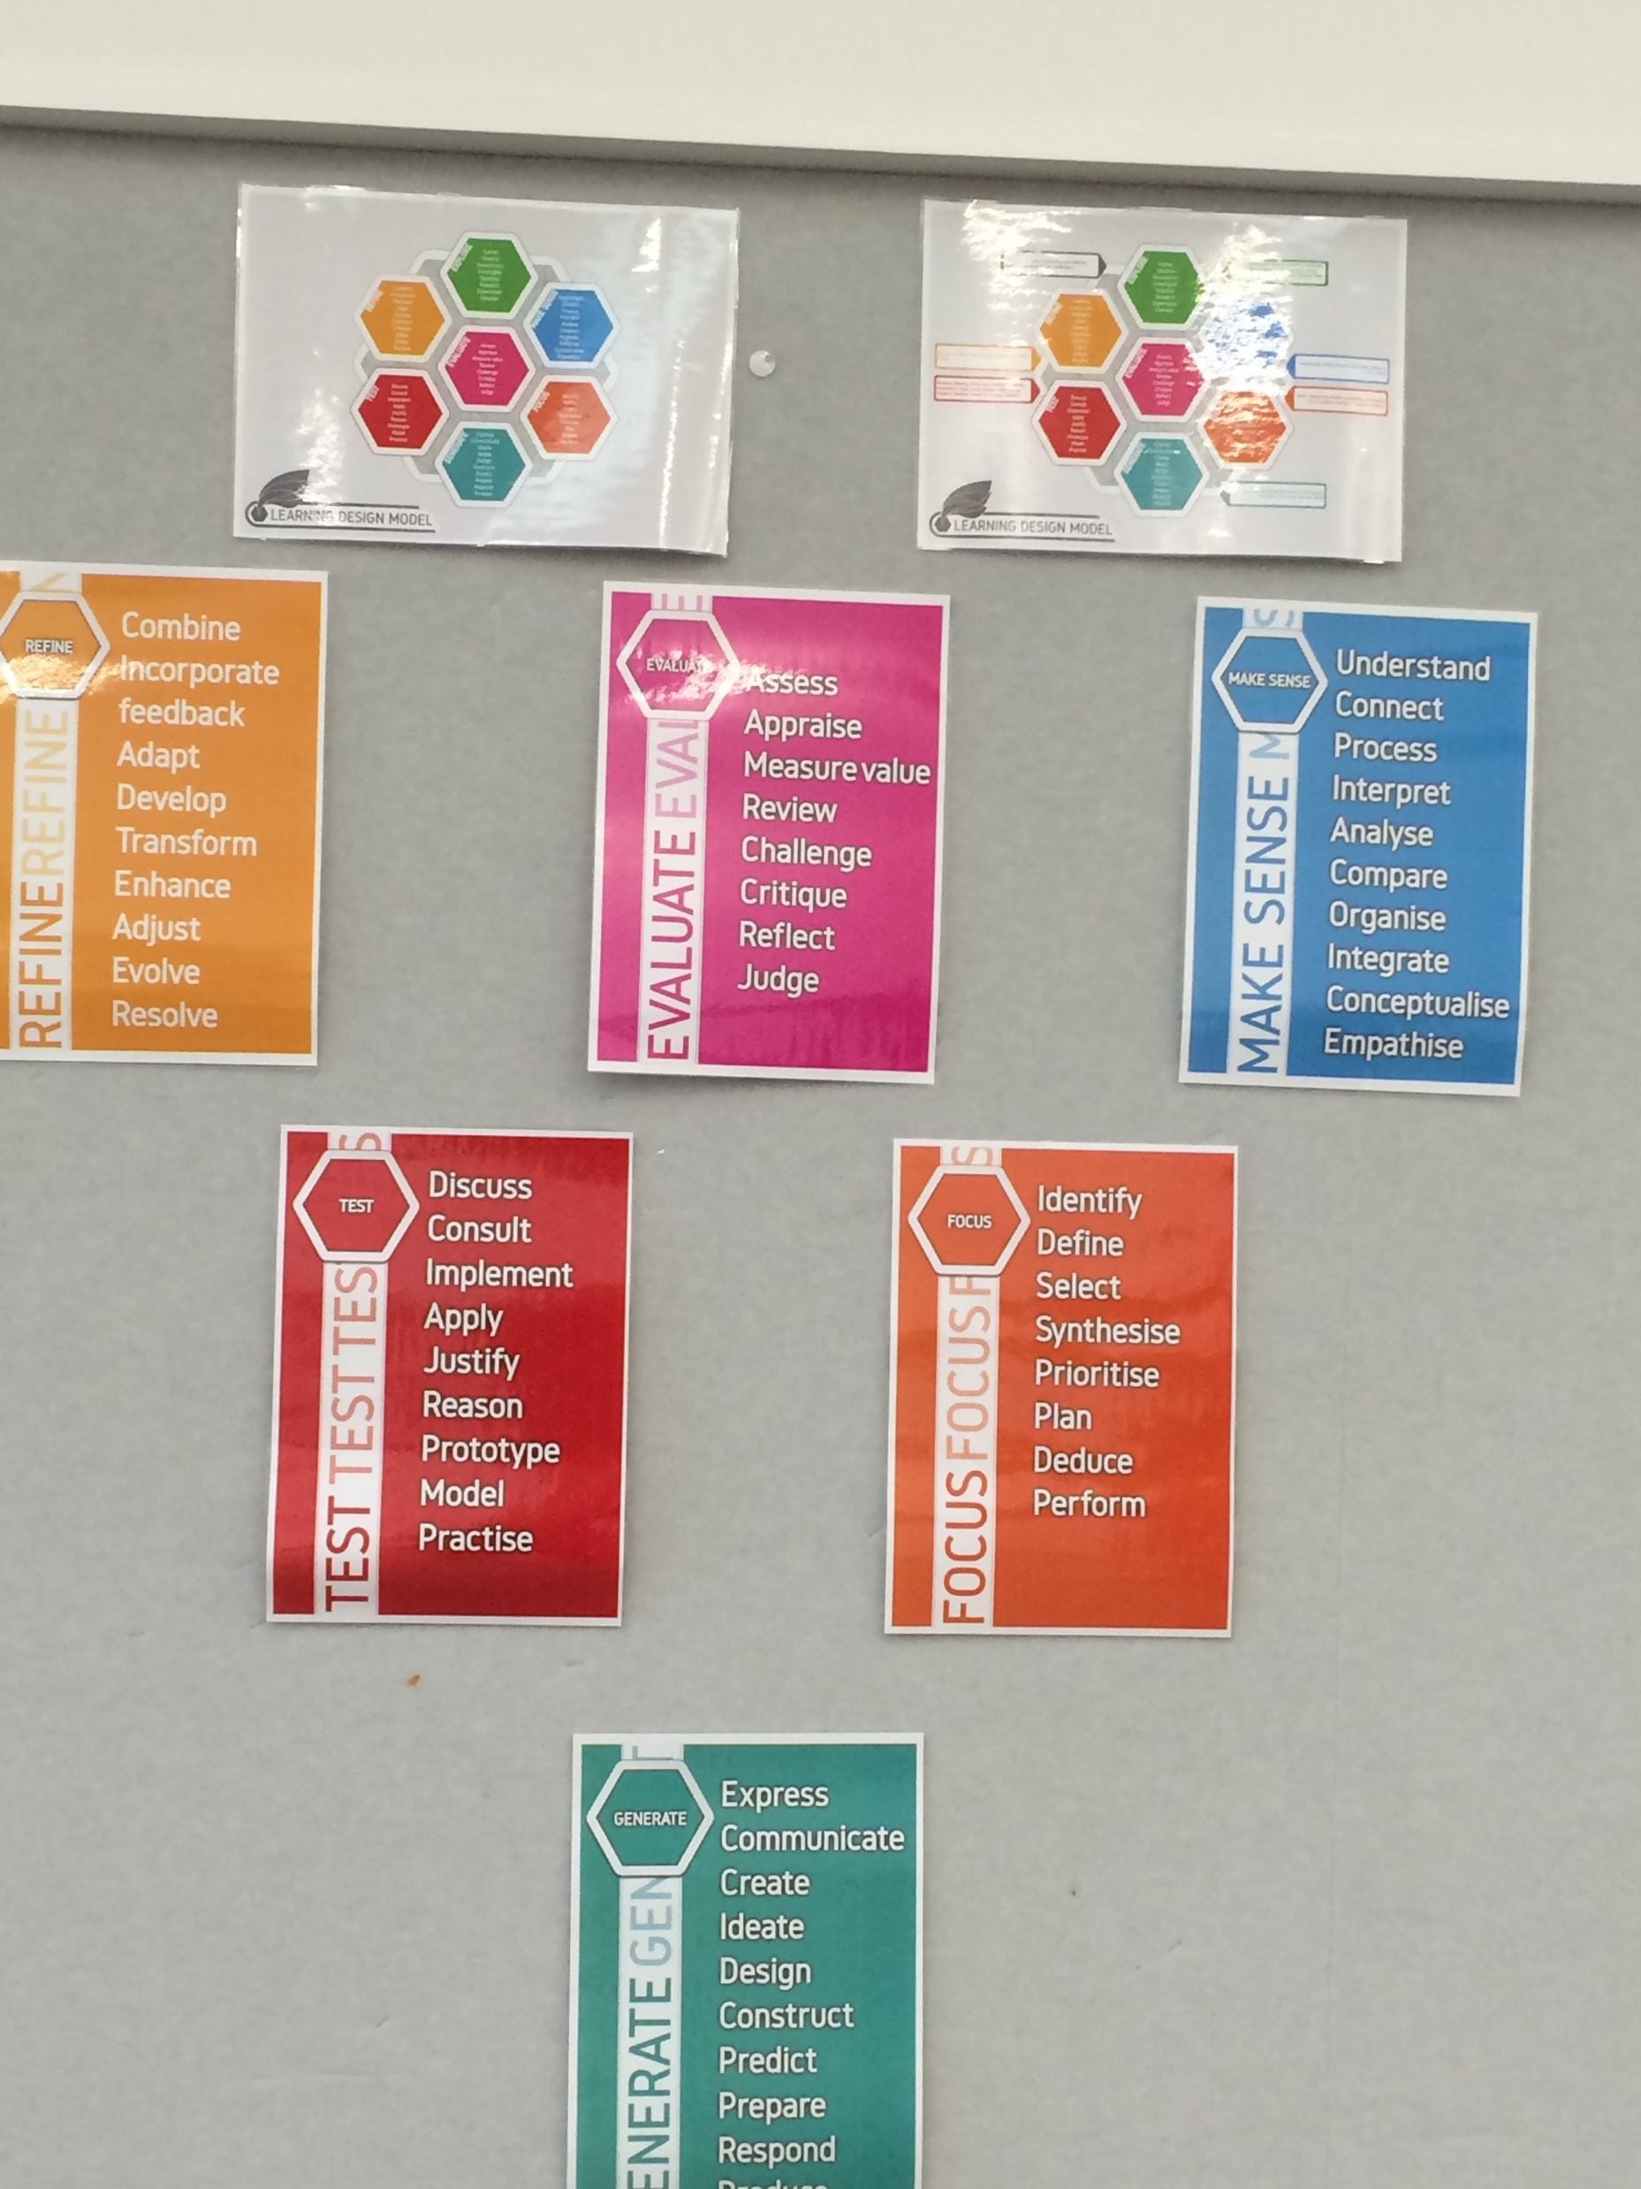

Slide 28
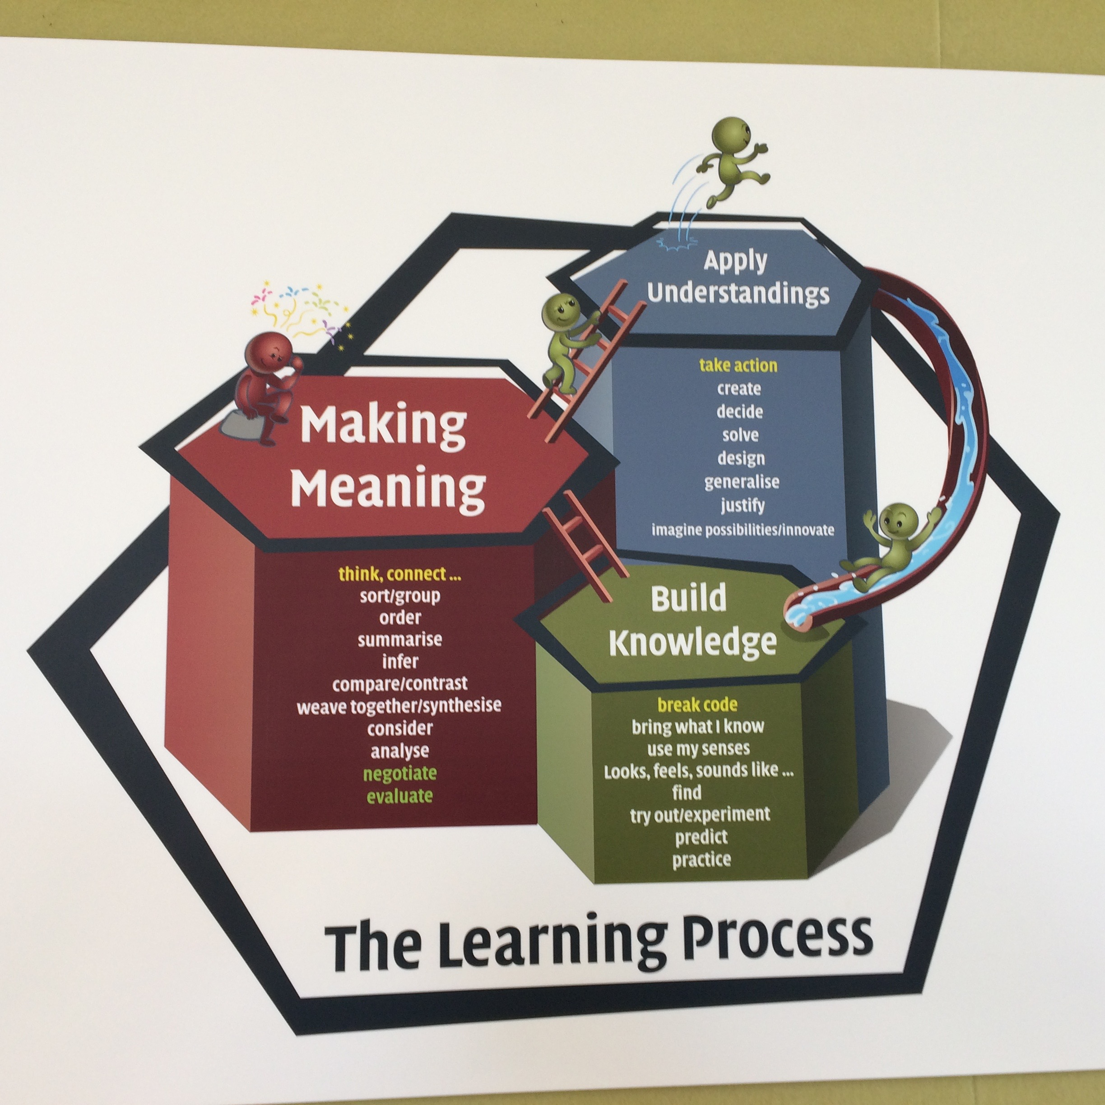

Slide 29
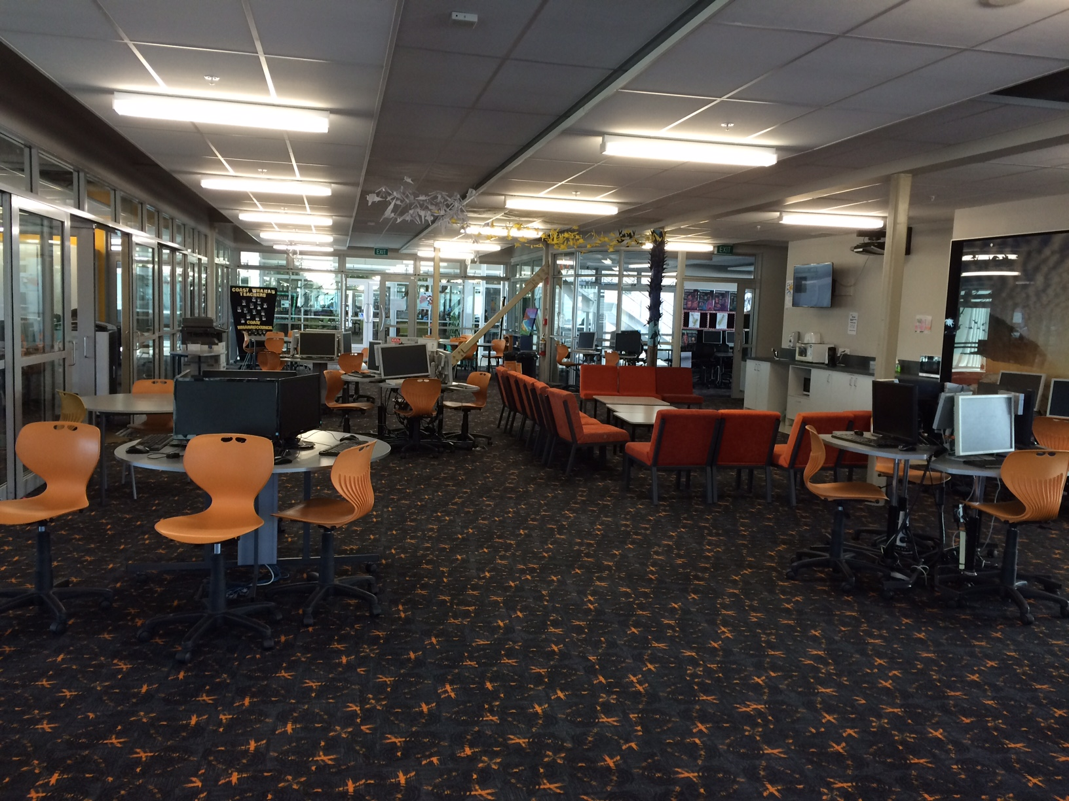

Slide 30


Slide 31
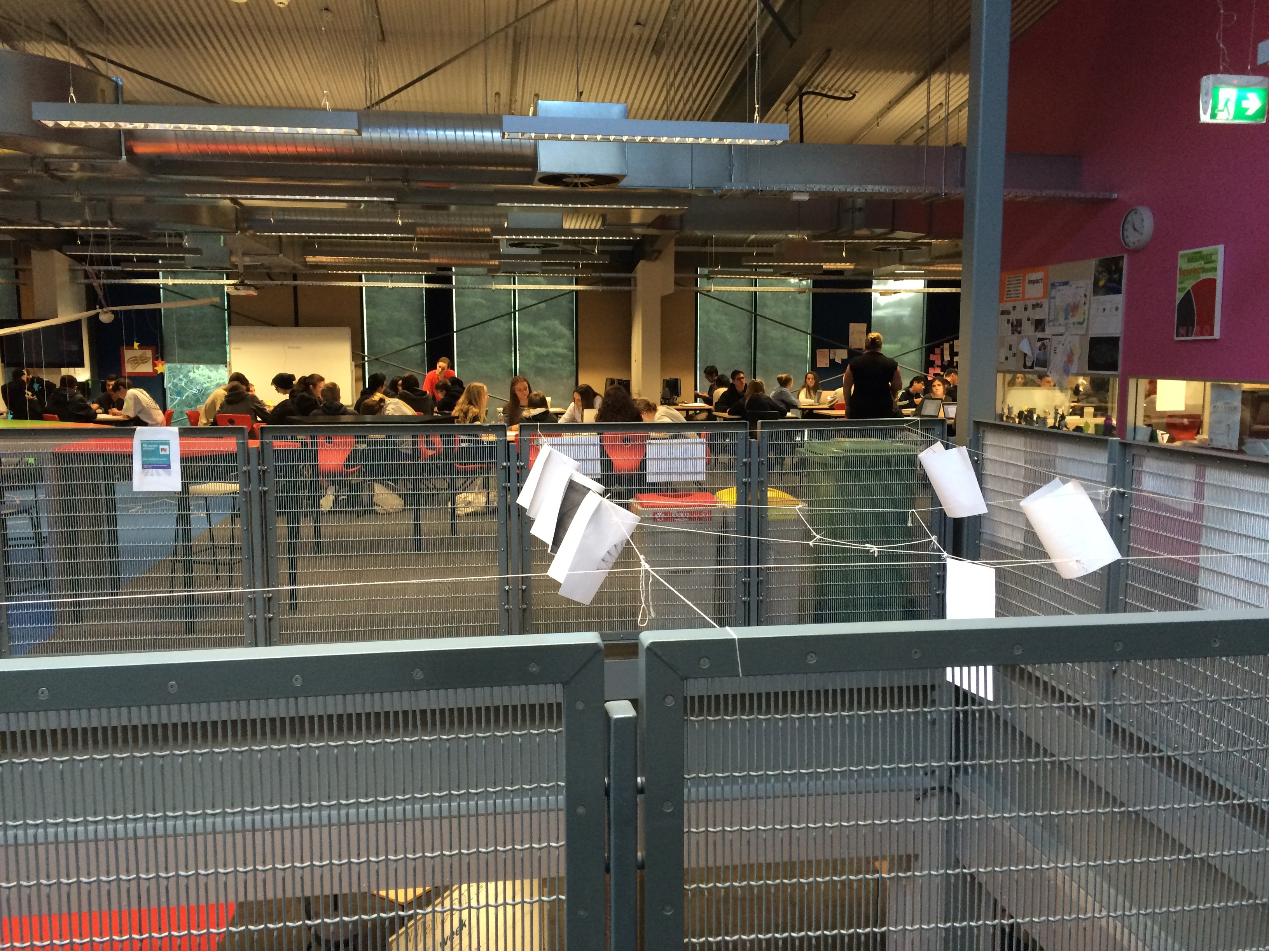

Slide 32
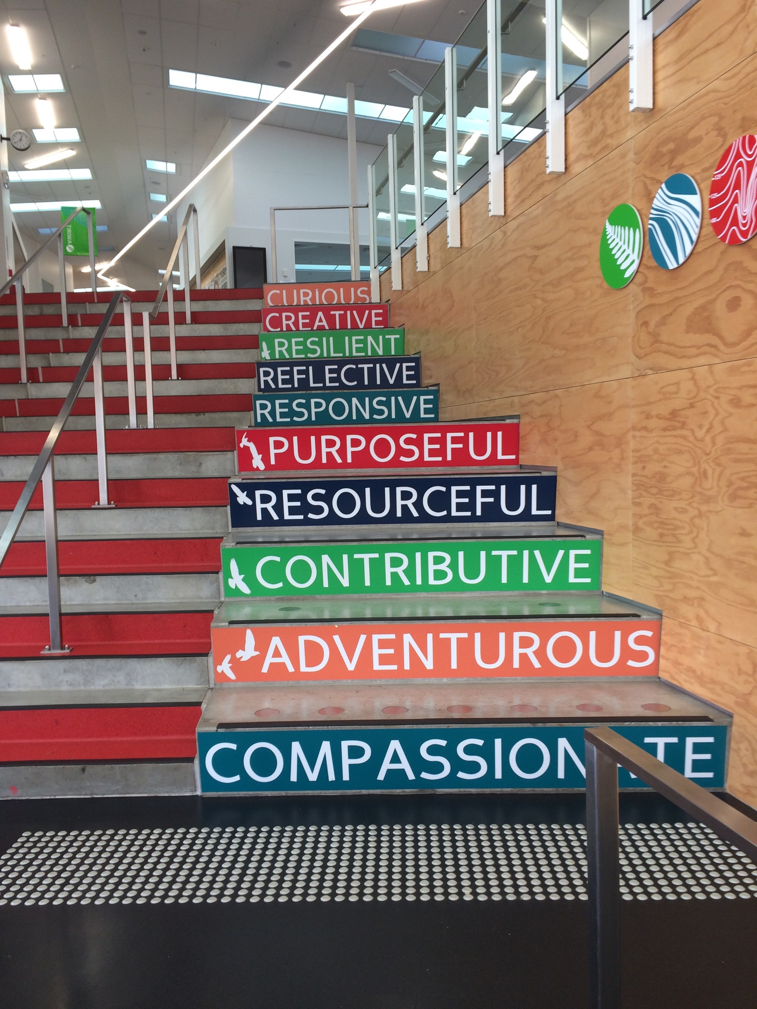

Slide 33
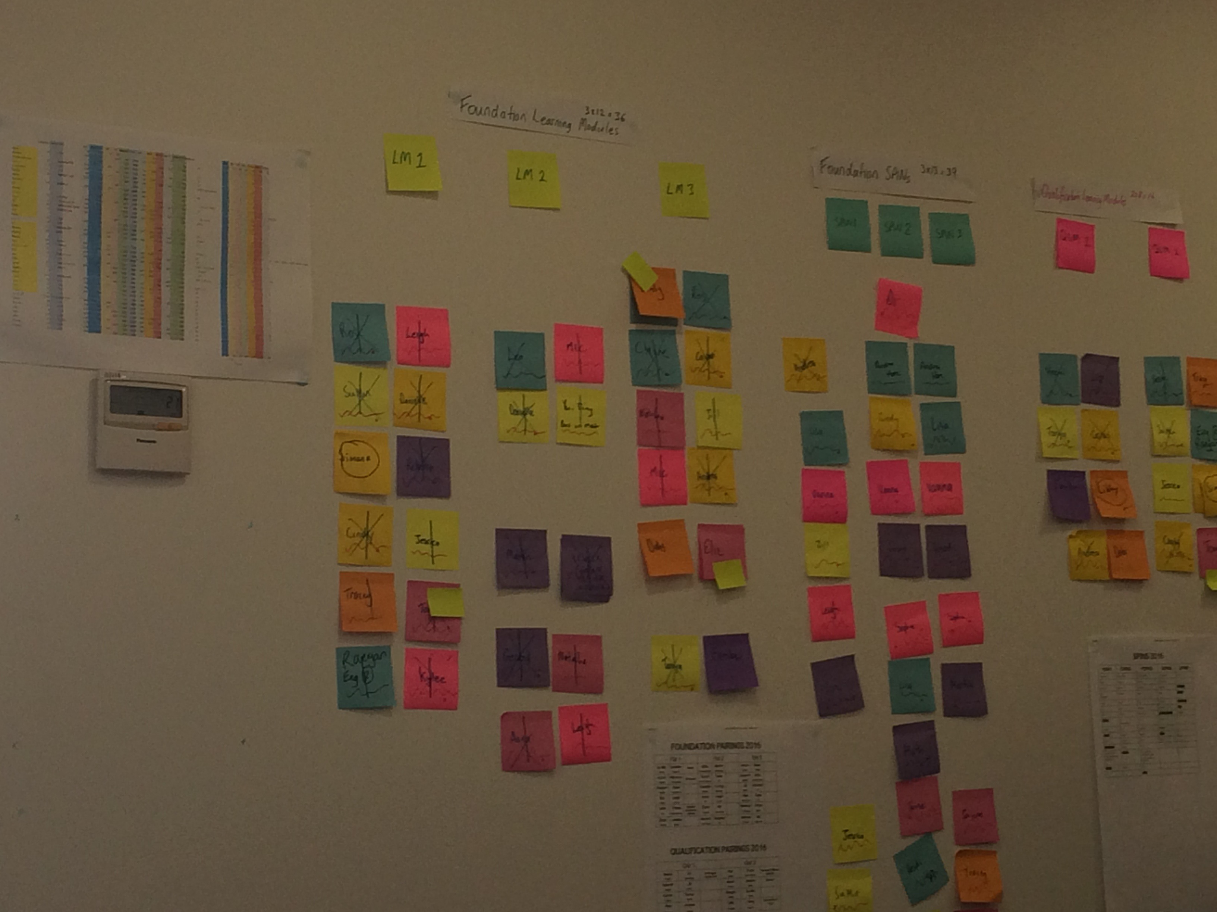

Slide 34
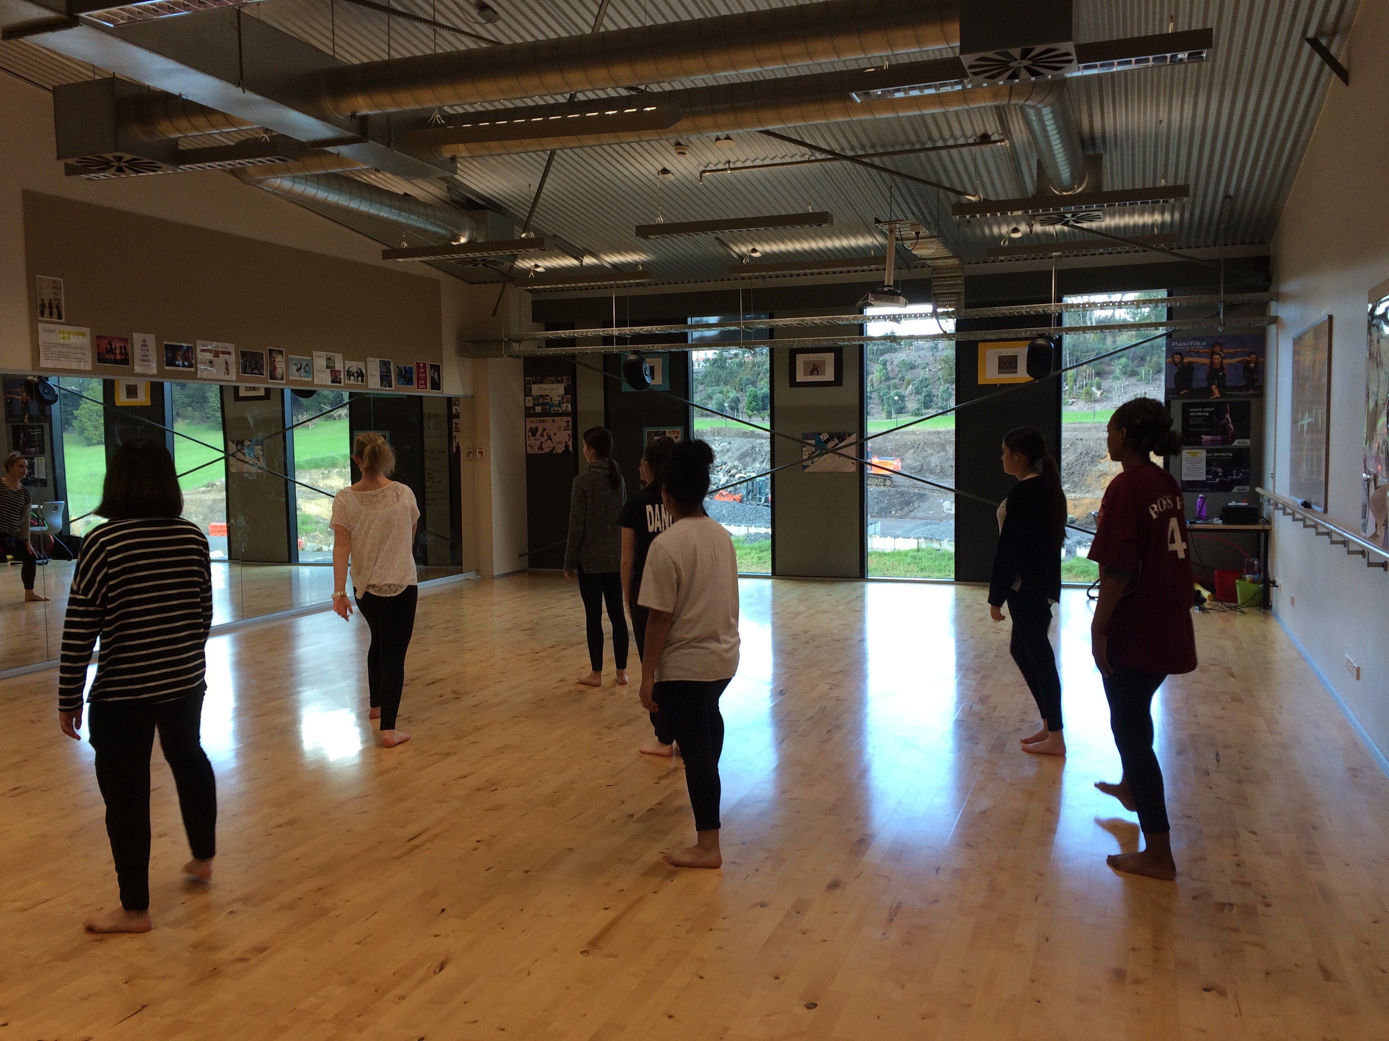

Slide 35
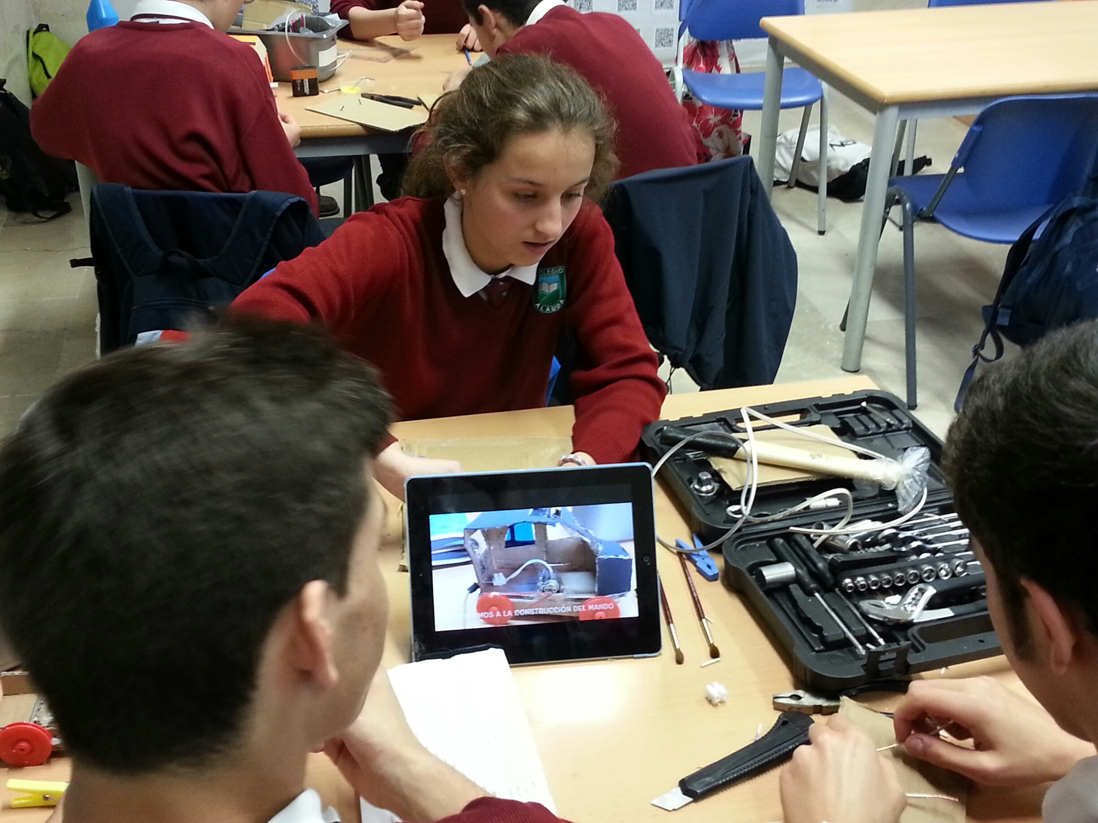

Slide 36
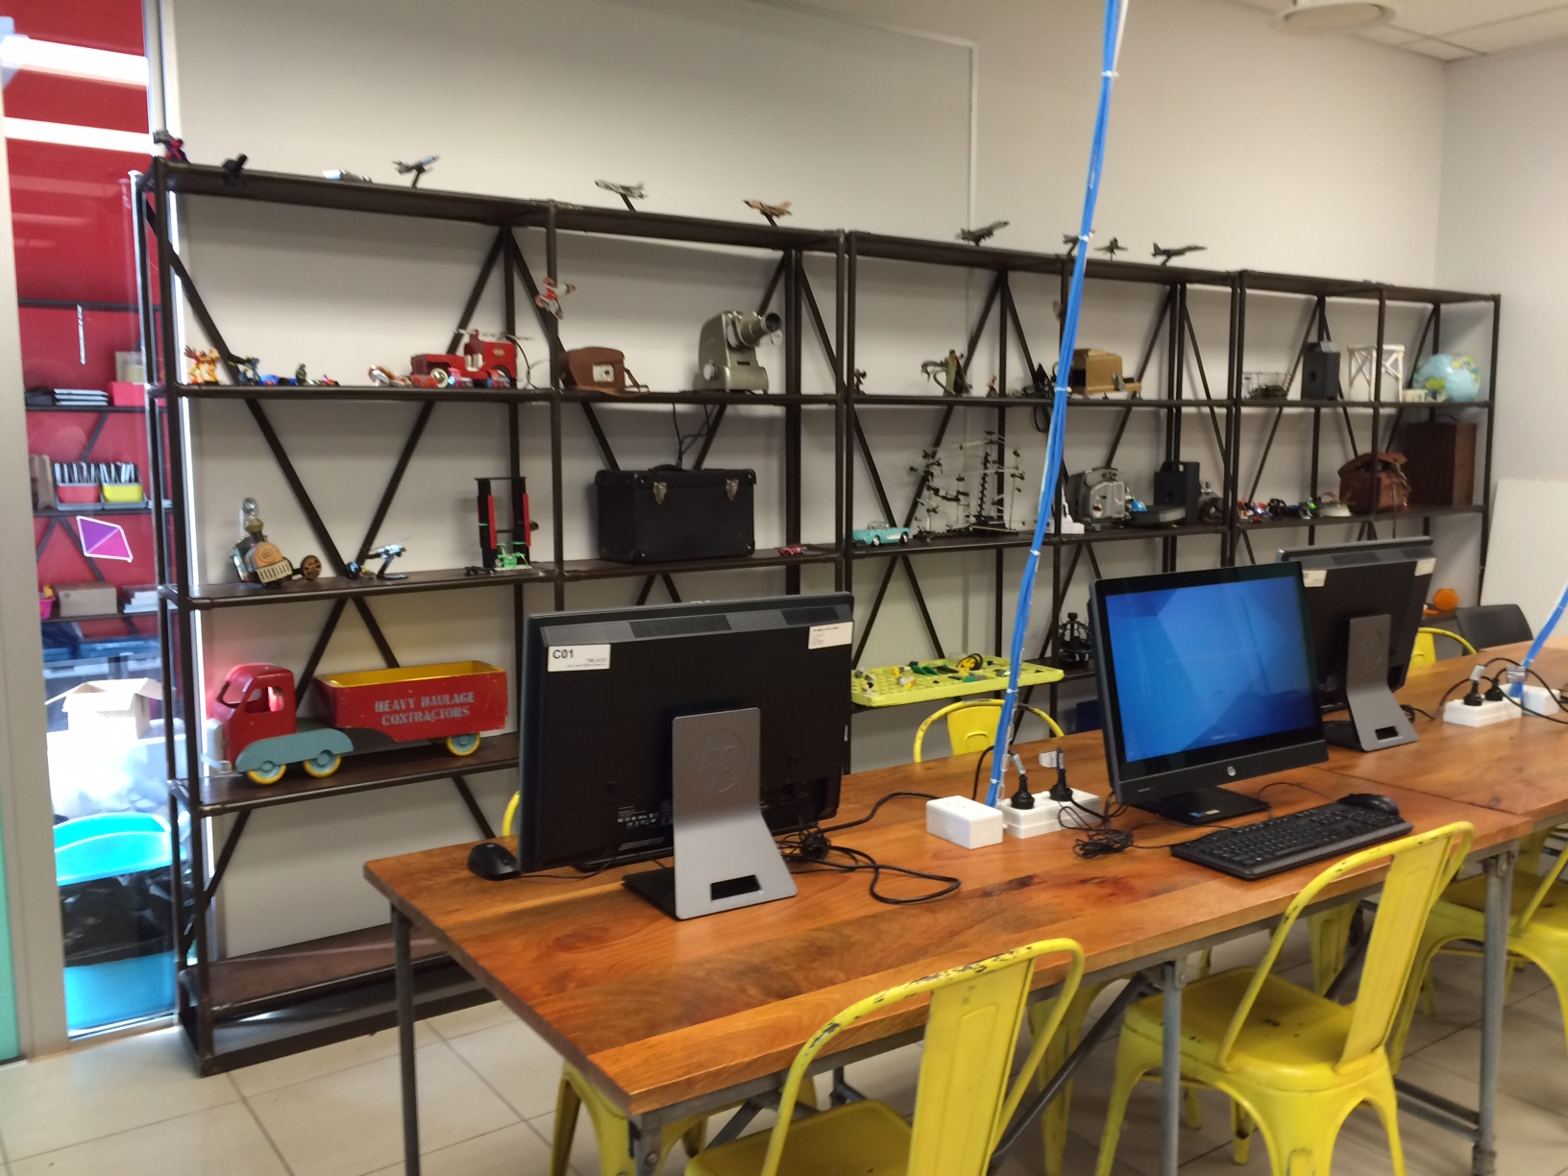

Slide 37
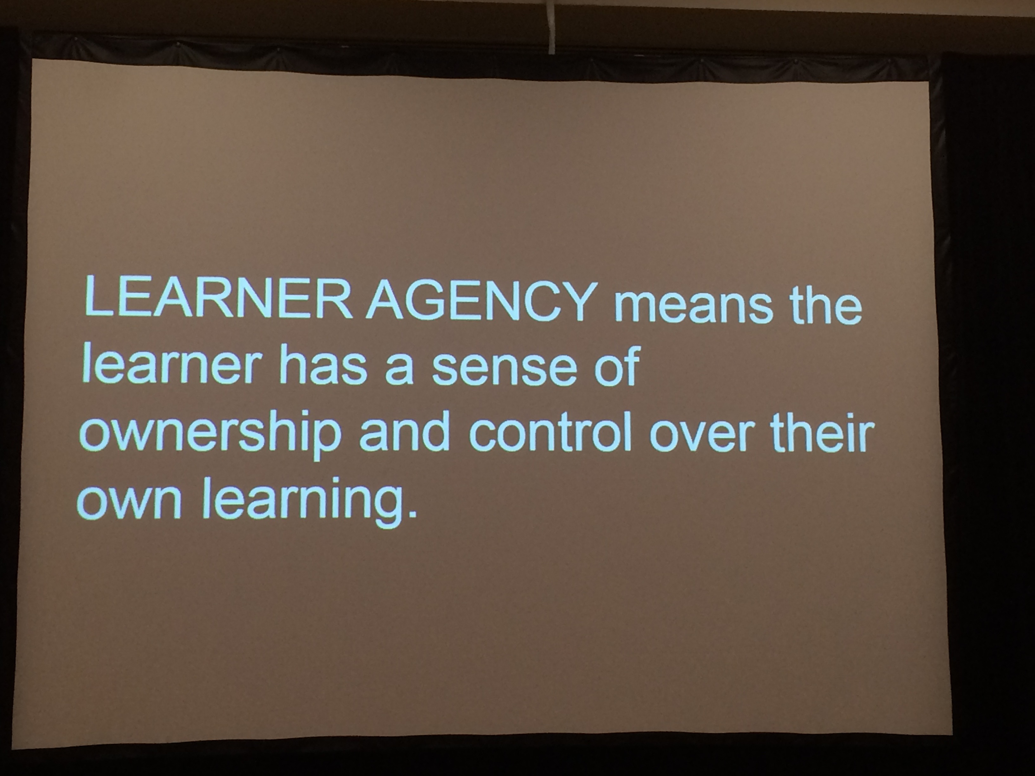

Slide 38
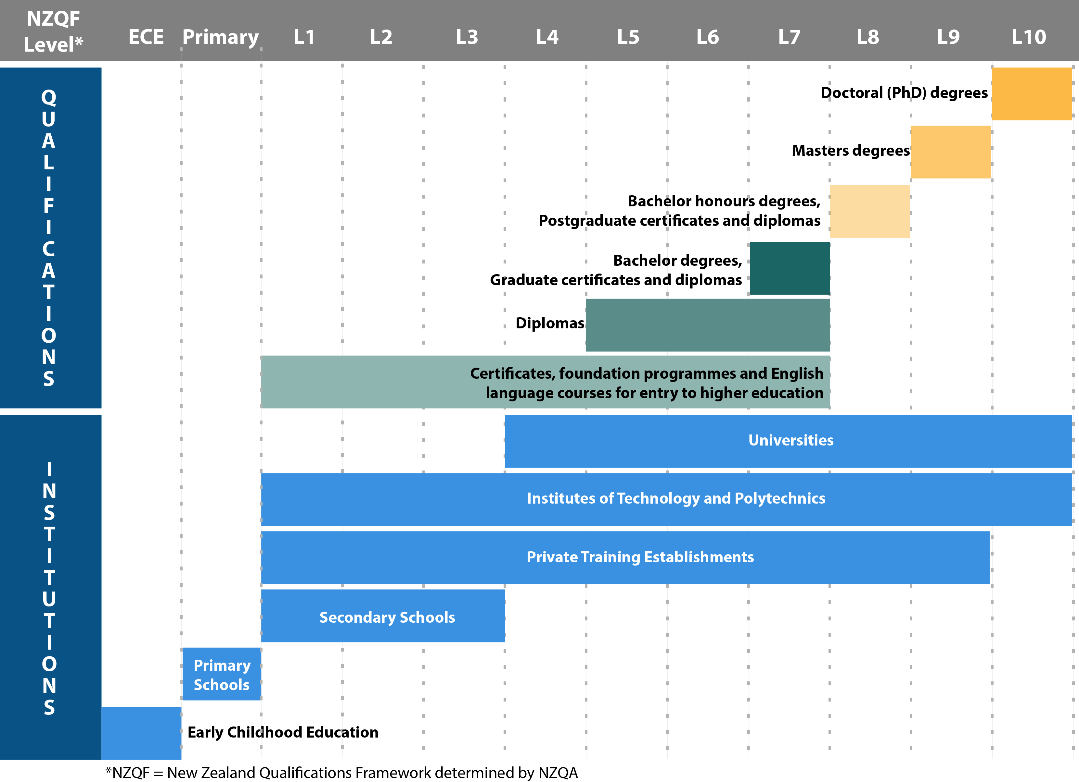
National Qualifications Frameworks
An Example from New Zealand
Notes:
3 minutes

Slide 39
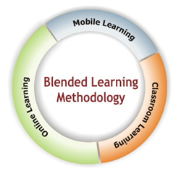
Defining blended learning
Notes:
Allison

Slide 40


The rise of K-12 blended learning
Michael Horn & Heather Staker definition of blended learning
A formal education program in which a student learns at least in part through online learning, with some element of student control over time, place, path and/or pace
at least in part in a supervised brick-and-mortar location away from home (such as school).
100010001111010101000
The modalities along each student’s learning path within a course or subject are connected to provide an integrated learning experience.
100010001111010101000

Slide 41
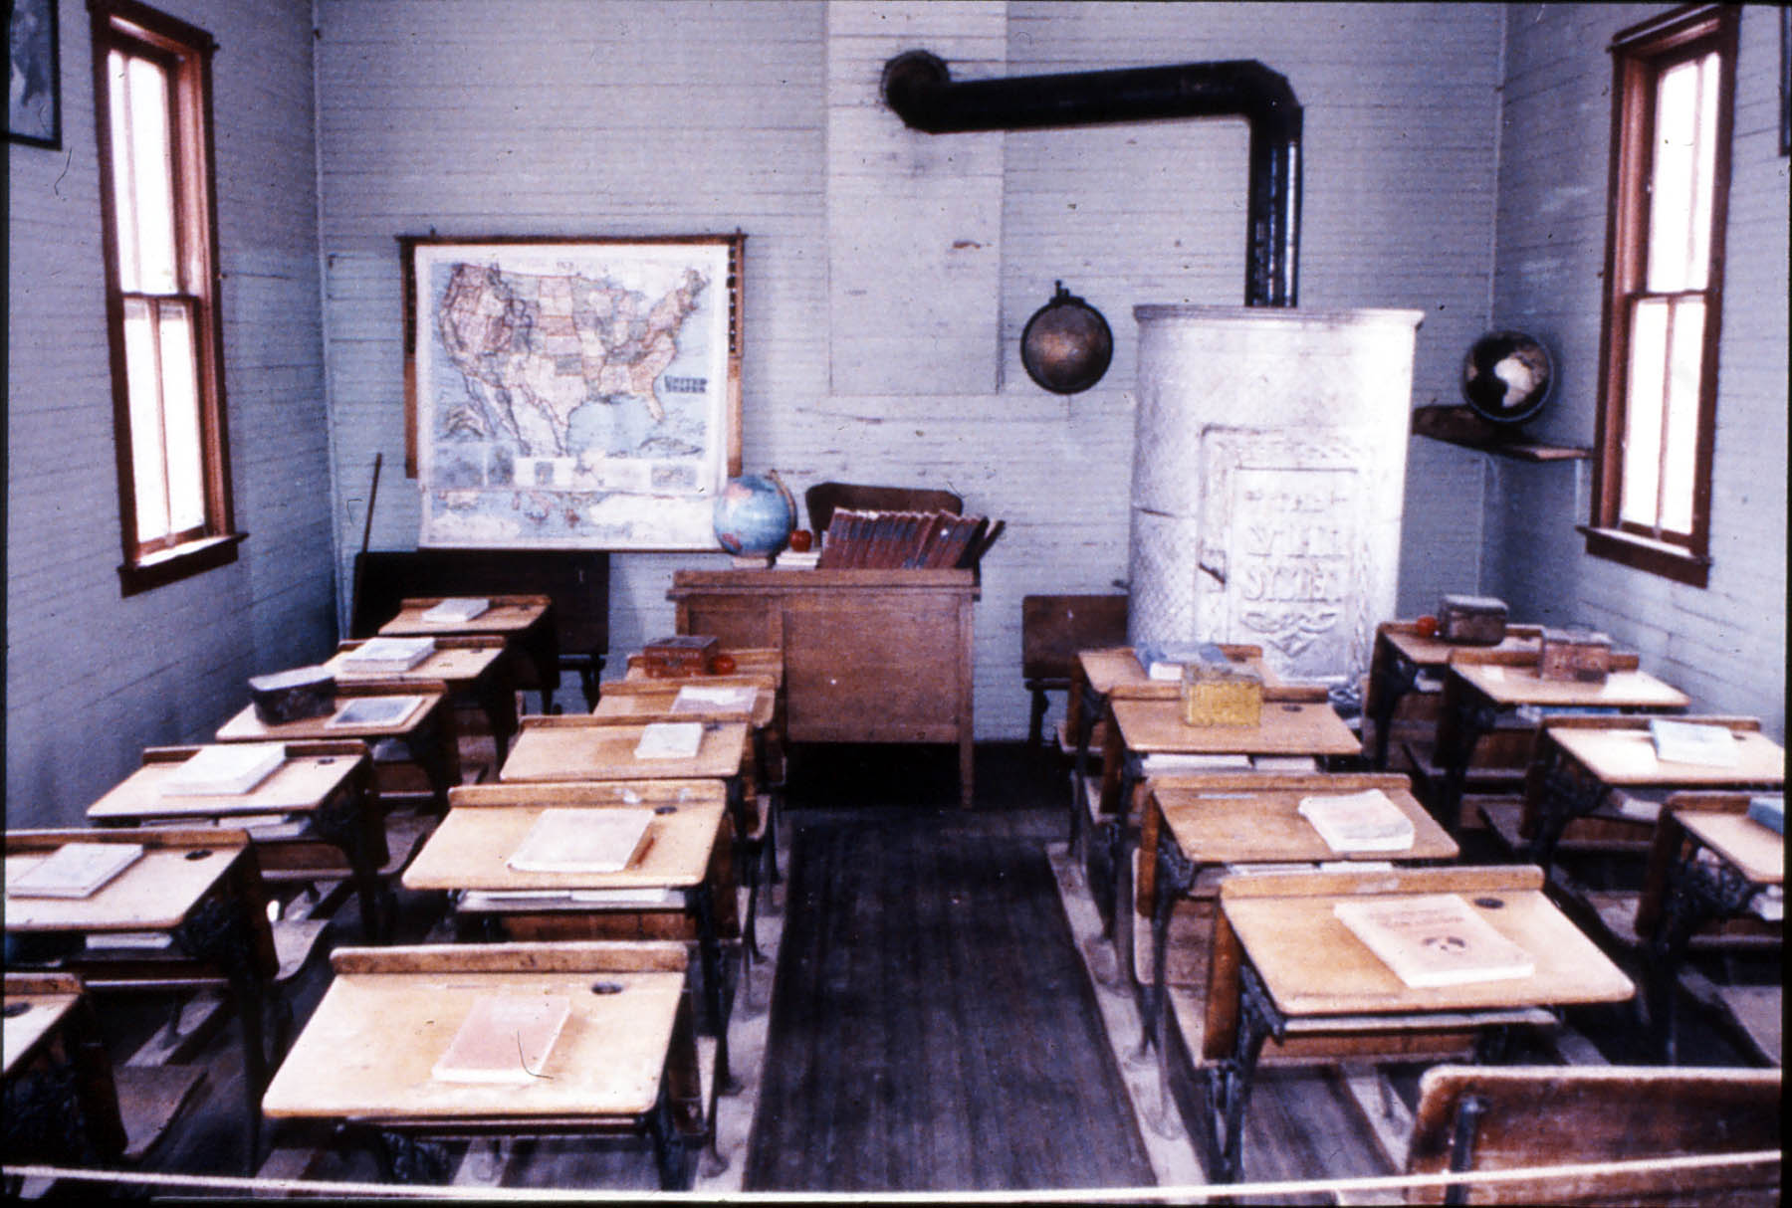
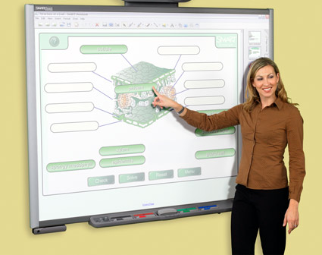








Blended learning is not…

Slide 42
Research on Blended Learning
Changing roles of educators
Teacher as conductor, designer, coach, concierge . . .
  Facilitators of learning
  Monitors of progress
  Graduation coaches
    See Keane , Irvin, de la Varre, & Hannum, 2010; Pettyjohn, Kennedy, & LaFrance, 2012; Cavanaugh, Barbour, & Clark, 2009; de la Varre, Keane, and Irvin, 2011; Irvin, Hannum, Farmer, de la Varre, & Keane, 2009
Notes:
KK

Slide 43
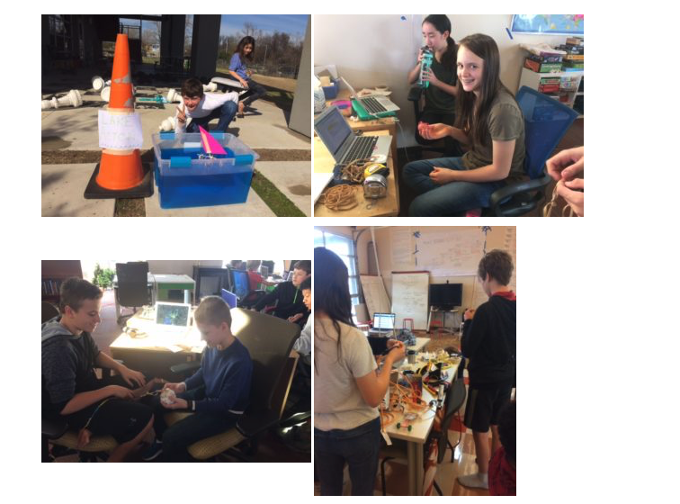


Slide 44
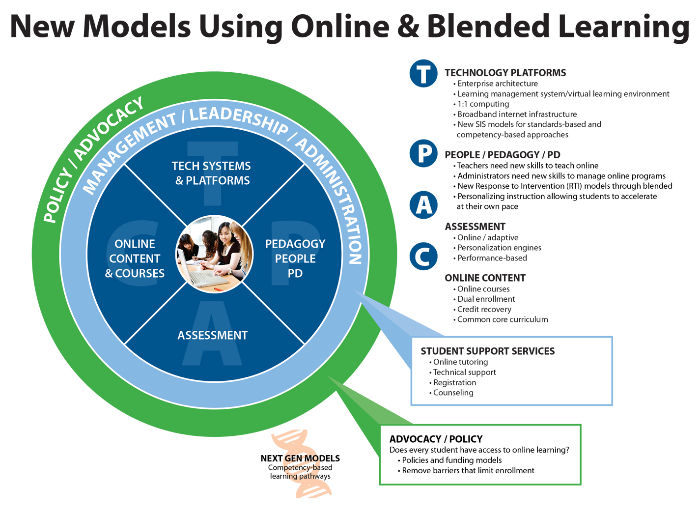

Slide 45
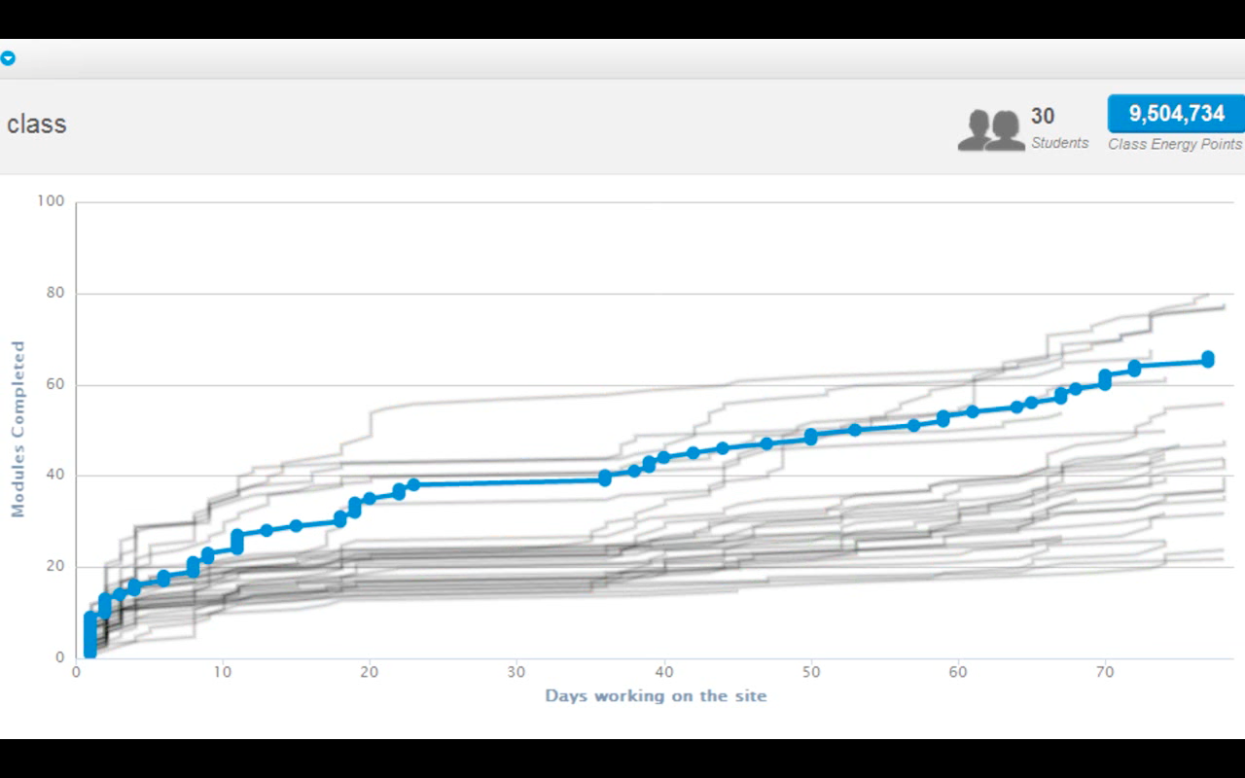
Online learning inherently modular
Image courtesy of Khan Academy

Slide 46
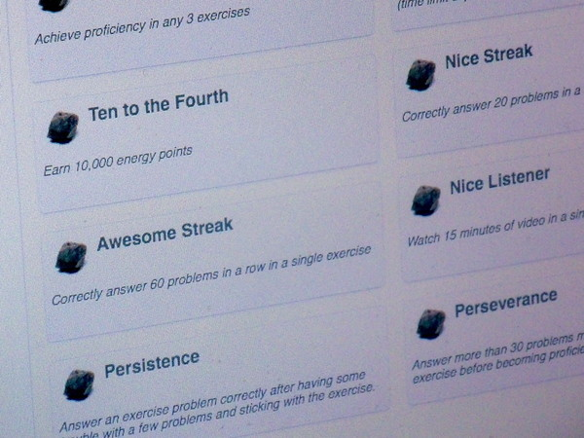
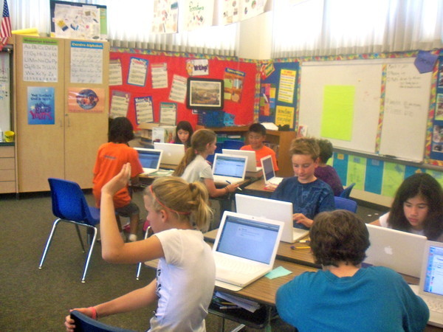
Khan Academy
NPR August 22, 2011: Khan Academy Pilot in Los Altos Schools
  Teacher Courtney Cadwell says she saw students become 'active learners' and the tool 'stretches us as educators.'

Slide 47
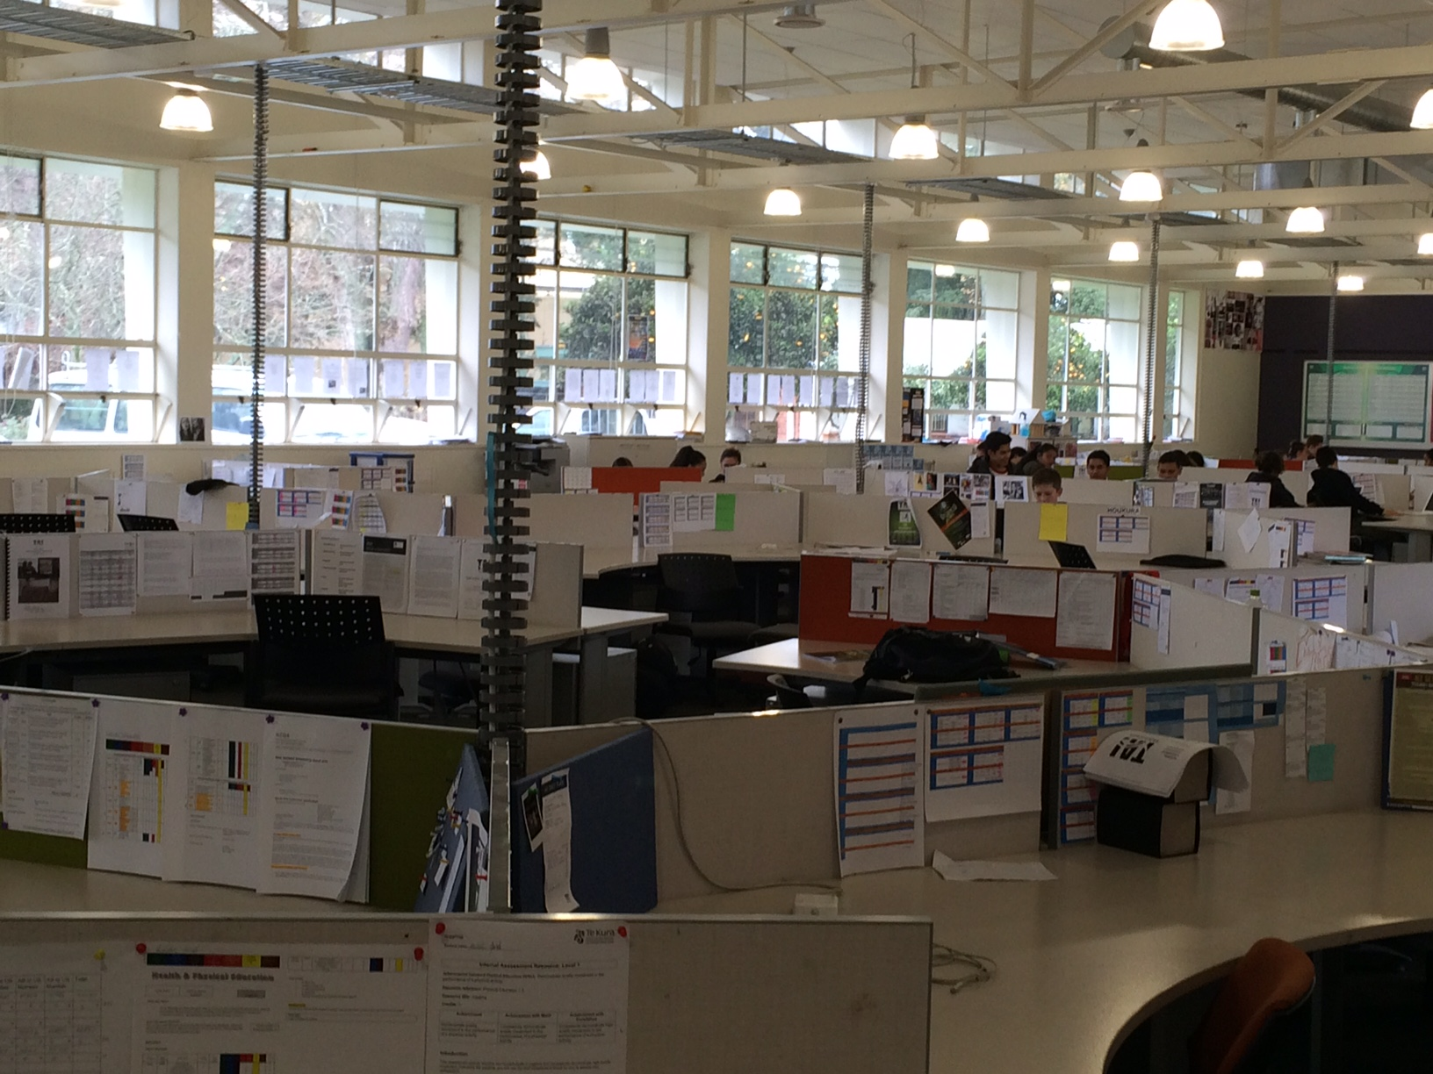

Slide 48
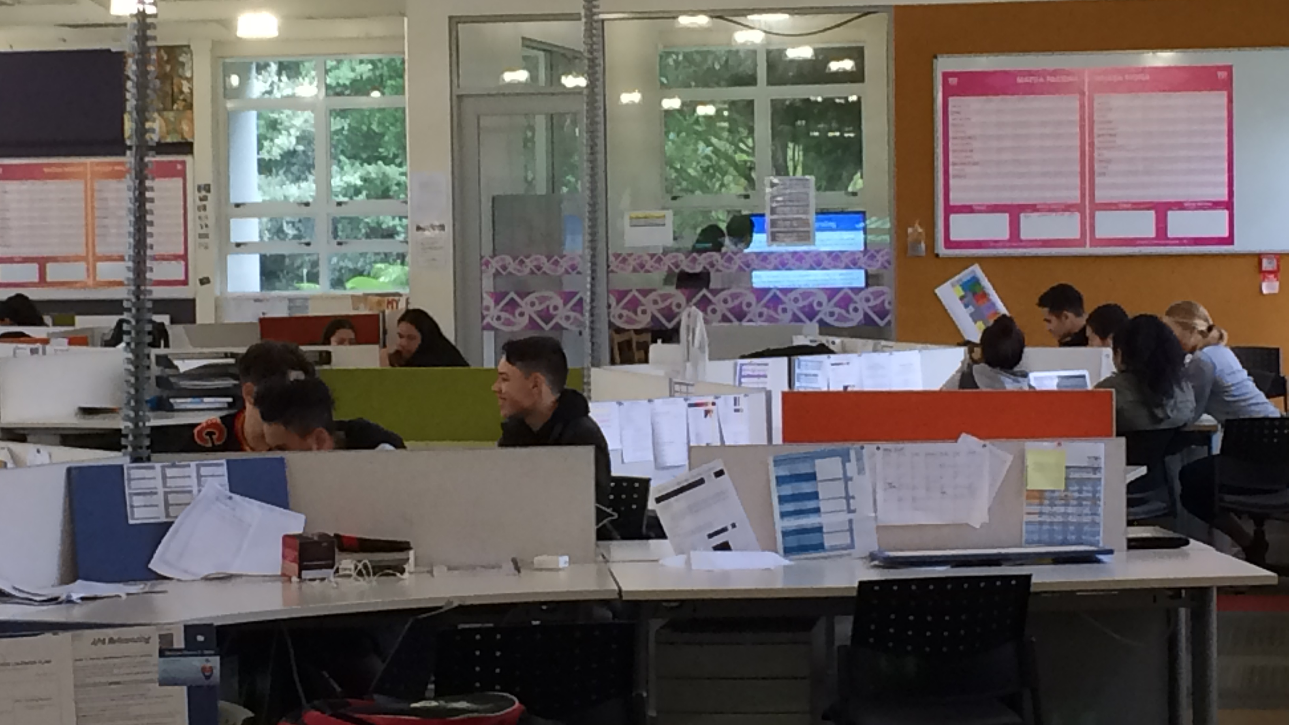

Slide 49
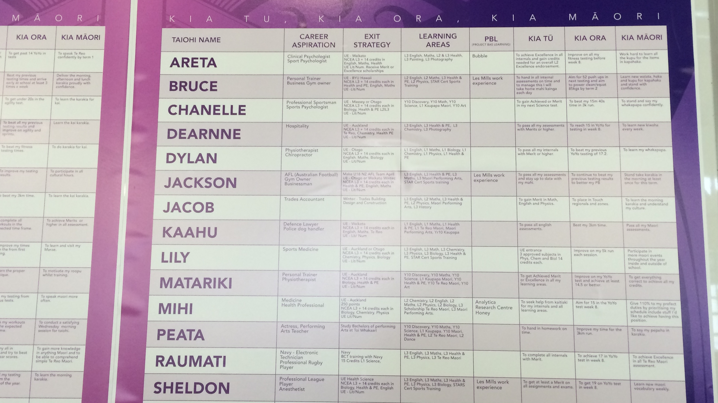

Slide 50
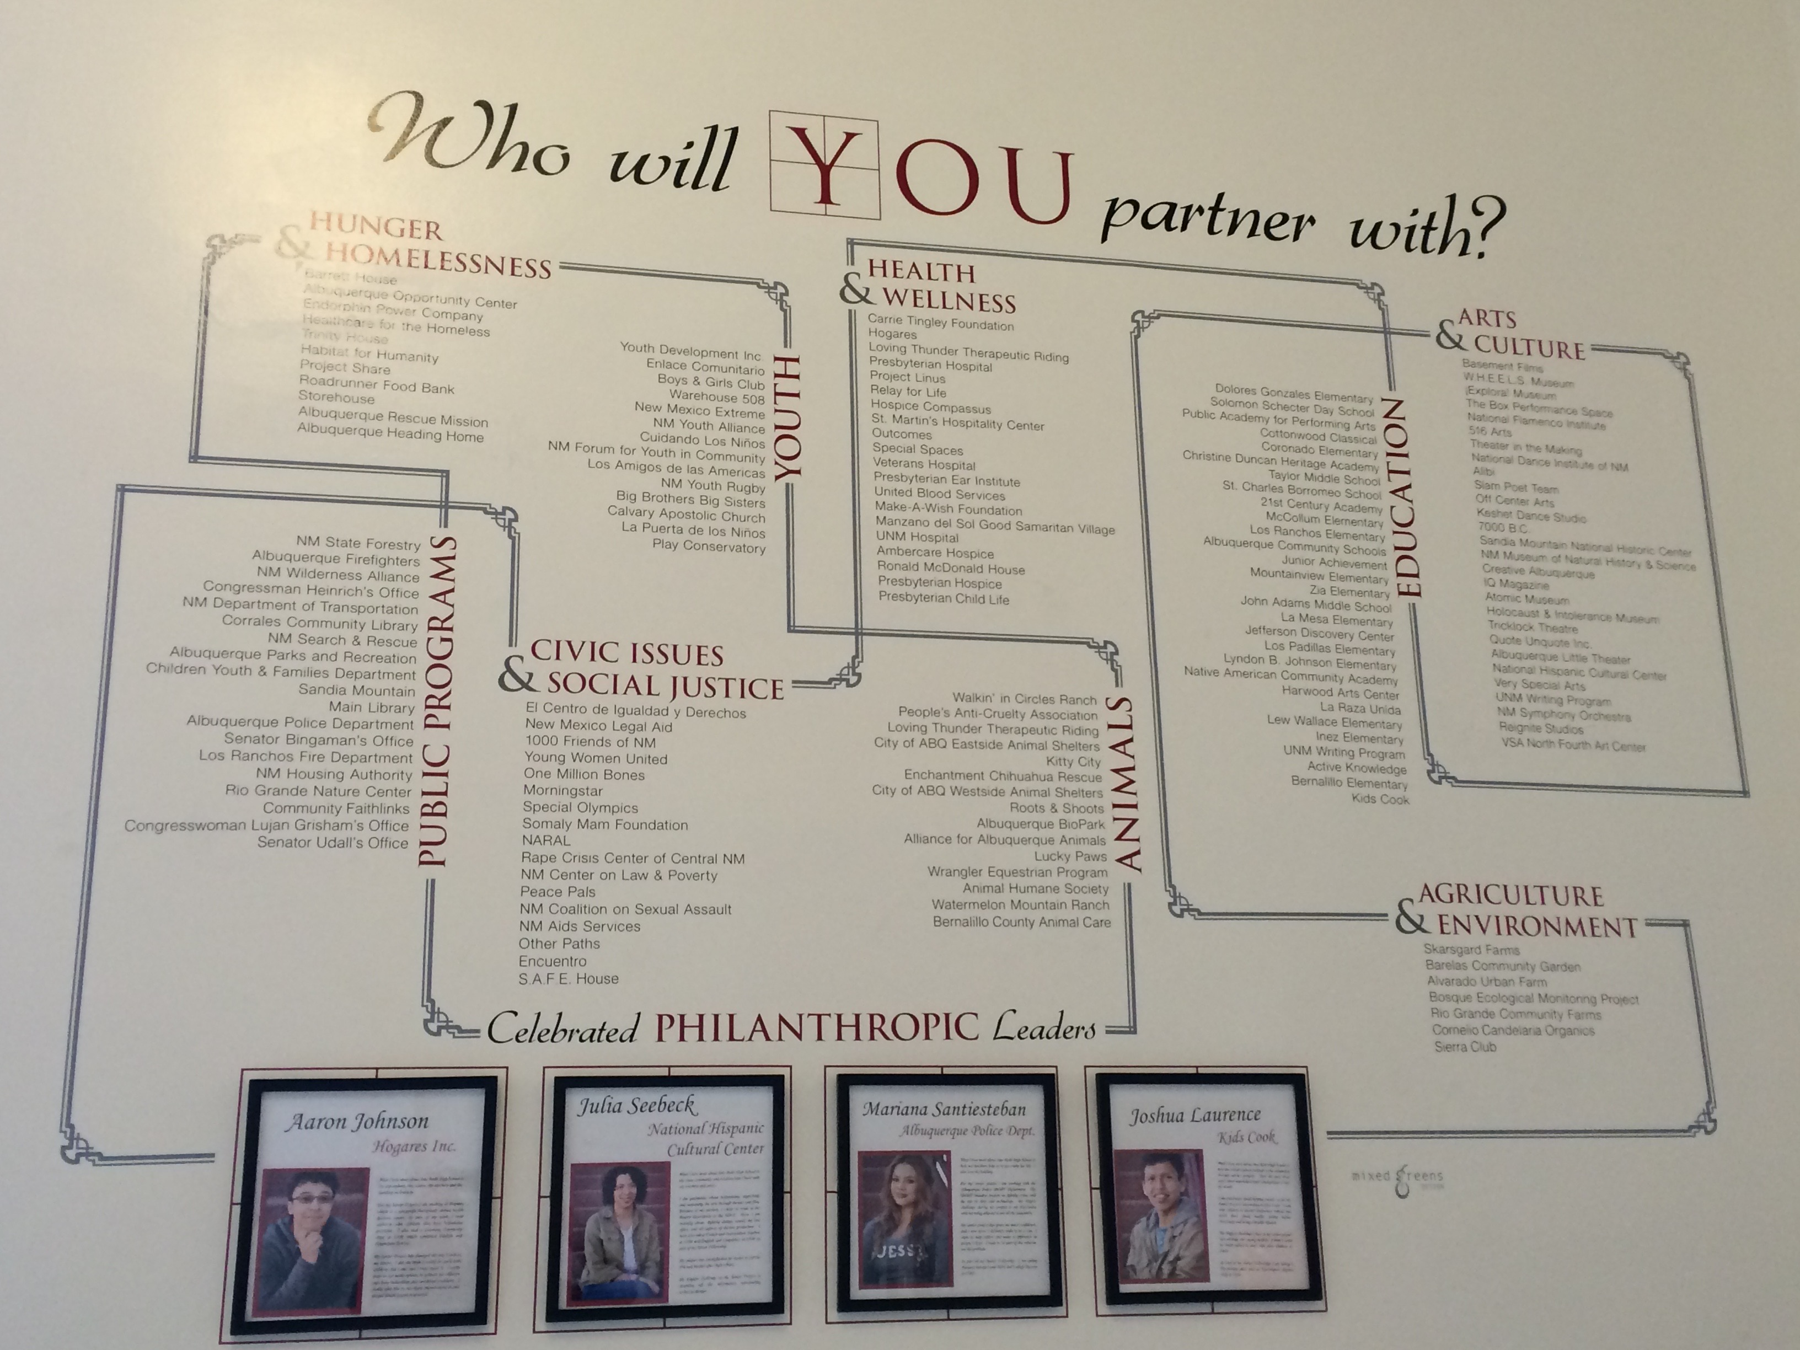

Slide 51
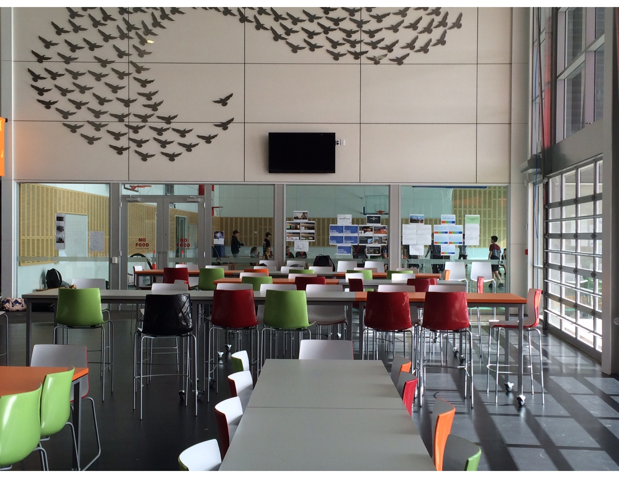

Slide 52
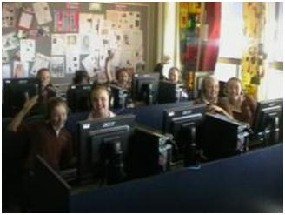
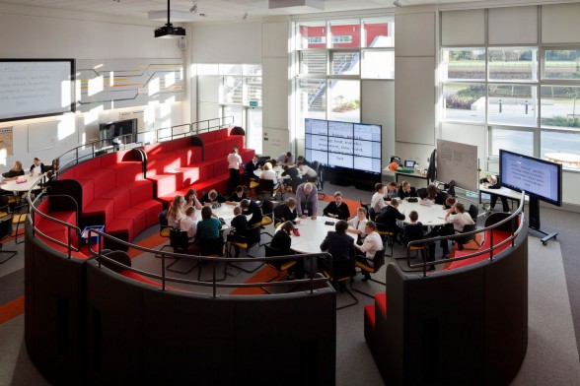
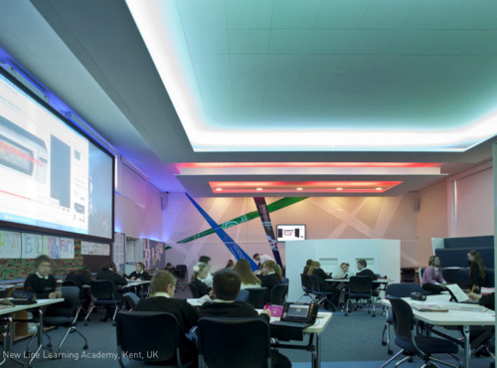


Slide 53
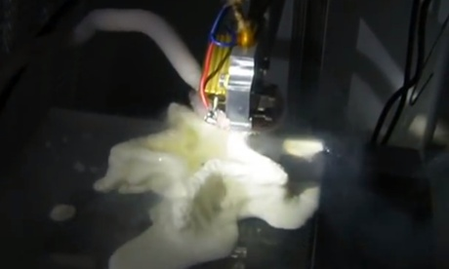
MIT students make 3D-printed ice cream

Slide 54
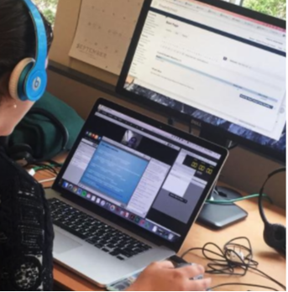

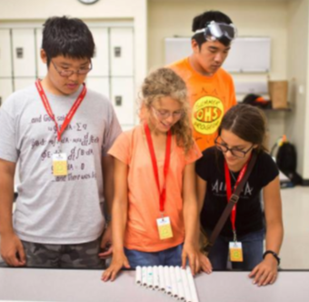
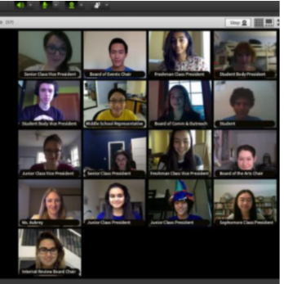

Slide 55
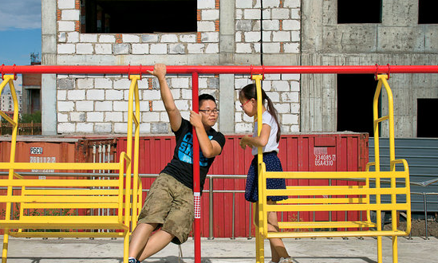
The Boy Genius of Ulan Bator
Notes:
"Battushig, then 15, became one of 340 students out of 150,000 to earn a perfect score in Circuits and Electronics, a sophomore-level class at M.I.T. and the first Massive Open Online Course, or MOOC — a college course filmed and broadcast free or nearly free to anyone with an Internet connection — offered by the university."
The principal of his high school "...had students watch the Circuits and Electronics MOOC lectures at home, but he wanted to supplement them with real-world labs."
The boy "said. “I had never done that kind of thing before. It was really a watershed moment for me.” To help his classmates, he made videos in Mongolian that offered pointers and explanations of difficult concepts and posted them on YouTube. "
"...In the past decade, Mongolia, which had limited landlines, invested heavily in its information technology infrastructure and now has an extensive 3G network. Most homes in Ulan Bator have Internet connections, and almost everyone, including nomads, has at least one cellphone. Even on the steppe, with only sheep in sight, you can get a signal.”

Slide 56

International Baccalaureate Diploma Program Online

Slide 57
Next Generation M-Learning Models
Students and teachers – from secondary to postsecondary –access high-quality, relevant and engaging content in multiple modalities.
Class time and structure will become more flexible, based on the learning needs of the students.
Students will access multiple sources of instruction as needed and use assessments and diagnostics to gain more control over the pace and format of their own learning.
Teachers, more important than ever, will spend their time in different ways, tailoring their help to ensure acceleration and mastery for all students.

Slide 58
M-Learning
Studies on 1:1 are now indicating that a device in the hands of each learner increases student engagement with learning and ‘promotes a shift in teaching practice to more collaborative, small-group work that is student centred and problem based, demanding more higher-order thinking’ (Metiri Group, 2007).

Slide 59

GPS
Time to Destination
Notes:
Today, with a GPS, it is almost impossible to get lost. The GPS knows multiple pathways to your destination. You have access to information on the routes, speed of travel, the time to destination, and places of interest along the way to explore.
Imagine if today’s learning environments were re-imagined to work more akin to the experience of using a GPS when you are driving.
Just as a car’s GPS system provides an immediate alert when a wrong turn is made or the driver gets stopped in a traffic jam, a learning system can provide immediate feedback to keep a student aware of the pacing and progress toward their learning goals — and advise them when they need help.
Effective blended learning environments provide this GPS for students, allowing them to navigate with flexibility along individual pathways for truly personalized learning.
A next generation education system would offer each student their own gPS-like dashboard for learning so that each student would know if they were on track toward their destination — graduation, college and career-readiness — every moment of every day and every point along the way.
You’d no longer have to wait until the end of a grading period or school year to take a summative assessment for accountability to show whether you are on or off-track. With a GPS, the moment a student makes a wrong turn, the system would help let the student know to turn around, to seek help and exactly where to find resources to get back on their route toward success and graduation.
Blended learning offers a vehicle for optimizing the instructional design toward personalization through transparent data dashboards and enhancing a student’s choice of path. This flexibility allows students to access multiple resources and a variety of content (with reviews and recommendations), but provides a clear profile of how far they have traveled along their pathway and the work still needed to continue along the pathway if they are to achieve success.
Not every student’s learning happens along a straight line. Side trips — peaked by interests that contribute to the broader acquisition of an individual’s knowledge and skills — can bring joy to the journey.
The blended learning journey is supported by people harnessing advanced, adaptive technologies that provide immediate feedback on time to destination, re-routing or help in order to get back on track, and opportunities to dive into areas of unique interests for deeper learning along the way. The journey is not necessarily linear, and a student is able take multiple pathways to achieve their learning goals and explore based on individual interests — all while co- piloting with educators and receiving regular feedback on progress so they don’t get lost.
A GPS for learning is an apt analogy to demonstrate how blended and online learning environments can be a vehicle for personalized learning through use of a customized dashboard display showing real-time information and offering tools to support optimized pathways along a personalized learning journey toward graduation and student success.

Slide 60
“Adaptive”: to What End?
Adaptive
  1) Leveling
  2) Real-time scaffold (RtS)/in-course correction: Provide adaptations in the moment
  3) Minimizing effort or number of problems worked; honing
  4) Limitless pathway - next sequential piece on the pathway/progression
  5) Recommendation engines - system recommends content objects based on student performance

Slide 61

What looks different in personalized, blended learning environment?
Describe some changes you see.
Notes:
Allison

Slide 62
Design Choices: Context
Why Are You Doing This?
  Who are your students and what are their lives & educational experiences like?
  What are the goals for your students?
  What are your values and vision for your school?
What Are the 3-5 Guiding Design Principles?
  Increased access to world class learning opportunities
  Co-design with students
  Deeper learning
  Relationships
  Ensure proficiency
Have a Good Sense of..
  Your educational philosophy, research on child/youth development and learning sciences
  How are you going to personalize your school and what capacities you will need?
  How are you going to use technology and why?
  What do you see as the key roles of educators?
  What are you going to do when students don’t reach proficiency?

Slide 63

Notes:
Susan – example of engaging session
Modeling blended learning
Group work/Collaboration

Slide 64
iNACOL Resources
RETHINK: Planning and Designing for K-12 Next Generation Learning
iNACOL Blended Learning Roadmap
Maximizing Competency Education & Blended Learning: Insights from Experts
iNACOL Promising Practices for Blended Learning
iNACOL Promising Practices for Online Credit Recovery
Blended Teaching Competencies
Implementing Competency Education: Lessons from Practitioners
Mean What You Say: Defining and Integrating Personalized, Blended and Competency Education
Blended by Michael Horn book and webinar
. . . And many more!
www.inacol.org
www.competencyworks.org

Slide 65

RETHINK: Planning and Designing for K-12 Next Generation Learning
(iNACOL, NGLC)

Slide 66








Slide 67

David Hood
“The Paradigm of One: one teacher, teaching one subject, to one class of one age, using one curriculum at one pace, in one classroom for one hour.”

Slide 68
Stephen Heppel (U.K.) notschool.net Quotes
“Students should advance on stage not age”
“Age and time are for adult convenience”.
“There’s no limit on how fast and how far students can go.”

Slide 69


Slide 71
Discussion: Q&A

Slide 72
Susan Patrick
spatrick@inacol.org
www.inacol.org

Slide 73


Slide 74
How can we ensure every student can access a world-class education?

Slide 75

India announces $35 tablet computer for rural poor
“Oct. 5, 2011 -
The $35 basic touch screen tablet aimed at students can be used for functions like word processing, web browsing and video conferencing. Aakash, manufactured by DataWind, has a 7" Android 2.2 touch screen and a HD video coprocessor.
The Indian government intends to deliver 10 million tablets to students across India.” (AP Photo - Gurinder Osan) (Source: Associated Press)
“Datawind says it can make about 100,000 units a month at the moment, not nearly enough to meet India's hope of getting its 220 million children online.”

Slide 76

Hong Kong
  In 2010, Hong Kong policy recommendation for digital learning that “de-bundled” textbooks and teaching materials to make more affordable and accessible to schools, and accelerated the development of an online repository of curriculum-based learning and teaching resources.
  Blended learning for Continuity of Learning

Slide 77


South Korea
South Korea
South Korea has 100 percent of schools connected to the Internet, 100 percent of teachers trained in digital learning and is moving toward all digital textbooks by 2015
  Conversion to digital content from textbooks

Slide 78

The Futurist: Education 2011
Global competitiveness driven by education
China may be the first country to succeed in educating most of its population through the Internet.
  From 2003-2007, China spent about $1 billion to implement online learning projects in the rural country-side.

Slide 79
China
“China is investing heavily in integrating technology into its K-12 sector which brings pressure on the rest of the world to keep pace. It has out paced the U.S. in the use of instructional technology.”

Slide 80
A 5-Part Definition:
Competency-based Education
Students advance upon demonstrated mastery.
Competencies include explicit, measurable, transferable learning objectives that empower students.
Assessment is meaningful and a positive learning experience for students.
Students receive timely, differentiated support based on their individual learning needs.
Learning outcomes emphasize competencies that include application and creation of knowledge, along with the development of important skills and dispositions.
    - Patrick & Sturgis (2011) from National Competency-based Education Summit co-hosted by CCSSO and iNACOL
Notes:
One of the biggest “aha’s” we had in this project is when we realized that competency-based pathways was not simply about breaking the link with the Carnegie unit. It was about replacing our time-based system with a learning based system. This definition should be considered as a basis for discussion. Ovetime we will want to hone this so that it can help to define what a high quality competency-based system might look like and what we need to bulid into policy and operations to ensure that failure is
indeed not an option.
Let’s take these three elements one by one:
Students advance upon mastery has several elements to it: first students will advance based upon performance not age; they will work at levels that are appropriately challenging, are evaluated on performance rather than inputs like attendance and assignments, and they may be doing performing at different levels in different subjects. So you can imagine a 14 year old student doing AP history, but 7th grade science.
The second element focuses on making learning explicit to the students. First of all the unit of learning becomes more modular. A course may contain many learning objectives that students will continue to work on until they demonstrate proficiency. Second, the learning objectives are made absolutely explicit to students and the ways in which they can demonstrate proficiency. This immediately changes the relationship between student and teachers, with students more responsible for their learning. Finally, if students “own” their own learning, they can also apply themselves beyond the classroom.
The third element is a very powerful element. It became clear in our interviews that in competency-based approaches, the traditional understanding of assessment is flipped on its head --- the primary focus is on assessment for learning rather than of learning. This means that schools emphasize formative evaluation, there has to be a deep shared understanding among teachers of what proficiency looks like, that students are expected to demonstrate proficiency multiple times and in multiple ways so that everyone is confident that as they progress to the next level they can fully apply the knowledge. Finally, grades begin to have a different meaning (and sometime different system). A grade of A suggests advanced level or mastery, B suggests proficiency and able to progress, C’s and D’s suggest that students are still working towards proficiency and need to keep working before they can progress.

Slide 81

NZ Curriculum Redesign (2007)

Slide 82


Slide 83

OECD Report: The Nature of Learning
Using Research to Inspire Practice
The 7 principles identified are:
  Learners at the centre
  Recognising individual differences
  Stretching all students
  Assessment for learning
  Building horizontal connections
  The social nature of learning
  Emotions are integral to learning
Notes:
https://www.oecd.org/edu/ceri/50300814.pdf

Slide 84

John A. Powell
“Our future will be impacted by the way the conscious and unconscious make meaning of our new social constructions.”

Slide 85

In 1947 – the mid-point of the 20th Century – Harry S. Truman warned in a report of his Commission on Higher Education, “If the ladder of educational opportunity rises high at the doors of some youth and scarcely rises at the doors of others, while at the same time formal education is made a prerequisite to occupational and social advancement, then education may become the means, not of eliminating race and class distinctions, but of deepening and solidifying them.”
-Harry S. Truman (1947)
Notes:
Harry S. Truman: “Statement by the President Making Public a Report of the Commission on Higher Education” December 15, 1947.

Slide 86


Slide 88


Every Student Succeeds Act
December 10, 2015

