Slide 1
2017-19 Legislative Session Update WCRIS Executive Director Sharon Schmeling
Notes:
Thank you for coming. We hope you are enjoying the conference and finding solutions to issues and problems that make your lives difficult.
WCRIS number 1 job is to identify issues and challenges that prevent our schools and staff from being effective at educating our state’s children and then crafting and implementing solutions that work.
Unfortunately, many of those barriers come from government and its agencies doing things they think will help, but only make our lives more complicated.
By partnering with you, we can work together to stop bad ideas and support good ones.

Slide 2
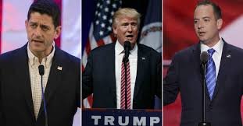
The National Picture
1988
WI, MI, PA.
Power troika
Pres. Trump’s campaign promises
Notes:
That begs the question: What’s the National Picture for private schools?
First time WI has voted for a Dem for Pres
Three states that delivered votes that made Trump win. That will be rewarded
Wi has out-size influence because of Speaker Ryan and Reince Preibus from Kenosha.
Pres Trump said less about education on the campaign trail than any major party nominee in recent history, except for his high profile proposal on school vouchers

Slide 3
Important Allies in D.C.
35 states
WI in top 10
Leader in choice, busing, tax deduction and services to members
Leader in unity
Accomplishments
Notes:
35 states and territories are in CAPE
Wisconsin is in top 10 of private school enrollment. Enrollment overall is up slightly in private schools nationwide.
WCRIS is a leader in gaining legislative support for busing, choice, tax deduction, services to members like group buying prices on criminal background checks; reduced QEI professional development membership; this annual professional development conference and an emerging one for teachers.
More major private school groups are in WCRIS than other states. Thanks to the leadership of our Board, listed on last page of program.
CAPE’s leadership and lobb

Slide 4
New Education Secretary
Historic vote
$1 per year
150 political appointees
Less not more
Transgender bathrooms
Eliminate DOE?
Expand choice?
Support charters
Notes:
First time in history VP had to vote to break tie for a cabinet secretary appointment
Billionaire. So she doesn’t need any of the after-office favors of previous secretaries. Makes her much freer to do things.
AFC colleagues predict her leadership will be noted by giving more power to states, fewer federal interpretations & rules.
Dear Colleague letter on transgender bathrooms may remain in place so the lawsuit by several states can go to the US Supreme Ct for review and a long-term decision. Repealing the letter will be a short-term solution, allowing the issue to be revisited in the years to come.
37-year old agency, $70 billion budget and 4,000 career employees
Trumps first budget proposal, to cover 2018, will likely come out late winter early spring and will give indication whether he will scrap it or just cut it.
Promised in confirmation process to not mandate choice in states.
Congress will have to act on choice expansion; could expand DC voucher program. Could seek to expand choice via tax code with tax credit scholarship program. Already exist in 17 states. Using ESSA funds was not upheld in committee and the votes still are not there.
Expand charters through federal start-up grants for new charter schools.

Slide 5
New ESSA
New formulas mean more money for private schools for Title I
Confusion triggered by Congressional Review Act
Not sandbagging
Ombudsman
New Deadlines: SEA has 45 days; DOE has 90.
Notes:
1. Public districts will no longer be able to take money off the top of their Title I allocation and then calculate percentage for private school children. Calculation now done based on all money. So the pie is bigger
2. Congress has moved to overturn Obama Administration regs on accountability, which will disrupt state planning because those plans are all based on those rules
3. Patience will be required as the DPI tries to figure this all out. They are not sandbagging.
4. ESSA mandates every state to have an Ombudsman to ensure that private school students get access to Federal programs they are entitled to.
5. ESSA requires SEAs to investigate complaints within 45 days and DOE has 90 days to investigate appeals of SEA rulings

Slide 6
New Ombudsman Position
“An official appointed to investigate individuals’ complaints against maladministration, especially that of public authorities.”
Logistics: where should it be located, who should be in charge?
Other states
Notes:
What is an Ombudsman
Most states are locating it in their equivalent of the DPI. Others are Department of Administration or Justice.

Slide 7
Ombudsman
Notes:
This is what WCRIS is working to prevent
Working with DPI on a public/private partnership
Modeled after ombudsman functions in health and human service programs with federal money and state agencies
Have support from both Governor Walker and Dr. Evers to contract with WCRIS to house the ombudsman
If we can get approval from DOA, and handle the legal hurdles, it will be unique in the nation
Schools will be able to call WCRIS to get help and will NEVER encounter the Tin Ombudsman!

Slide 8
Important Allies

Slide 9
A Coalition of Ed Reformers
We are not alone!
Support and Resources
Don’t always agree
Meet regularly
Agree to disagree
Notes:
-- their help has expanded vouchers to 313 schools:
-- MPCP: 127 schools
-- Racine: 23 schools
-- WPCP: 163 schools

Slide 10
103rd Legislature
Assembly: 64 to 35
Senate: 20 to 13
11 new Reps (7r & 4d)
4 new Senators (3r & 1d)
Pressure to fund roads and UW

Slide 11
DPI Superintendent Race
Nonpartisan
Primary: Feb. 21
General: April 4
Four Candidates:
Incumbent Tony Evers
Lowel Holz
John Humphries
Rick Melcher – official write-in

Slide 12
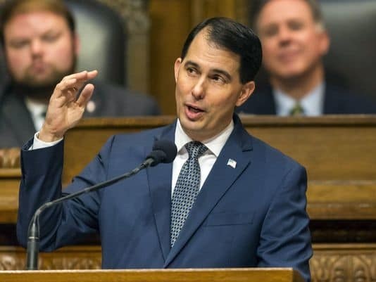
New State Budget
“We are investing more money into education than ever before in the history of Wisconsin…”
“In this budget, we used the reform dividend to invest more into public schools. We put more into rural schools with unique needs. We do more to improve schools in Milwaukee...We do more to help recruit and retain excellent teachers.”
“I want every student to succeed. And I trust parents to make the right decision for their children.”

Slide 13
Budget Details
Two-year
Nearly 2,000 pages long
$76.1 billion
Raises vouchers by $217 per pupil in each year of biennium
K-8 now $7,323
K-12 now $7,969
Notes:
Same increase as publics, according to a law passed two years ago.

Slide 14
Improving Relations with DPI
Helping draft Title I consultation form that private schools will sign off on
WCRIS Board met with Dr. Tony Evers Thursday
Forward Exam pricing
Career Cruising pricing
Success!
PDP Plan reviewers training

Slide 15
Budget Timeline
February – April 2017
Joint Finance Committee reviews
Holds hearings around state
Fiscal bureau develops analysis
April – May 2017
JFC holds exec sessions to amend/finalize budget
June: votes in both houses
July 1, 2017: New budget effective

Slide 16
WCRIS Legislative Action Center
Your involvement is needed!
We can make a difference
E-mails and phone calls can “blow the roof off…..”

Slide 17
Why We Do This: Protecting the Future
WCRIS: small but mighty
Leaven for the world
Living reminder: Education is soul craft
Religious & Independent Schools – Institutions help protect our democracy, Harvard Prof. Clayton Christiansen.

